Slide 1
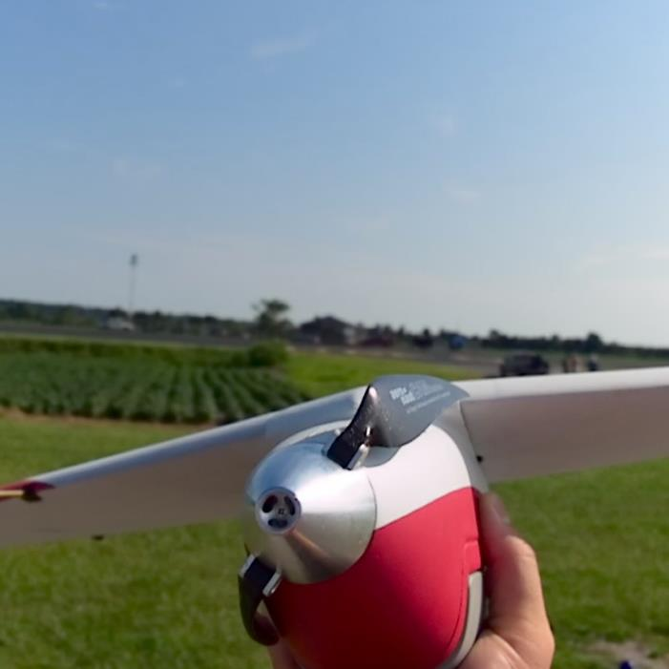
NC UAS Program Overview October 22, 2014 TFRSAC Reno, NV
Thomas Zajkowski,
Flight Operations Manager

Slide 2
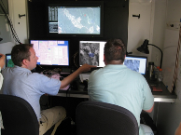
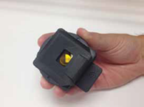
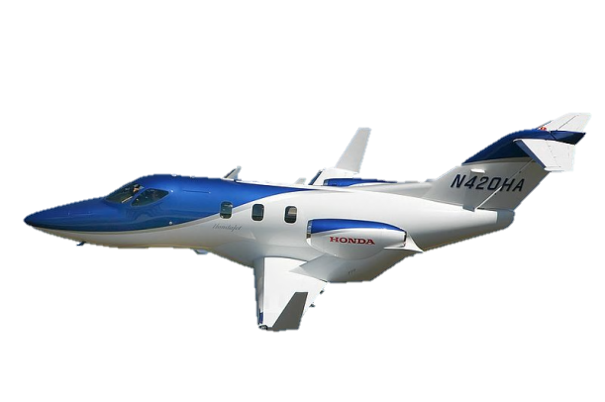
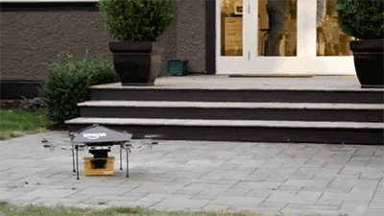
“NextGen”
Unmanned Aircraft Systems
Satellite Based Navigation and Surveillance
Digital Data Exchange
Automation Assisted Air Traffic Management
Probabilistic Weather Decision Tools
Equivalent Visual Operations
Prognostic Safety Systems
Reduced Aircraft Environmental Footprint
Pilot
Observer
Aircraft
Payload/sensor/camera(s)
Ground station/equipment
Communications
Not model aircraft
Part of “NextGen”

Slide 3
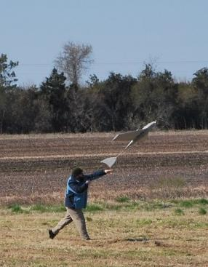
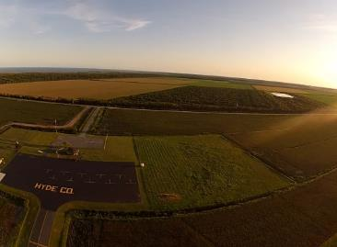
NGAT Program: Introduction
ITRE
ORIED
NCSU
Organizational Structure
Staff
NGAT Program Director- Kyle Snyder
NGAT Flight Operations Manager- Tom Zajkowski
NGAT Programs Manager- John Gorman
NGAT Program Support Specialist- coming soon
NGAT Airspace Consultant - Randy Breedlove
NGAT Postdoc- Fred Livingston
Students - 2 Graduate, 3 Undergraduate,1 High School
History: NextGen Air Transportation Program
Relaunched in May 2012 with UAS Program focus
2012: Build foundation
2013: Begin UAS flight operations
2014: Governance, Research, Integration
2015: Registration, Research, Partnerships
Mechanical and Aerospace Engineering Dept.
NGAT
NCDOT-Division of Aviation
State CIO

Slide 4
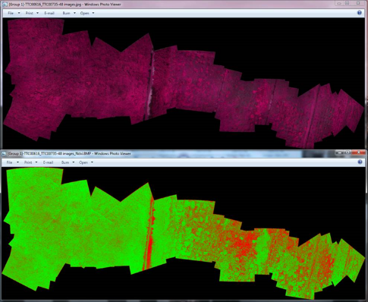
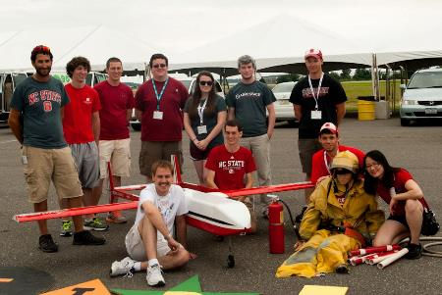
NGAT Center: UAS Research
Operational Safety
Policy (collaboration with SCIO and NCDOT)
Training
Applications
Agriculture- aerial imaging (crop health), aerial application
Small area surveys- mapping, 3D modeling, remote sensing
Wildlife/herd management
Public Safety- infrastructure inspections, emergency response
Cargo delivery
Scientific

Slide 5
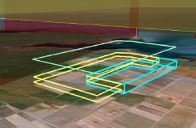
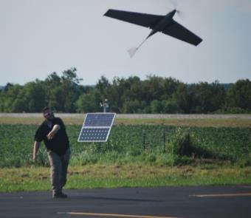
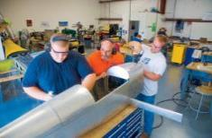
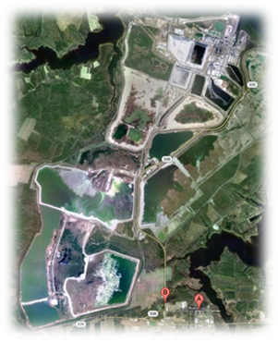
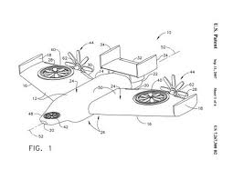
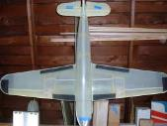
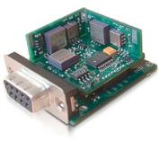
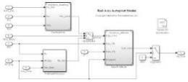
Building a UAS Ecosystem in NC
User Capability Requirements
Initial Design and Development
Testing
Training
Sustainment / Maintenance
Fielding
Production Design
Policies
Manufacturing

Slide 6
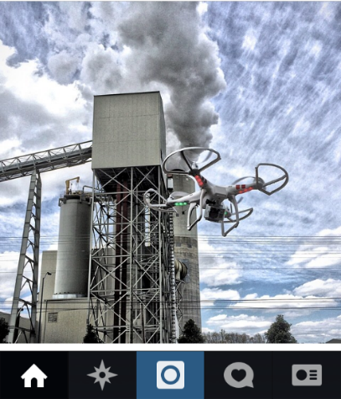
Current NC UAS Policy Activities
FAA is THE authority today
UAS operated by state agencies are “public aircraft”
Must have a COA (Certificate of Authorization) from FAA
Must meet NC requirements in addition to federal laws
Current UAS operations by state/local agencies require approval from State CIO
2014 NC UAS Legislation Highlights
No UAS may be launched from any State or private property without consent. Local governments may adopt similar rules.
Allows civil penalty of up to $5000.00 for unwarranted surveillance by UAS.
Requires NCDOT Division of Aviation to develop a knowledge and skills test for operating UAS not later than May 31, 2015. Test must comply with state and federal regulations. Working group has formed to address.
Division of Aviation is required to immediately begin developing a Commercial licensing system that complies with FAA guidelines (not yet developed). Within 60 days of issuance of authorization by FAA be able to implement commercial license requirements.
Notes:
Hobbyist are recreational pilots
Commercial operations are NOT allowed (even for practice).
State/local agency aircraft will only operate with COAs.
Pic: Marshall Coal Station, Catawba County (Lake Norman)

Slide 7
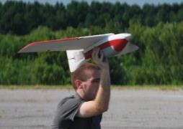
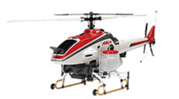
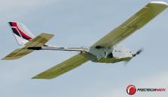
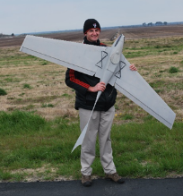
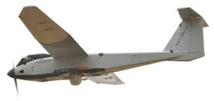
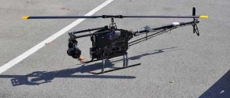
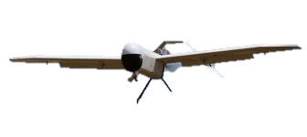
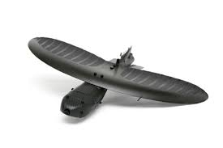
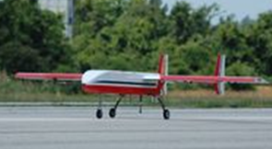
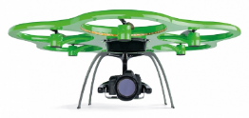
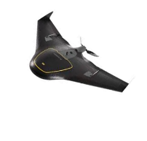
Current Fleet with COA Locations
Vireo (FourthWing Inc.)
[3 lbs, 2.5ft wingspan]
All locations
RMAX (Yamaha)
[194 lbs, 10ft rotor span]
GRTS
Lancaster (Precision Hawk)
[3 lbs, 4ft wingspan]
Butner
Lake Wheeler
Super Swiper (Digital Harvest)
[9 lbs, 6ft wingspan]
GRTS
T-20 (Arcturus)
[175 lbs, 20ft wingspan]
Caratoke
Condor II (Bosh Technologies / Lepton)
[10 lbs, 6ft rotor span]
GRTS
Protector 10 (Digital Harvest)
[36 lbs, 8.5ft wingspan]
GRTS
Maveric (Prioria Robotics)
[3 lbs, 3ft wingspan]
Butner
FENRIR (NCSU ARC Team)
[45 lbs, 10ft wingspan]
Butner
X6 (Aibotix)
[11 lbs, 3.4ft rotor span]
Butner*
UX5 (Trimble)
[5.5 lbs, 3.2ft wingspan]
Lake Wheeler*

Slide 8
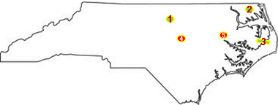
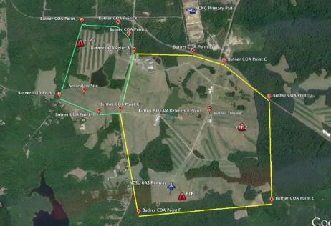
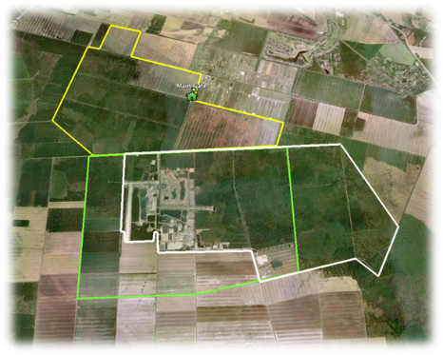
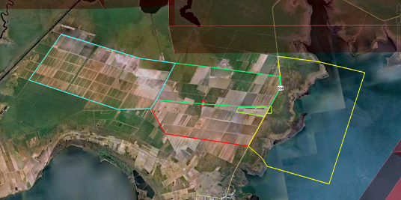
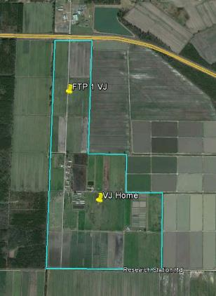
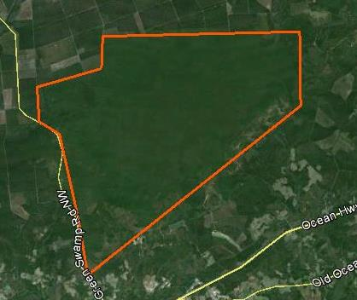
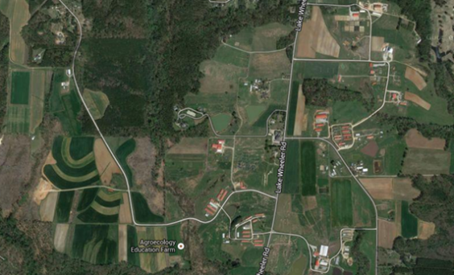
NC UAS COA Flight Locations
1- Butner 2- Caratoke (Moyock) 3- Gull Rock Test Site (Hyde County)
4- Lake Wheeler 5- Vernon James 6- Green Swamp

Slide 9
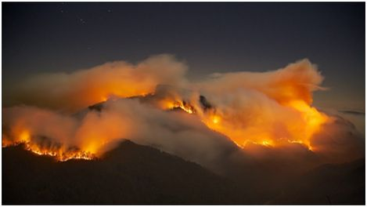
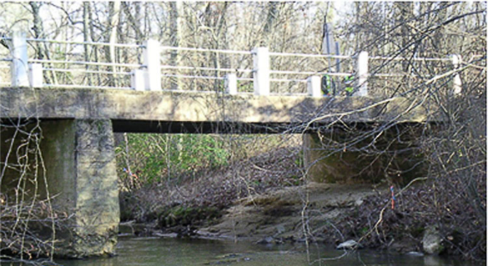
UAS Statewide Integration
Dept. of Transportation
Dept. of Environment and Natural Resources
Dept. of Agriculture
Dept. of Public Safety
State Bureau of Investigations, Highway Patrol
NC National Guard
Local
Law Enforcement
Emergency Response
Utilities
Universities
Commercial Industries

Slide 10
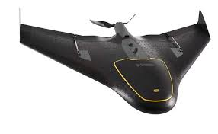
Path to a NC UAS Program
Obtain Support
Conduct Initial Research
Develop Integration Plan
Obtain Funding and Purchase
Obtain FAA Certificate of Authorization (CoA)
Start Flight Ops
Identify Requirements
Complete CIO/NCDOT Requirements
Manage Data
Report Operations

Slide 11
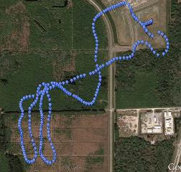
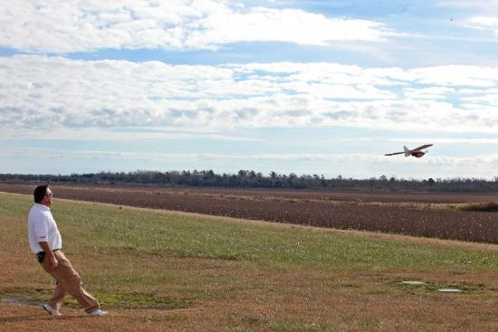
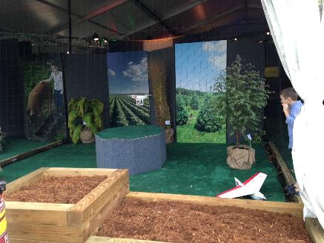
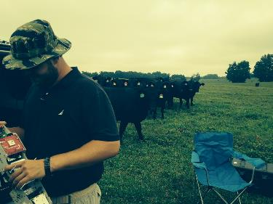
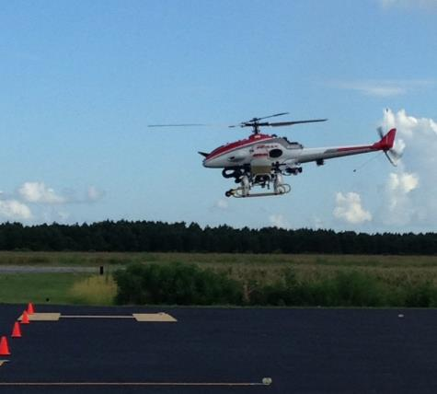
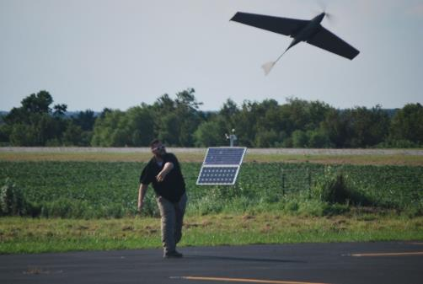
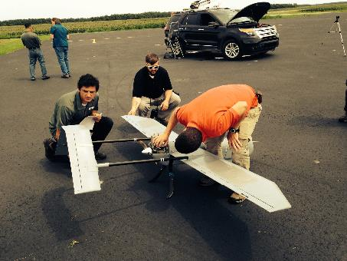
NGAT UAS In Action

Slide 12
Yamaha RMAX Operations Hyde County

Slide 13
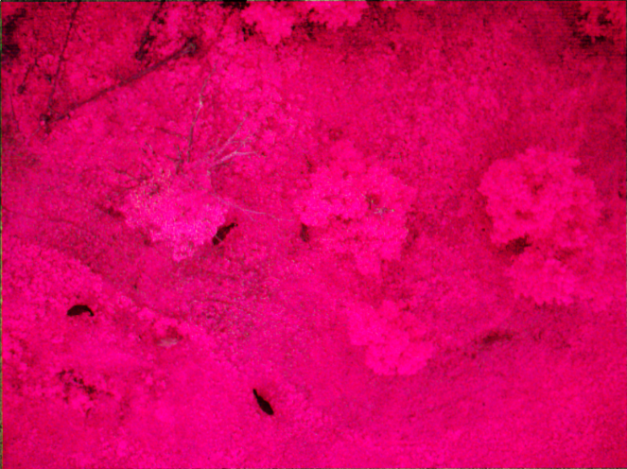
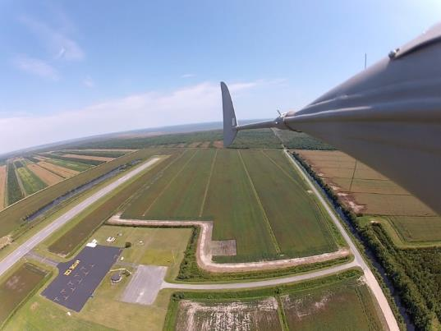
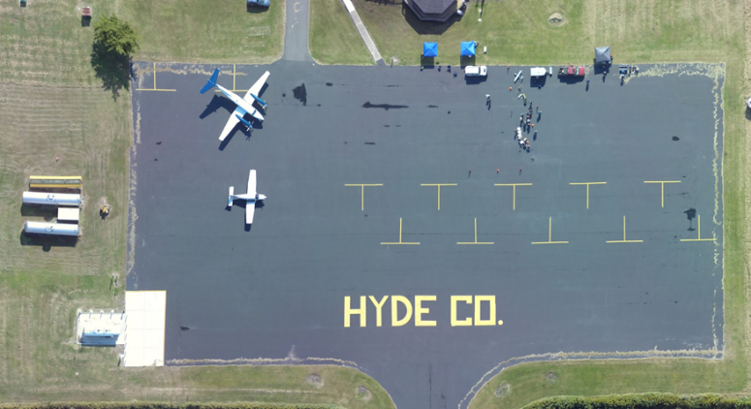
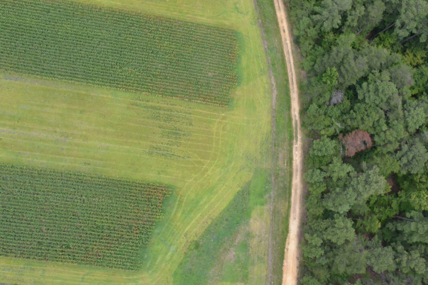
NGAT UAS Products

Slide 14
BGR to False Color Mosaic KML

Slide 15
UAS Inspection Tool Project: NCDOT

Slide 16
RxCADRE
Prescribed Fire Combustion and Atmospheric Dynamics Research (RxCADRE)
2 UAS Related Papers: Measurements datasets and preliminary result from the RxCADRE project. Special Issue, International Journal of Wildland Fire
Evaluation and use of remotely-piloted aircraft systems for operations and research—RxCADRE 2012
Ground, airborne, and satellite measurement of fire radiative power

Slide 17
RxCADRE G2R Thermal Infrared

Slide 18
RxCADRE Fire Progression

Slide 19
RxCADRE Fire Progression
S4
S5

Slide 20
RxCADRE Data
Oblique FLIR
UAS/ Oblique FLIR

Slide 24
ScanEagle Overview Imagery

Slide 25
Aeryon Scout Highly Instrumented Plot

Slide 26
For More Information
Contact:
Kyle Snyder
NGAT Program Director
919-515-8623 (office)
kyle_snyder@ncsu.edu
It is not really necessary to look too far into the future; we see enough already to be certain it will be magnificent. Only let us hurry and open the roads.
Wilbur Wright
“If you decide to try your machine here & come, I will take pleasure in doing all I can for your convenience & success & pleasure, & I assure you- you will find a hospitable people when you come among us.”
- William J. Tate, Kitty Hawk Postmaster 1900

