Slide 1
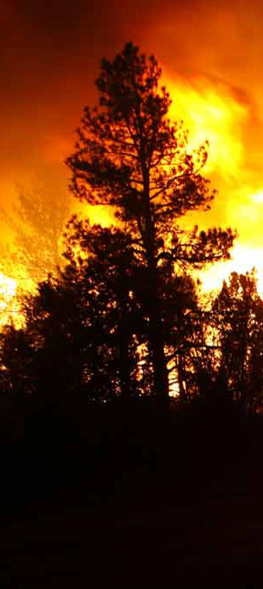
2011 NIROPS Close-out
October 26, 2011
NIFC, Boise, ID
Call in #: 877-936-2574
Passcode: 4079674

Slide 2
Welcome!
Call in #: 877-936-2574
Passcode: 4079674

Slide 3
Housekeeping
Turn cell phones off/vibrate
Rest rooms
Parking
Emergency exits

Slide 4
Agenda – Oct.26
Welcome and Introduction
Tom Mellin
NICC Summary
Kim Christensen

Slide 5
Agenda – Oct. 26
NIROPS Overview: 2011 Fire Season
GACC Reports
GACC IR Liaisons
Pilots’ Report
Dan Johnson
IR Technicians’ Report
Woody Smith/Kaz Kazimir/David Chamberlain

Slide 6
Agenda – Oct. 26
RSAC Report
Brad Quayle/Tom Zajkowski/Jan Johnson
The View From the Field
Paul Moore, SITL NR IMT1
Customs and Border Patrol UAV support for Fire Detection
Emily Keplar CBP/Lance Brady BLM
LUNCH ~11:30 to 13:00

Slide 7
Agenda – Oct. 26
NASA Activity Update
Vince Ambrosia
Wide Area Imager
John Green
Issues from NIROPS Family Meeting
Wrap-up
Tom Mellin

Slide 8
Agenda – Oct. 27
TFRSAC (Tactical Fire Remote Sensing Advisory Committee) Meeting
Same conf call #
Different WebEx
Start at 0830

Slide 9
Introductions

Slide 10
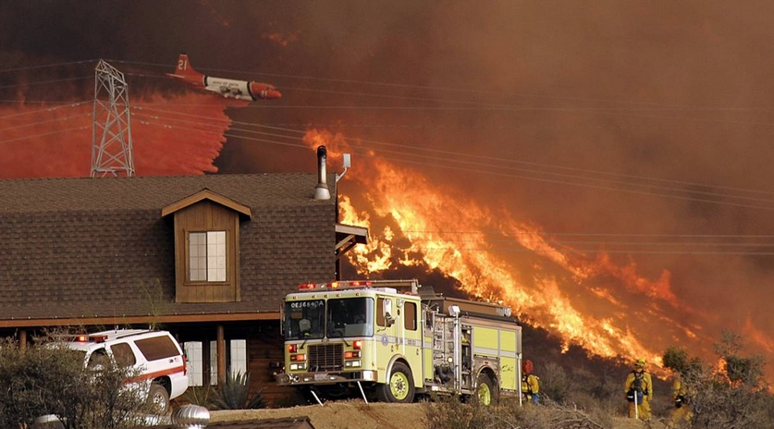
Questions?

