Slide 1
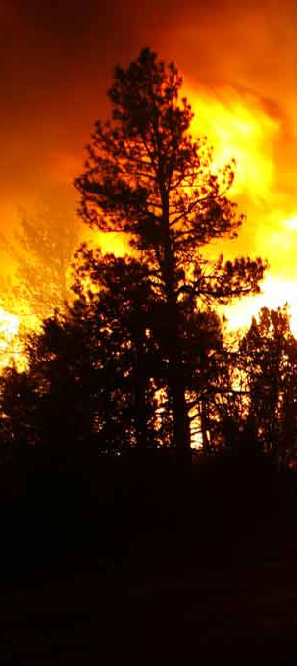
2014 NIROPS National Summary
Tom Mellin,
National Infrared Program Manager
October 23, 2014
TFRSAC, Reno, NV

Slide 2
2014 –
Relatively mild fire season overall
3.2 million acres burned, 48% of the ten year average
Very skewed geographically
Long season
1st mission Jan 18 on Colby Fire in CA
AMS missions on early season AZ fires -Brown Fire in April and Signal Fire in May
Last flight on Oct 13 (3 fires)
Notes:
As of 10/22 - 2014 ~3,168,930 acres, 10 year average is ~6.6 million acres, last year was ~4,146,336 acres

Slide 3
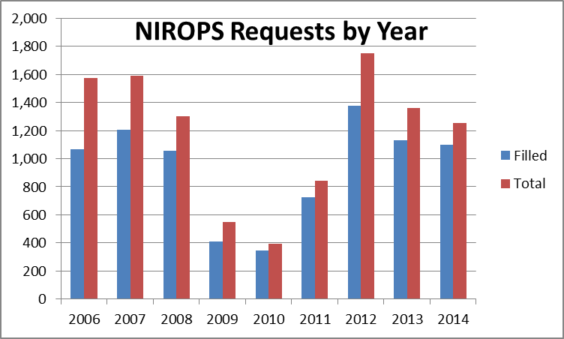
2014 NIROPS Requests
1,252 total requests
1,101 filled
Busiest night – Aug 13 flew 27 fires
12% UTF rate
Notes:
Numbers are current as of 10/6/14.
12% UTF is tied for lowest since tracking thru our website (2010 also had 12% but flew less than a third of the missions flown in 2014)
Fourth highest number of filled requests
Single night – 144Z flew 19 fires on Aug 8

Slide 4
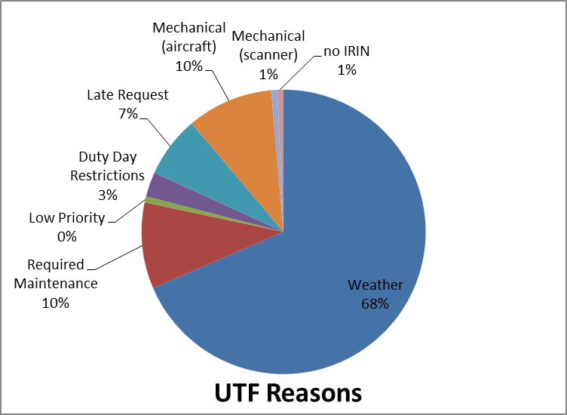
UTFs (Unable to Fill)
151 total UTFs (NIROPS only)
UTF rate drops from 12% to 4% when weather UTFs are not counted
Notes:
NIROPS only (143 UTFs)
UTF rate for AC3 was 25%
Weather – 98, req maint – 14, low prior – 1, duty day – 4, late – 10, aircraft – 14, scanner – 1, no IRIN - 1

Slide 5
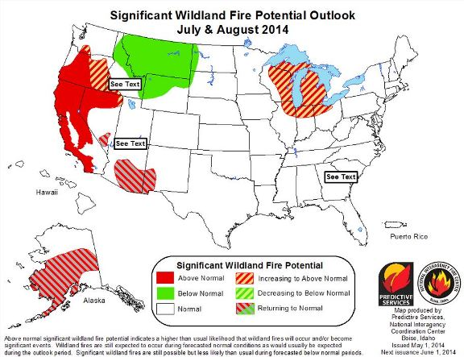
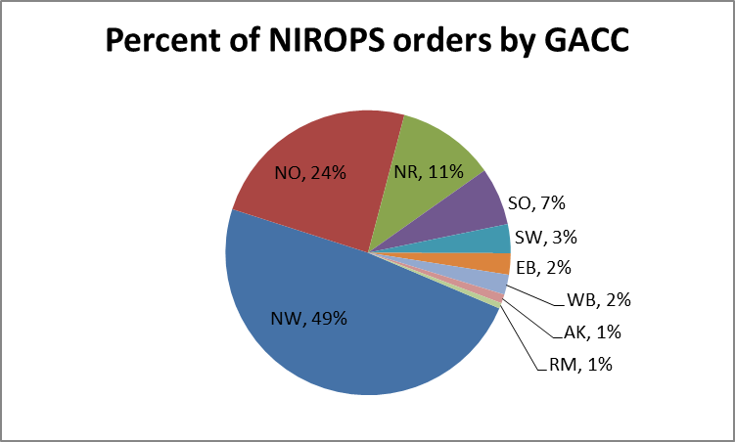
2014 – Orders by GACC
West Coast dominated the fire season
Notes:
75% of Northern Rockies orders were for Type 3 or smaller fires, lots of wilderness/backcountry

Slide 6
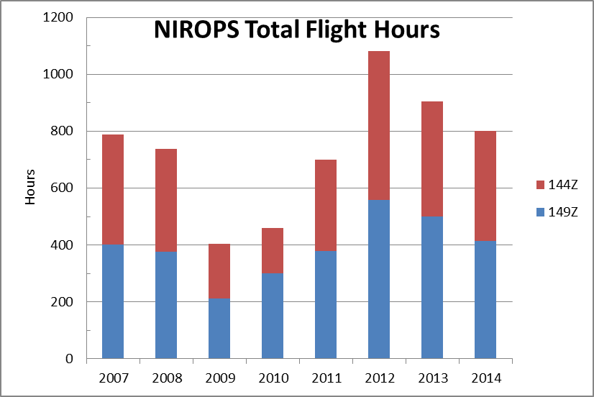
2014 NIROPS Flight Hours
800 hours flown (as of 10/6/14)
Notes:
3rd highest total in recent years

Slide 7
Extended Support to numerous incidents
KNF July Complex (CA) – 52 flights
Happy Camp Complex (CA) – 41 flights
Coffee Complex (CA) – 41 flights
Chiwaukum Complex (OR) – 40 flights
Carlton Complex (WA) – 31 flights
South Fork Complex (OR) – 31 flights
Deception Complex (OR) – 29 flights
790 Fire (OR) – 28 flights
Beaver Fire (CA) – 27 flights
Johnson Bar Fire (ID) – 27 flights
Notes:
All but one were west coast fires
Increased reliance on IR as more fires are managed with a combined strategy – suppression and monitor/confine
King Fire 24 flights

Slide 8
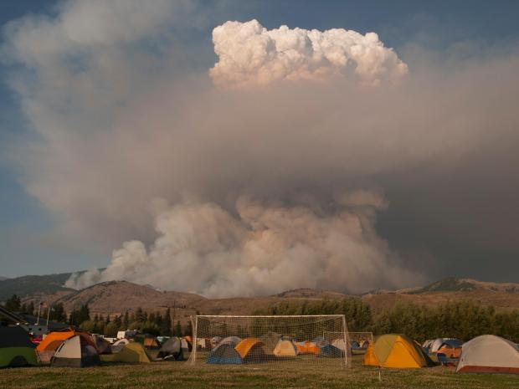
Carlton Complex - WA
Started July 14 by lightning
Grew by 127,000 acres on July 17
Ran thru town of Pateros, 300 homes lost
Final acreage of 256,108 – largest fire in Washington State history
$69M to fight

Slide 9
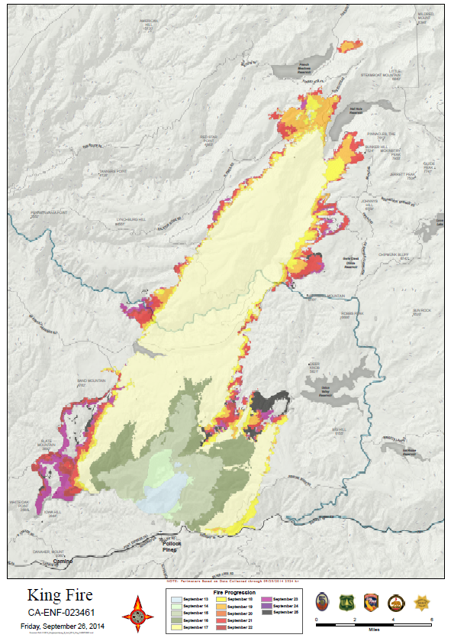
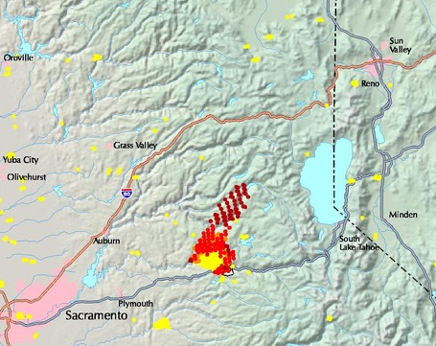
King Fire, Eldorado NF - CA
Started on Sept 13 by arson
On Sept 17 grew by 50,000+ acres making a 13 mile run to the northeast and nearly tripling in size, final size of 97,717 acres
80 structures damaged (incl. 12 residences)
$102.5M to fight

Slide 10
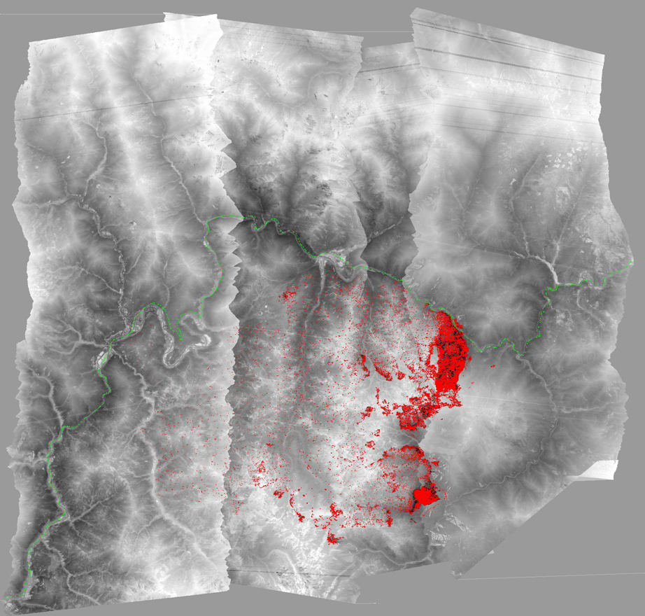
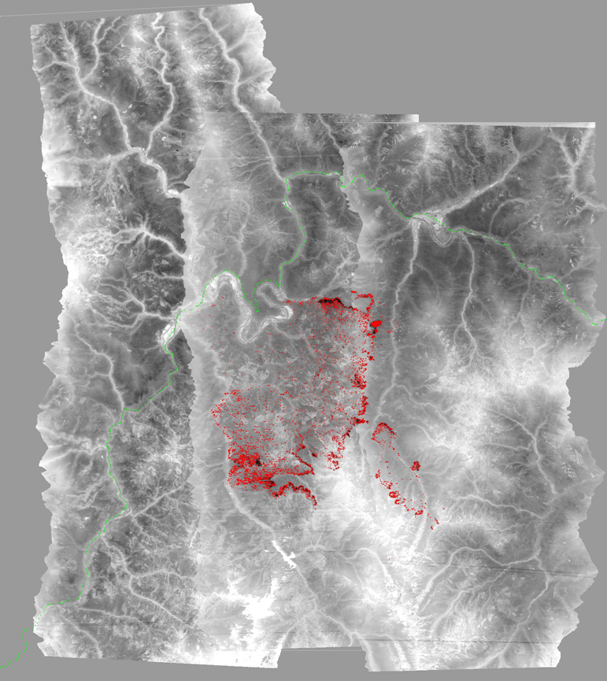
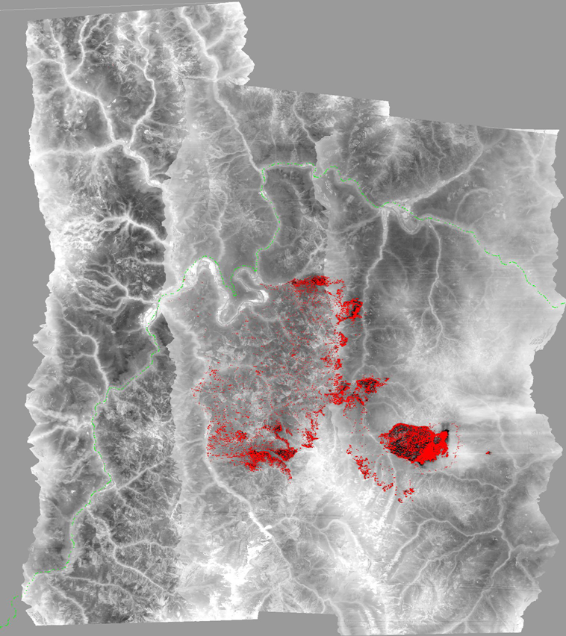
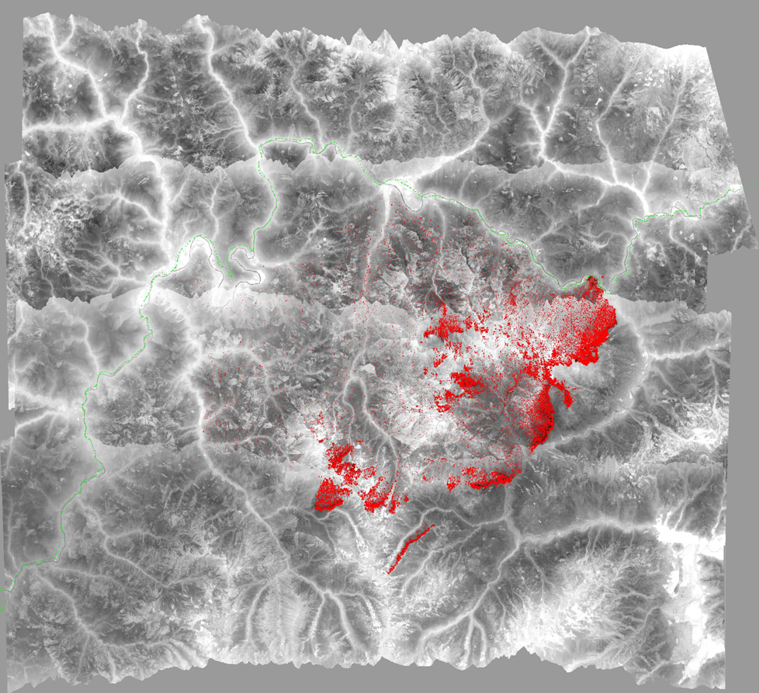
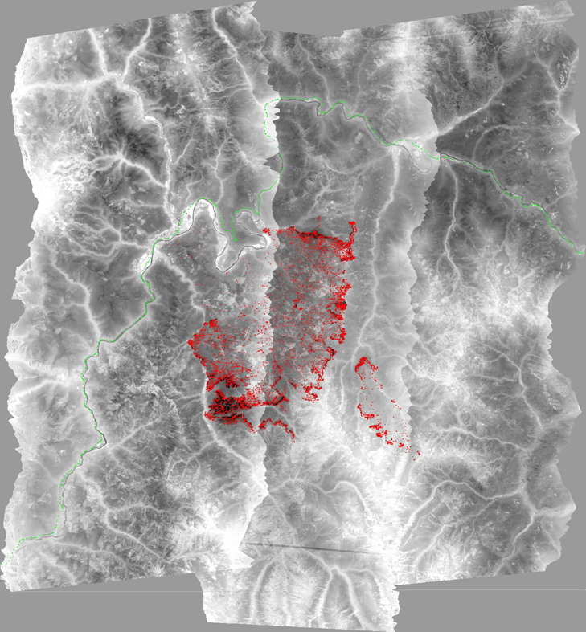
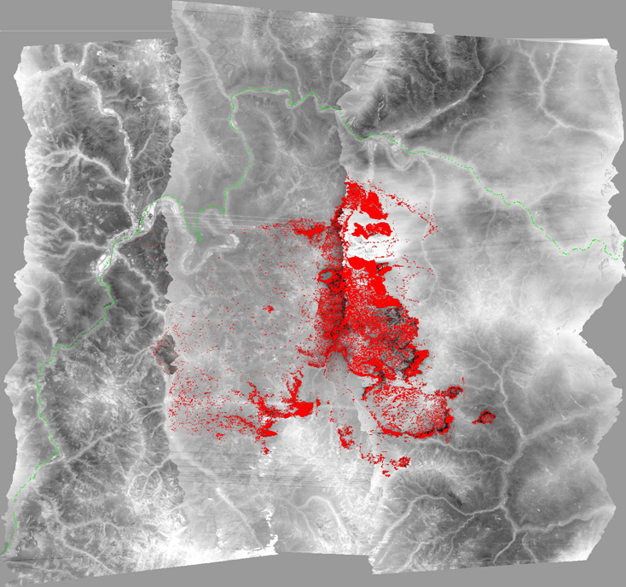
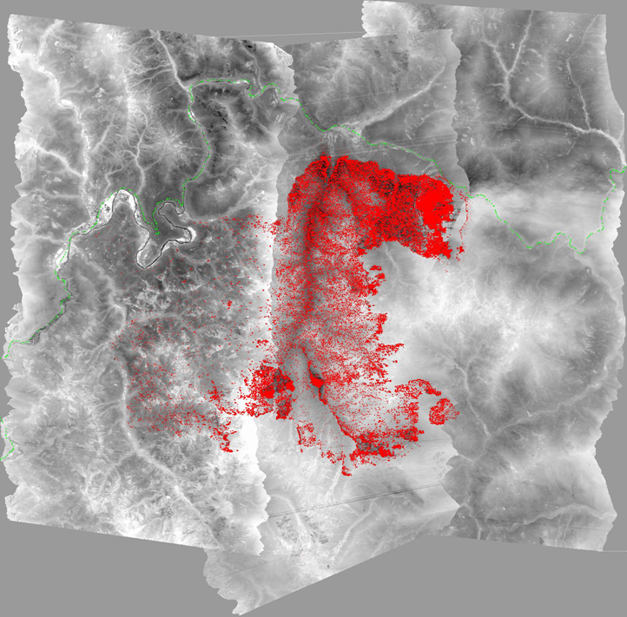
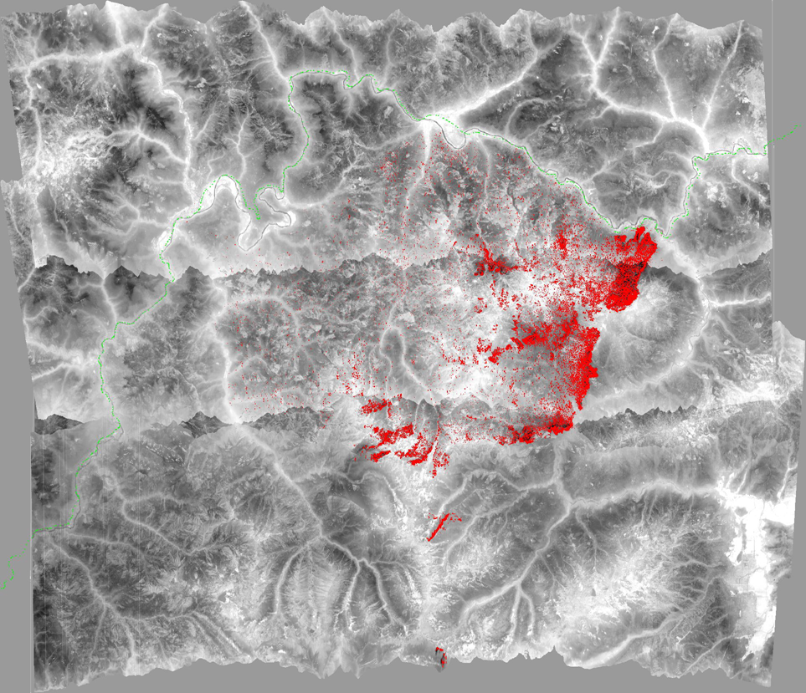
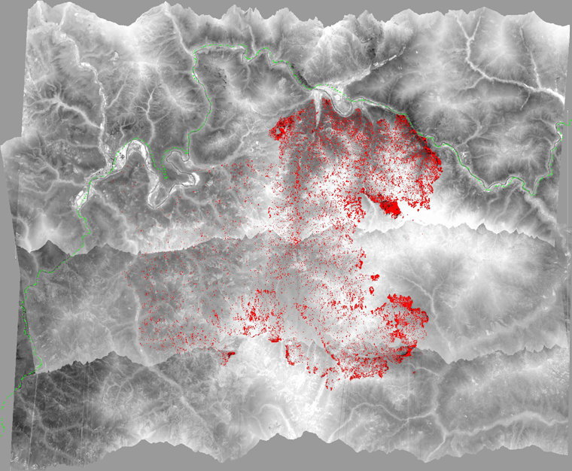
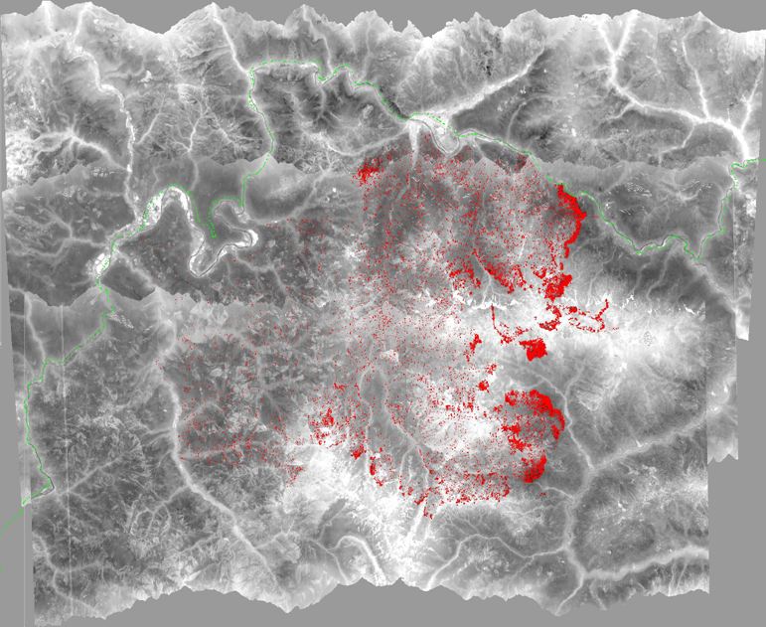
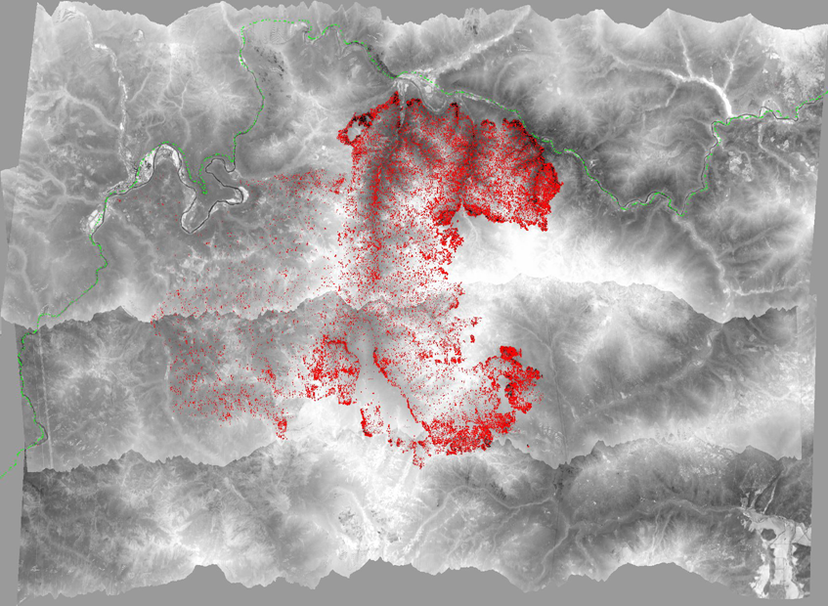
Happy Camp Complex
Started by lightning on Aug 12
Final acreage of 132,833
Flew 41 nights
Examples cover Aug 26 – Sept 6

Slide 11
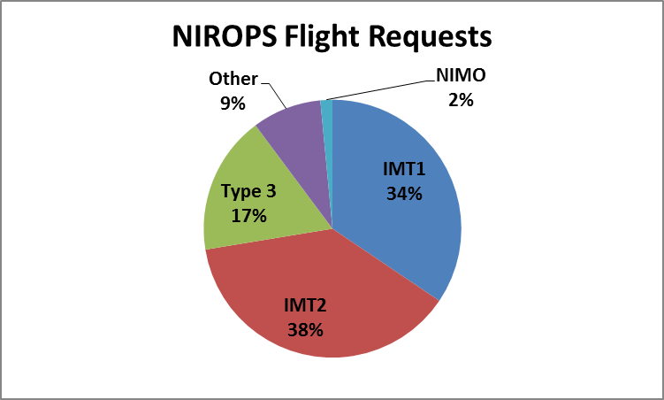
Who is Requesting?
2014 was the second year we captured this information on the flight requests
Very good response
Need to make
sure info is
updated for
transitions
Notes:
2014 – IMT1 – 432, IMT2 – 476, IMT3 – 218, Other – 109, NIMO – 19, 25 had no info
2013 - IMT1 – 23%, IMT2 – 41%, IMT3 – 22%, Other – 11%, NIMO – 3%
19 had no info
2012 – IMT1 47%, IMT2 29%, other 29%

Slide 12
It Takes a Team!
IR Techs - 4 man rotation
Pilots – 4 FS, 2 contract
33 different IRINs, 5 trainees got assignments and qualified
National IR desk staffed from 8/1 to 8/26 by 3 different IRCNs
Aircraft 3 (Firehawk) coverage key for covering Alaska requests and during maintenance on NIROPS aircraft- AC3 liaison at RSAC
Notes:
Pilots - Dan Johnson, Don Boyce, Ed Netcher, Andre Mascheroni, Pete Meyer, Jim Rozman
Techs - Woody Smith, Kaz Kazimir, Rob Navarro, Woody Kessler
Jan Johnson AC3 liaison

Slide 13
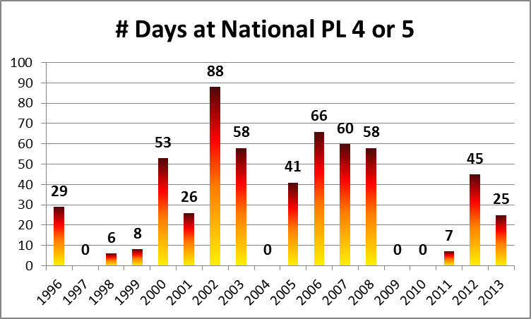
Next Year?........

Slide 14
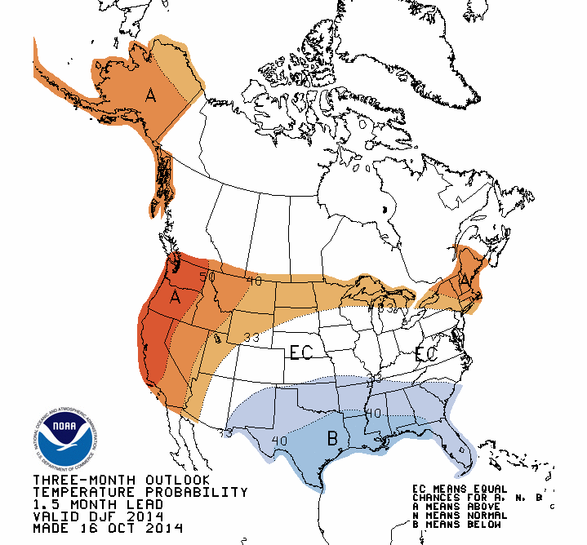
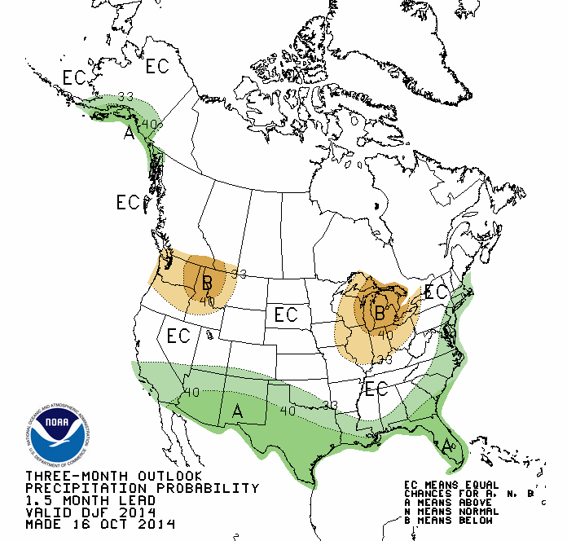
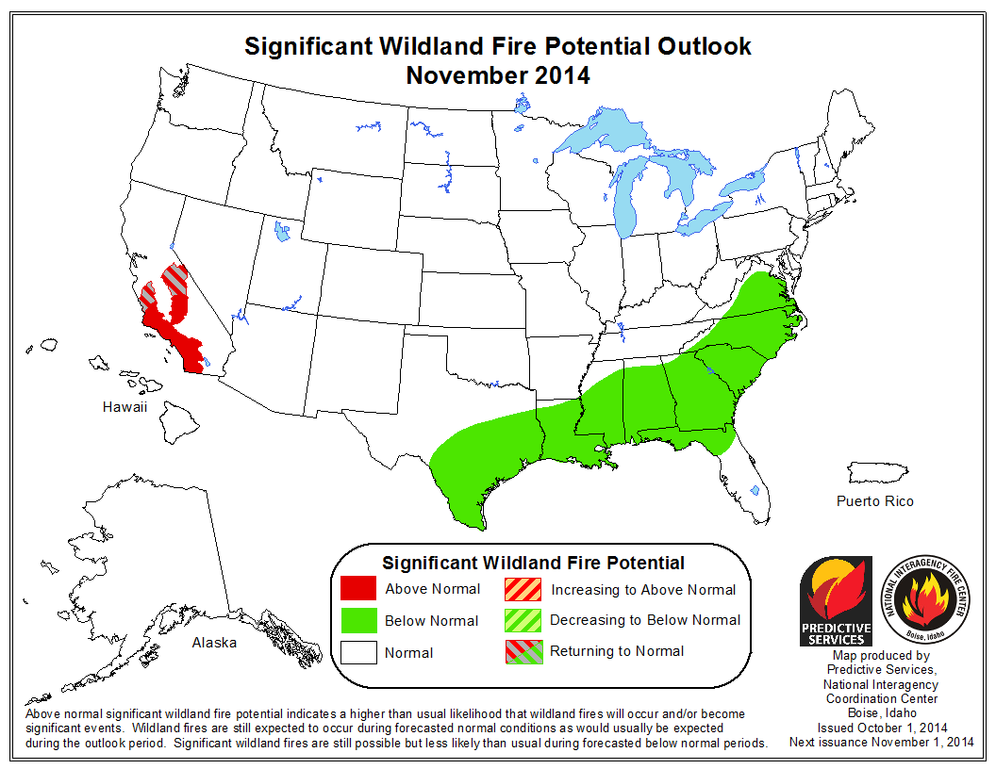
Rest of 2014 and into 2015
Most models favor a weak El Nino
Status of planes
AMS in 144
Keep Phoenix in 149?
NOV - JAN

Slide 15
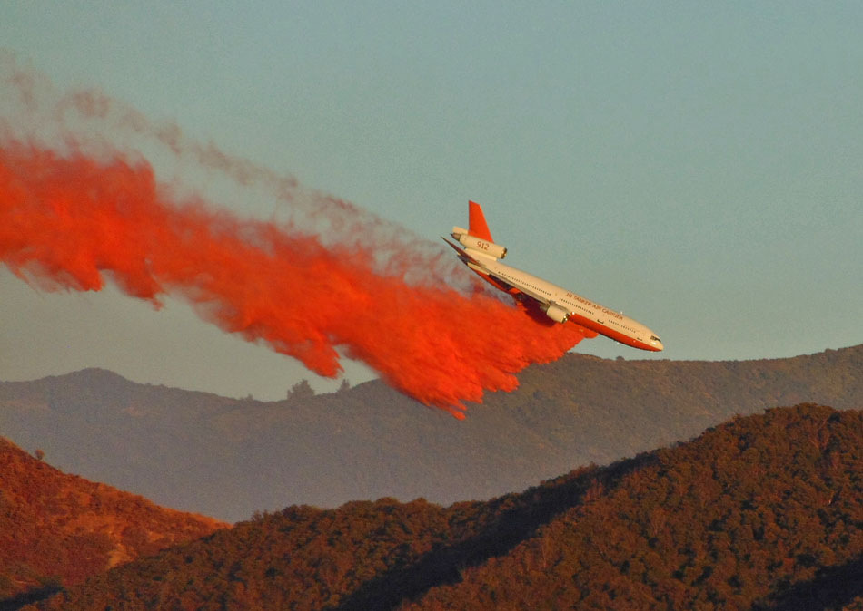
Get ready for next year!
Photo: Initial Attack Fire Media
Notes:
T-912 Silverado Fire – Cleveland NF, Photo by Initial Attack Fire Media

