Slide 1
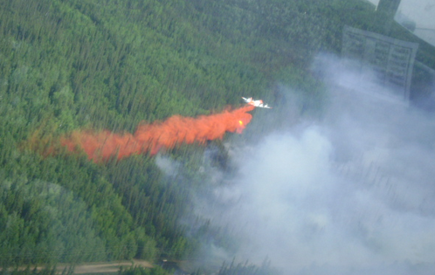
Wildfire IR Tactical & Intelligence
Mark Zaller
SkyIMD Developer
mzaller@skyimd.com, 408-623-4303
Hart Drobish
Courtney Aviation Air Attack Operator
hart@hub3.net, 209-532-2345

Slide 2
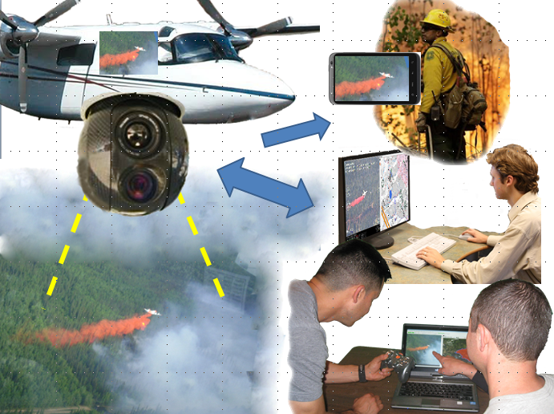
One Aircraft supports Ground Crews, Incident Command, HQ & Itself
IC OPs

Slide 3
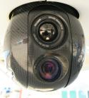
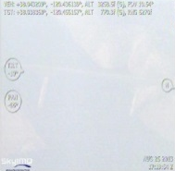
Microwave (unlicensed) duplicates control to the Ground
Internet
HotSpot
Airborne Wifi
Microwave, 3G
Satellite
Live Video & Snapshots
To firefighters
Operate in the Air
Air
Ground
Operate on the Ground
Tablet Interface: + Touch video to lock Scene
+ Touch moving object to lock on target
+Touch Map to zoom to location
+Auto-Track GIS lines
Air the same as the Ground
Operate from either Air or Ground or Both. Continuous video record both ground and air

Slide 4
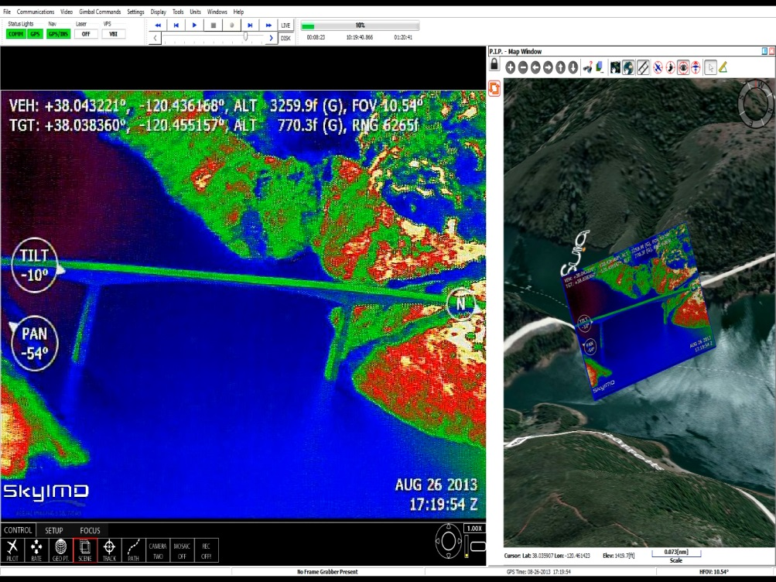
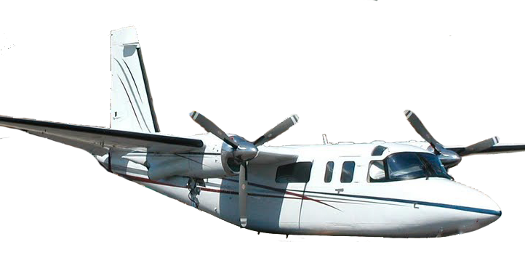
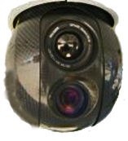
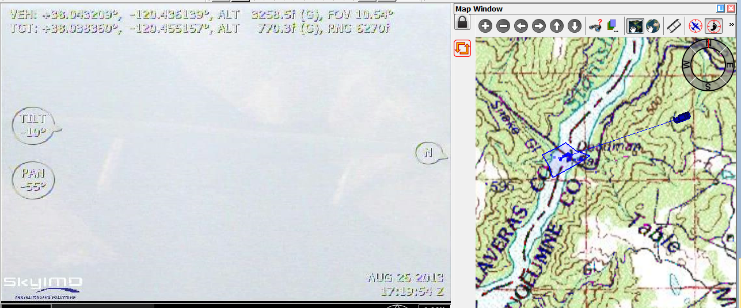
Air Attack Mode
Hands Off, Eyes Outside
Infrared at Same Image Overlaid
Exact Location On Aerial Map
Outline on Topos
Instant Situational Awareness
Identify Map Names
Oriented to Intuitive line-of-sight
At Night and in Smoke
See Mountains & Terrain
Discover Spot Fires
Fire Perimeter & Slop-overs
People
As seen Through
Windshield (Visible)

Slide 5
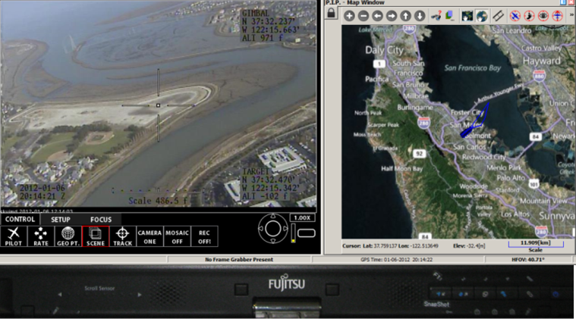
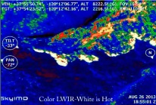
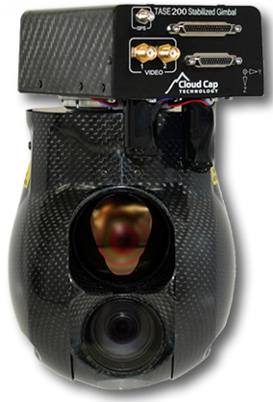
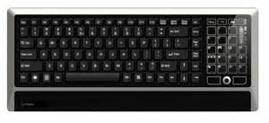
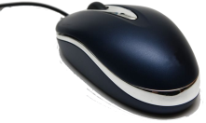
Operate Gimbal: IR 5/10⁰ & Super Zoom Visible 2-56⁰
Touch (like an iPad)
Buttons/Joy stick (not needed, matches touch commands)
Keyboard (not needed, Key-caps are labeled)
Mouse (same as touch, but more precise than fat fingers)
Ground: Microwave link upgrade allows for operator
anywhere in the world - not in aircraft
Easy
Touch Map
Touch Video
JPG·KMZ
IR 10/5⁰ fov
Visible 56-2⁰ fov

Slide 6
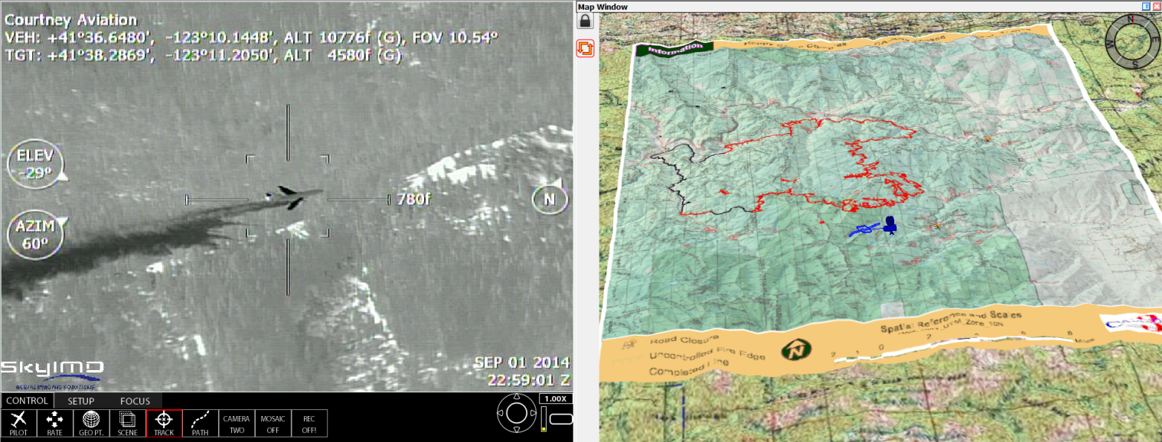
Maps, AutoTrack Fire lines & Targets
Import Preflight or OTA (Over-the-Air):
Daily Team GIS Map
NIFC Firelines .SHPs: Dozer, Hand-cut, Fire, Escape Routes
Auto-track GIS Hands-off, and Record
Lock-on to Moving and Stationary target Locking ok at any time
Touch or Click it: Tracking will restart by touching Track
Photos and Video will transmit as normal
Click to see on
YouTube

Slide 7
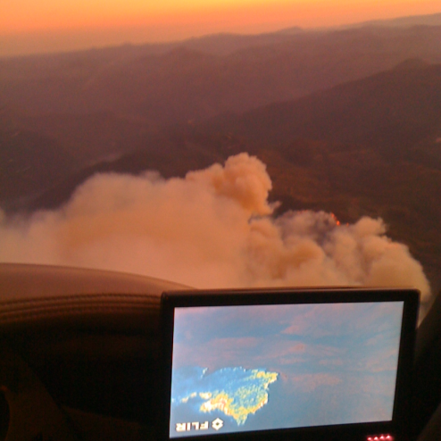
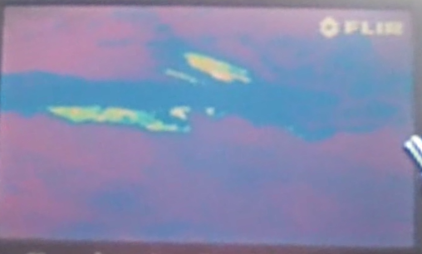
Wildfire Isotherm
Specially developed WildFire sensitivity for IR
Distinguish sun baked ground from fire
Makes IR functional on Hot Afternoons
Fix-mounted IR and Gimbal IR are the same
Un-Burned
Black
Fire

Slide 8
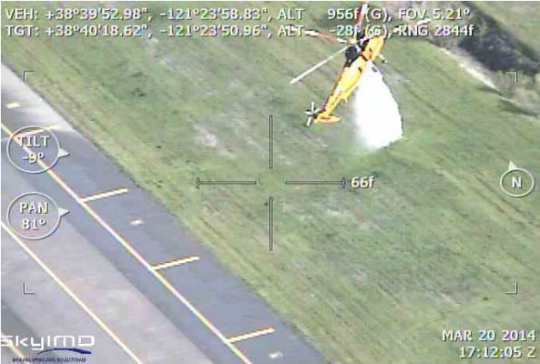
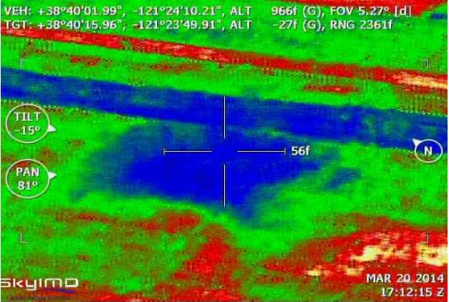
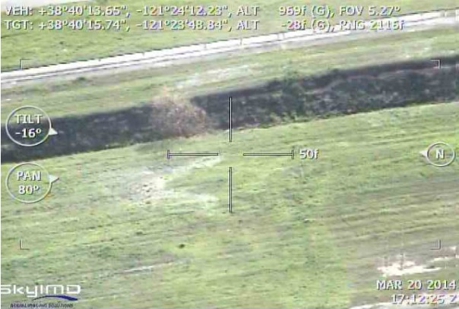
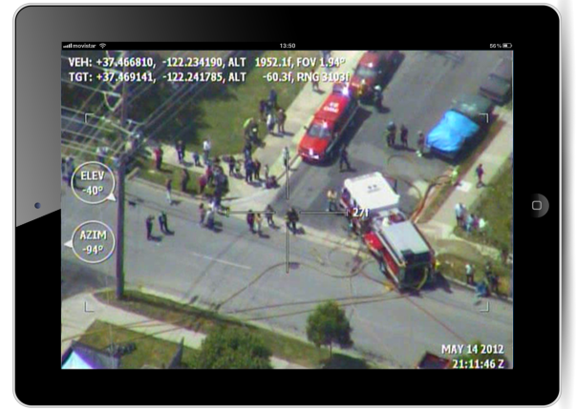
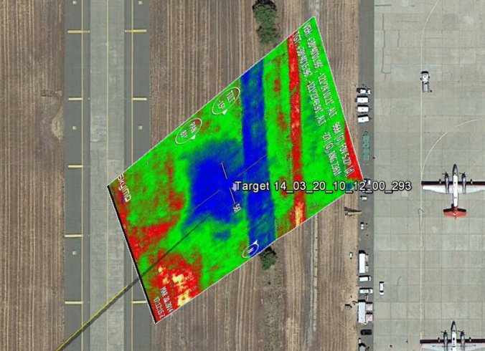
Coverage Levels of Retardant Drops Water or Retardants on the Ground can be Seen in IR
Confirm Coverage
See Gaps and Thin Spots
Colorless Retardants
Email to Ground Crews and IC
Press button to Map Drops
or Post Flight
Identify New Target Drop Sites
Review Post Fire and BAER
Click to see on
YouTube

Slide 9
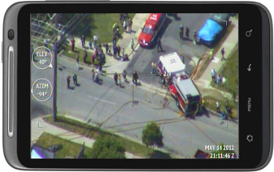
Internet Hotspot airborne
Internet
HotSpot
Airborne Wifi
WiFi throughout aircraft
Internet when 3G available
DataLink antennas 2-3x better than 3G phones
Gimbal video is available through out aircraft cabin (iOS, Android, Windows or Mac devices)

Slide 10
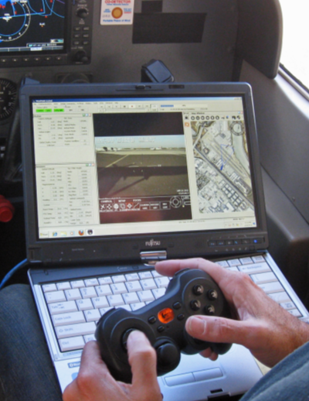
Services Before & During Emergencies
Remote Desktop live
On-site Airborne Operator
1-on-1 training
Group Classes
Ground Implementation
Setup user devices: Snaps, live Video, KMZs, Aircraft moving-map
Group distribution
GIS input
inReach ground resource tracking
Comm towers setup

Slide 11
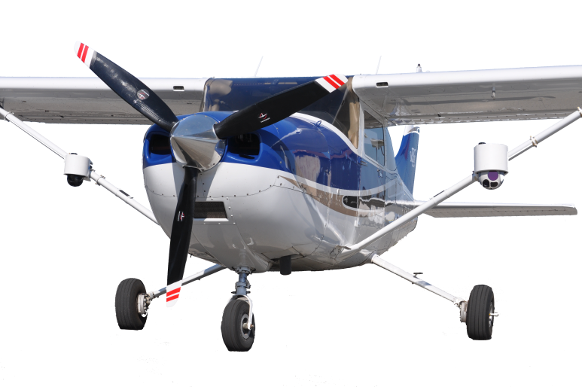
Manned UAV
Small Aircraft flown solo parked above fire traffic area. Manned.
Managed by Air Attack. 3 Sensor pods per Manned UAV

Slide 12
Happy Camp Complex – the good
IC seeing live video improved collaboration with Air Attack
IC would operate the gimbal to look for spot fires when the ATGS was busy
There were some questions about who got the gimbal, and ATGS wants it clear they own it
IR zoom found creeping fire threads burning through retardant not visible to the naked eye
IR inspection of retardant drops was helpful in addition to red dye
Recorded tanker drops were used in the daily debrief of Tanker pilots
Hands-off tracking (optical image recognition lock), worked better than expected
Retardant recordings available for Bob Roth’s retardant study
ATGS wants more IR, absolutely always in their Air Attack aircraft
ATGS would also like EO/IR aircraft flown solo parked above the congested altitudes, and remote operated by the ATGS or IC
Air crew used the system more than expected
3rd person or trainee is desired. Switch findings to the front seat display
Easy: Both airborne crews and IC were functional within minutes
Training conducted by Remote Desktop Control
Over-the-Air update: Fresh team GIS as moving map base was important

Slide 13
Happy Camp Complex – not so good
That’s the good news. The only difficult news is that it needed someone on the ground to:
Set up the microwave
Move the microwave as the fire moved, and then take down the microwave
Route the camera feed from Microwave through the internet
Talk IC into looking at it. Once viewed they loved it, and their client setup seemed a non-issue. Getting them to just look was difficult.
Contention over operation: Flow of Control

Slide 14
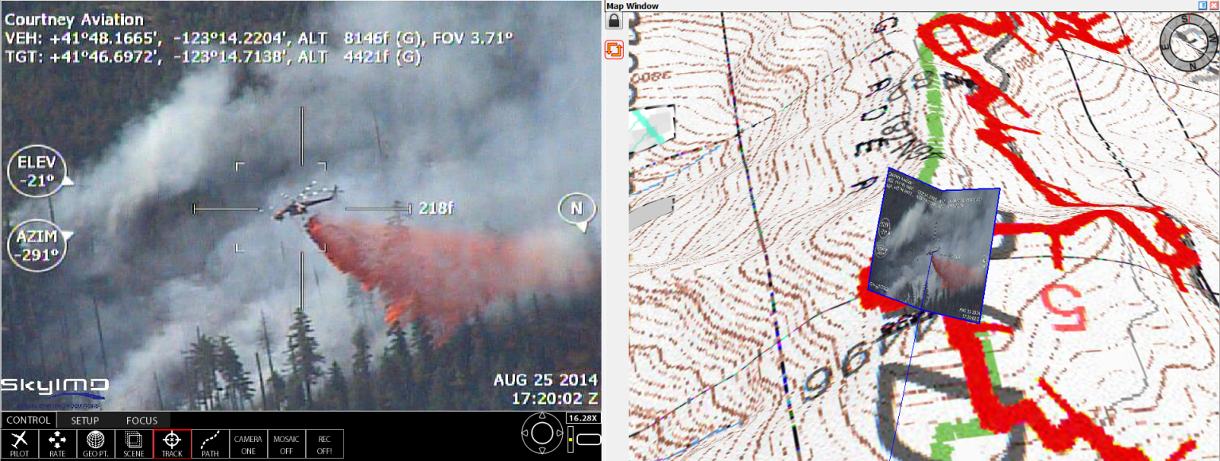
Interagency-Industry participatory working group
Aerial Infrared and DataComm
Tactical Fire Remote Sensing Advisory Group
Communicate/Share
Advice, Guidelines, Rules of the Road
Collaborate with IC teams

