Slide 1
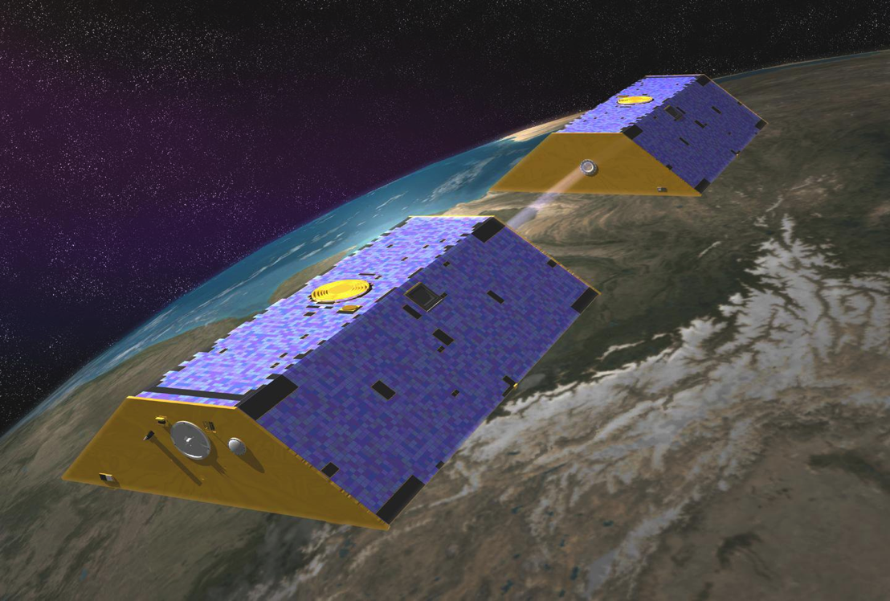
NASA’s GRACE Mission - Opportunities in Fire Severity Risk Mapping
TFRSAC Fall Meeting October 23, 2014
JT Reager Jet Propulsion Laboratory
Christine Rains NASA DEVELOP National Program
Notes:
Coming to you as a representative of the NASA’s National DEVELOP program.
Appreciate being allowed to participate in this meeting. Know that you are not interested in one-offs and products that you can’t use. (Caleb Berry)
As Vince pointed out, the Applied Sciences program in NASA’s Earth Science division is also interested in making sure the products and methods are developed that will see useful implementation in partner agencies.
I’d like to tell you about some novel approaches to fire detection, risk assessment and post-burn assessment that DEVELOP has done work on and will be investigating in the upcoming year. I’m going to focus on a project that investigates a new application for data derived from NASA’s GRACE mission.
<refer to image>
Will be talking about what it measures and how it is potentially useful.

Slide 2
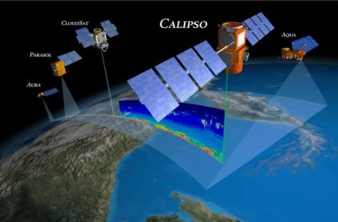
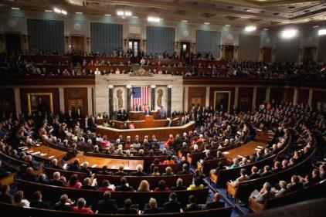
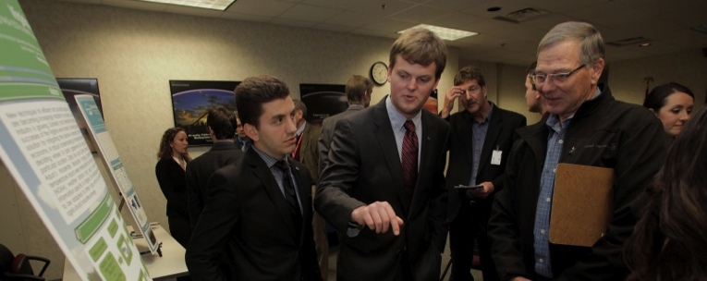
The DEVELOP National Program
NASA DEVELOP
Measurements
and Predictions
Communities
Discovering Innovative & Practical Applications
of NASA Earth Science
Ecological
Forecasting
Health &
Air Quality
Water
Resources
Agriculture
Disasters
Weather
Climate
Energy
Oceans
Applied Sciences Program Website: www.nasa.gov/applied-sciences
Notes:
So just a little bit about DEVELOP.
DEVELOP is a capacity-program designed to bridge the gap between NASA Earth Sciences and society. Capacity-building means that we are fostering remote sensing and applications capabilities in both our participants and the community. We accomplish this through the implementation of short, 10-week projects that aim to discover and demonstrate innovative uses and practical benefits of NASA Earth science data, scientific knowledge, and technology. Participants are undergrads, grad students, recent grads, veterans of the armed forces and transitioning professionals. Partner organizations can be federal and state agencies, such as the US Forest Service and CAL FIRE, to NGO’s such as the Audobon Society. I’m also here in search of partners for our upcoming projects as well as to tell you about a successful partnership with the US Forest Service that has come out of our node at NASA Ames.
Our projects focus on the 9 applications areas identified by NASA Applies Sciences, listed at the bottom of this slide.
DEVELOP is part of NASA’s Applied Sciences Program, addresses environmental and public policy issues by conducting interdisciplinary feasibility projects that apply the lens of NASA Earth observations to community concerns around the globe. Bridging the gap between NASA Earth Science and society, DEVELOP builds capacity in both participants and partner organizations to better prepare them to address the challenges that face our society and future generations. With the competitive nature and growing societal role of science and technology in today’s global workplace, DEVELOP is fostering an adept corps of tomorrow’s scientists and leaders. The Applied Sciences Program (ASP) serves as a bridge between the data and knowledge generated by NASA Earth Science and the information and decision-making needs of public and private organizations. The goal of the program is to discover and demonstrate innovative uses and practical benefits of NASA Earth science data, scientific knowledge, and technology.
ASP is organized thematically around 9 application areas and 4 capacity building programs that aim to improve domestic and international skills and capabilities in the use of NASA Earth science.

Slide 3
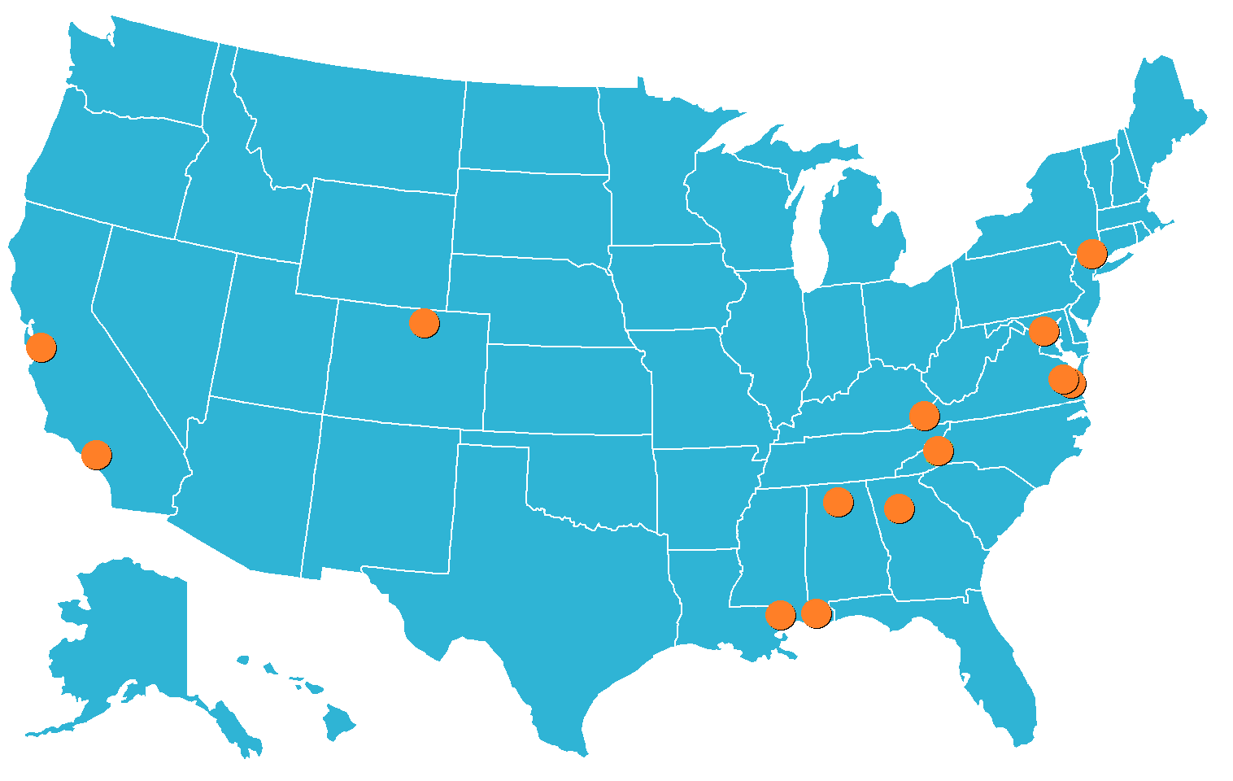
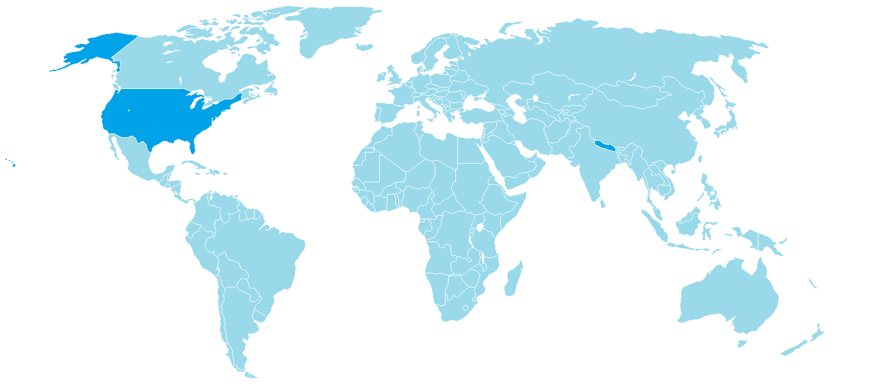
DEVELOP Locations
Federal Locations
NASA Ames Research Center – Moffett Field, CA
NASA Goddard Space Flight Center – Greenbelt, MD
NASA Jet Propulsion Laboratory – Pasadena, CA
NASA Langley Research Center – Hampton, VA
NASA Marshall Space Flight Center at NSSTC – Huntsville, AL
NASA Stennis Space Center – Stennis, MS
USGS at Colorado State University – Fort Collins, CO
NOAA National Climatic Data Center – Asheville, NC
Regional Locations
International Research Institute – Palisades, NY
Mobile County Health Department – Mobile, AL
Patrick Henry Building – Richmond, VA
University of Georgia – Athens, GA
Wise County Clerk of Court’s Office – Wise, VA
Additional Project Activity
ICIMOD – Kathmandu, Nepal
GIS TReC – Pocatello, ID
Notes:
Over a dozen locations, or nodes around the country.

Slide 4
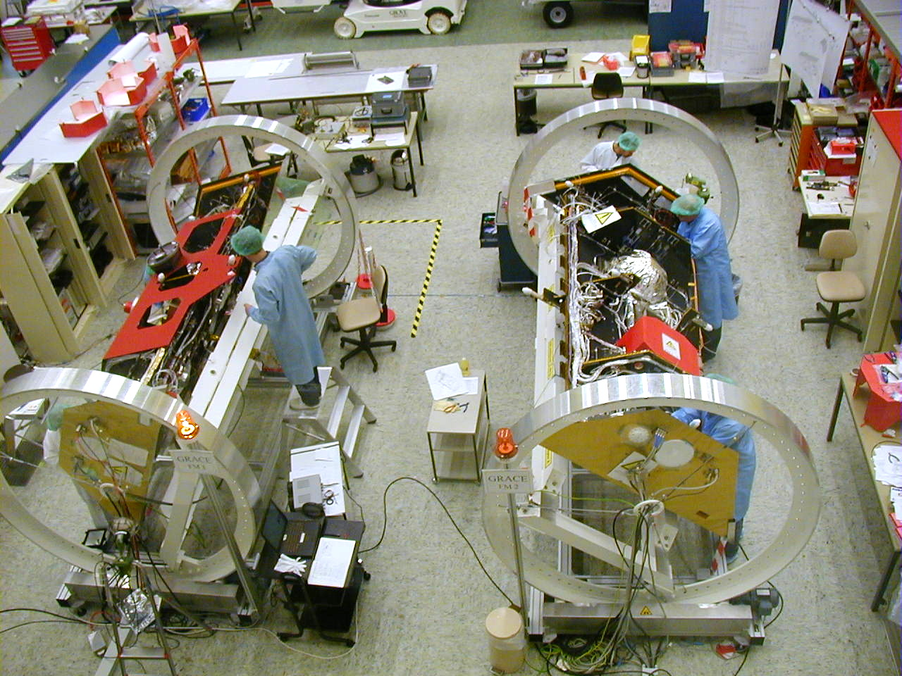
Gravity Recovery And Climate Experiment
Notes:
Going to focus on a project that utilizes the GRACE sensor. Joint project between JPL and the German Space Agency.

Slide 5
Gravity Recovery and Climate Experiment
Notes:
Joint project between JPL and the German Space Agency.

Slide 6
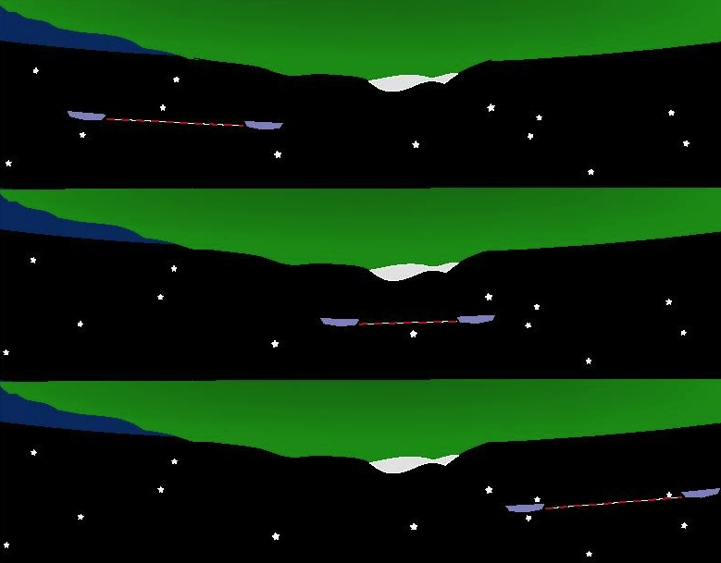
How GRACE works
Concentrations (or deficits) of mass
affect the spacing
between the satellites
Notes:
450 km altitude. 250 km apart. For any given mass anomaly, the satellites experience an increase/decrease in the distance between them. Use GPS to map the distances. Inverse solving for how much water would have had to have been there to cause that anomaly.

Slide 7
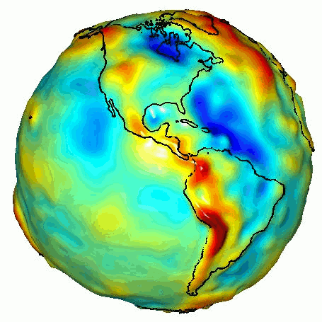
What GRACE “sees”
Notes:
60 terms!

Slide 8
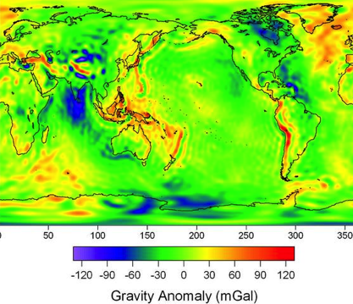
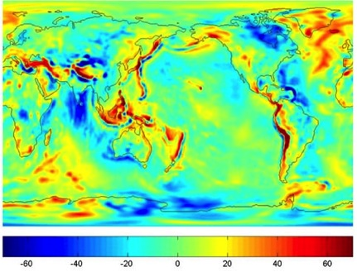
Anomaly Detection
Monthly map
Long term average map
-
=
Notes:
2002

Slide 9
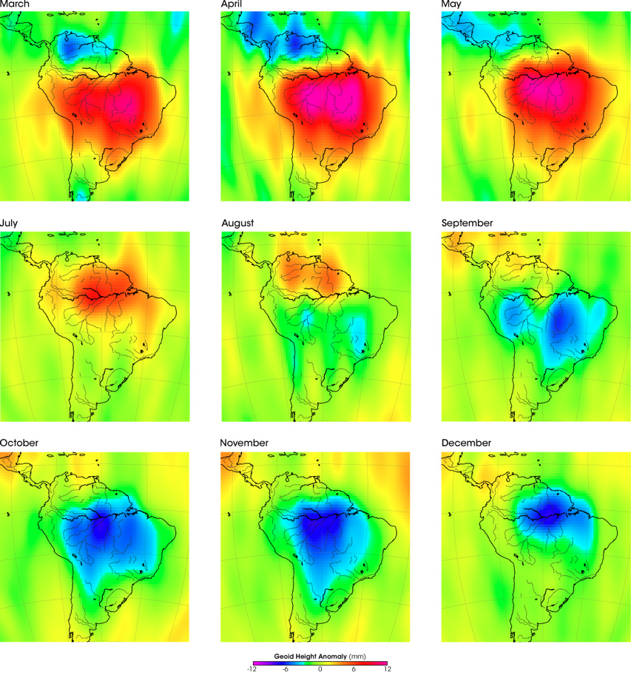
Terrestrial Water Storage Anomaly
Monthly changes in gravity are caused by monthly changes in mass
At certain time and space scales, assume change in gravity caused by changes in water storage
Vertical extent on the order of centimeters
CSR- 3 source : Time resolution of monthly, resolution ~200,000 km²

Slide 10
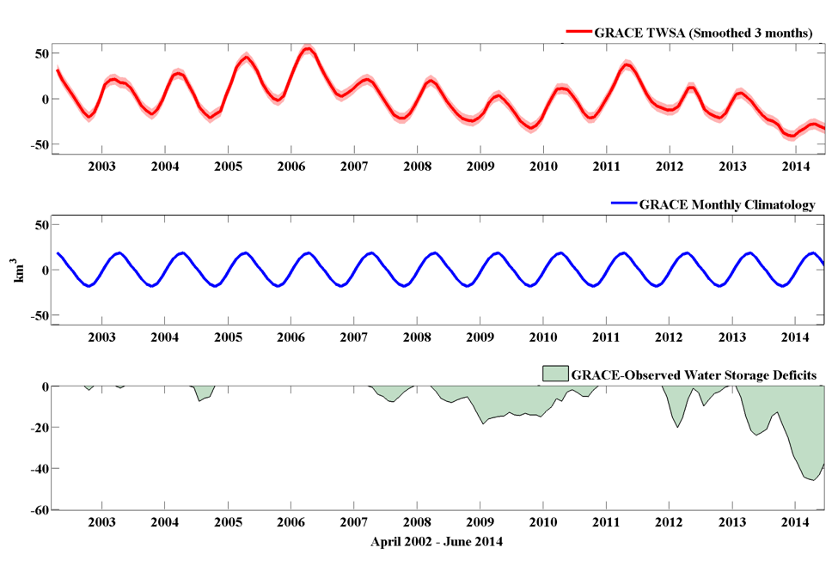
GRACE Water storage deficits
Thomas, Reager, Famiglietti, GRL 2014

Slide 11
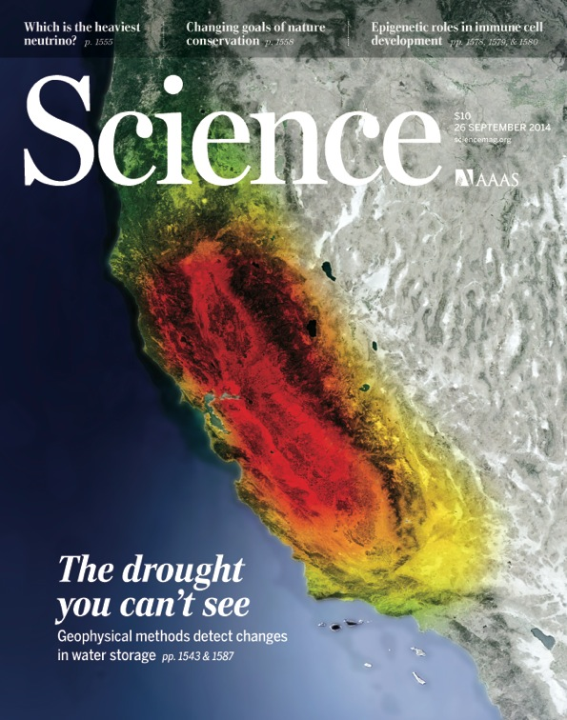

Slide 12
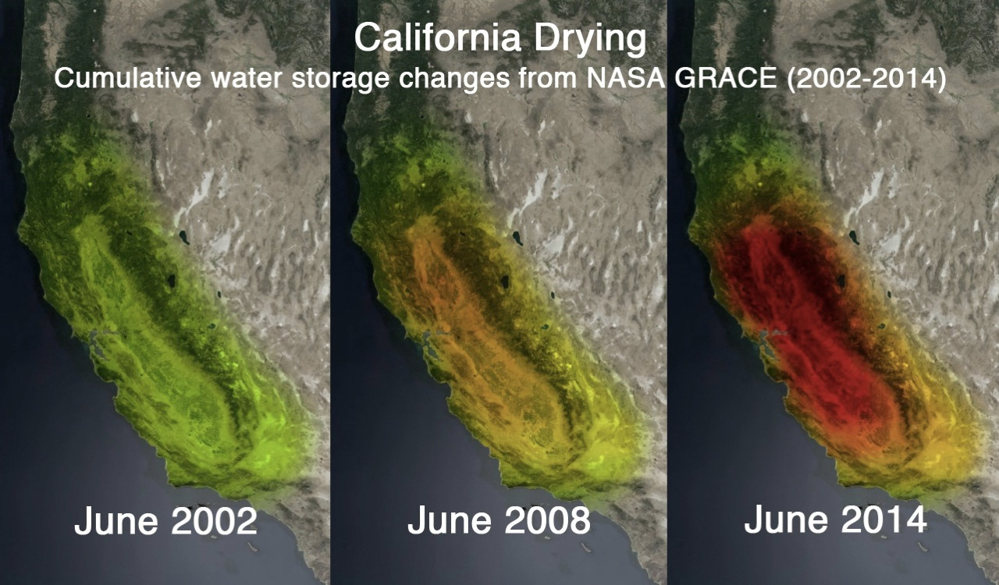
Notes:
Great science—question is how to turn this into an application.

Slide 13
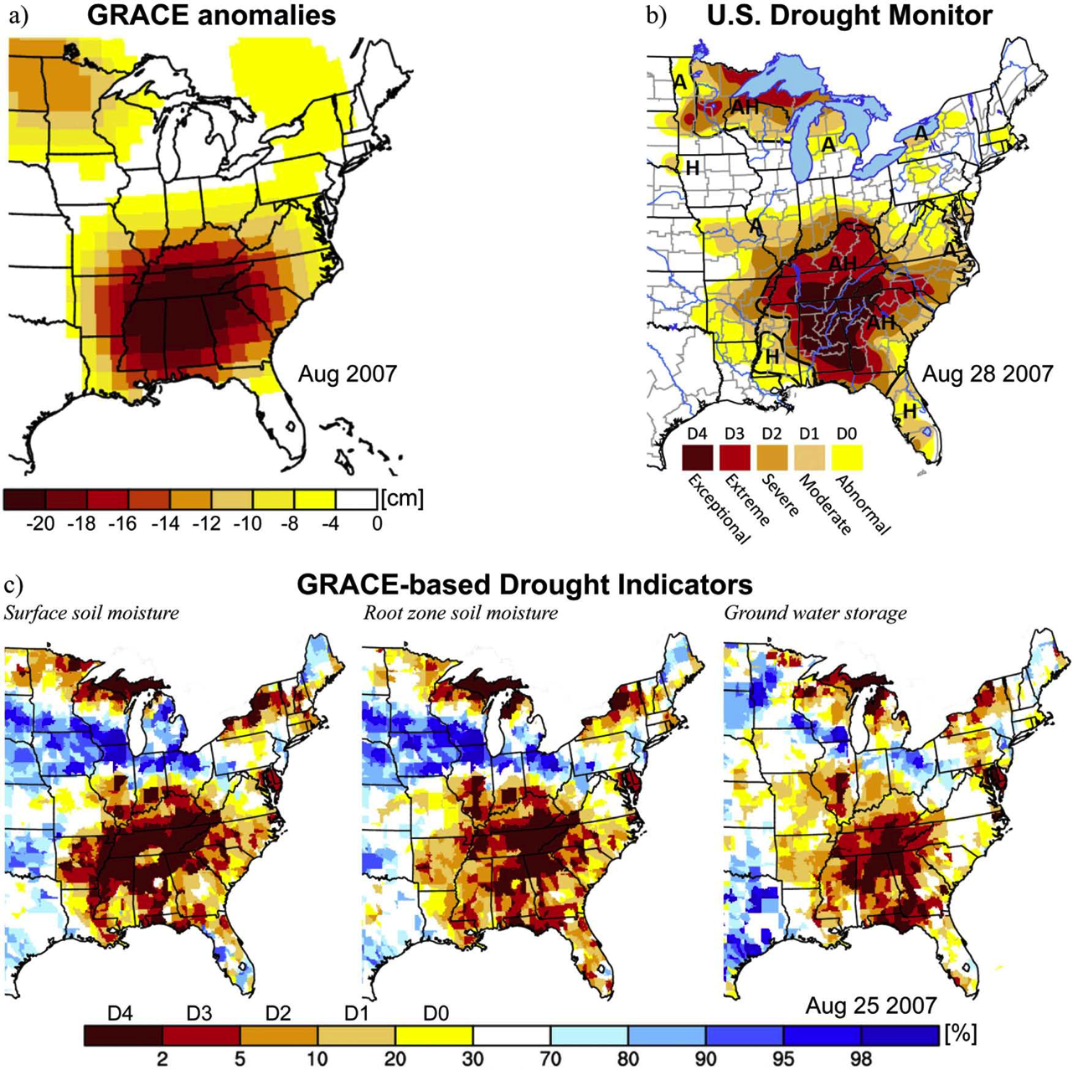
GRACE Data Assimilated Products

Slide 14
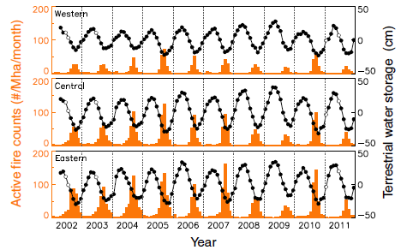
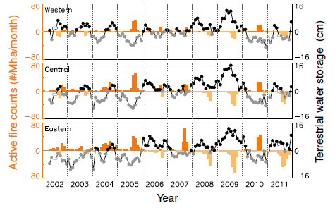
Strategy
Evidence that it is not just the dry years that are correlated with fire
Fuel accumulation occurs in wet years, so both wet and dry years are needed in sequence
Data Plot
Anomaly Plot
Chen, Y., I. Velicogna, J. S. Famiglietti, and J. T. Randerson (2013). Satellite observations of terrestrial water storage provide early warning information about drought and fire season severity in the Amazon, JGRB

Slide 15
Case study of GRACE Terrestrial Water Storage vs. Active Fires
Data Plot
Anomaly Plot
Chen, Y., I. Velicogna, J. S. Famiglietti, and J. T. Randerson (2013), Satellite observations of terrestrial water storage provide early warning information about drought and fire season severity in the Amazon, J. Geophys. Res. Biogeosci., 118, 495–504, doi: 10.1002/jgrg.20046.

Slide 16
Strategy
Evidence that it is not just the dry years that are correlated with fire
Fuel accumulation occurs in wet years, so both wet and dry years are needed in sequence
Use GRACE-assimilated data combined with NDVI/EVI to identify areas of high fire risk at 0.25 deg resolution for CONUS, 2003 to Present
Validate with GFED historical data to assess predictive capability of the methodology

Slide 17
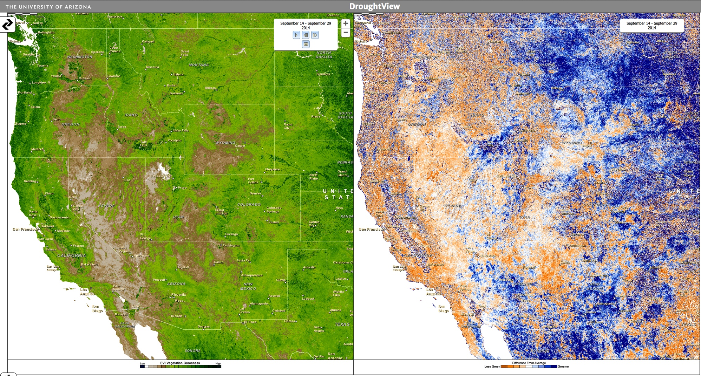
MODIS Vegetative Indices, e.g. EVI
EVI
Greenness
Index
Percent
change
from average
Obtained from the University of Arizona http://rangeview.arizona.edu/

Slide 18
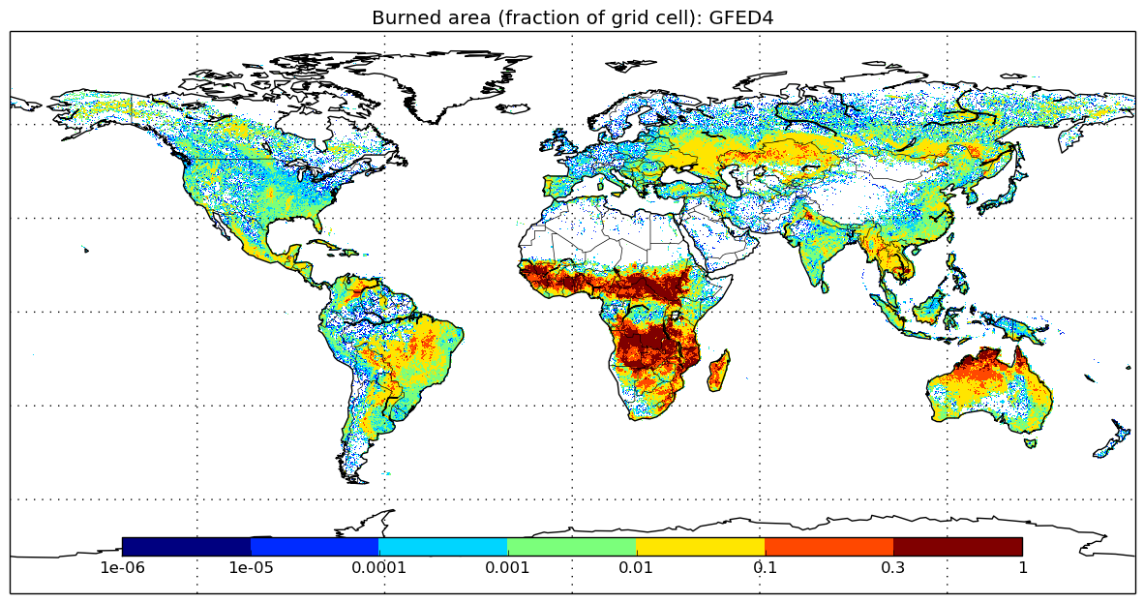
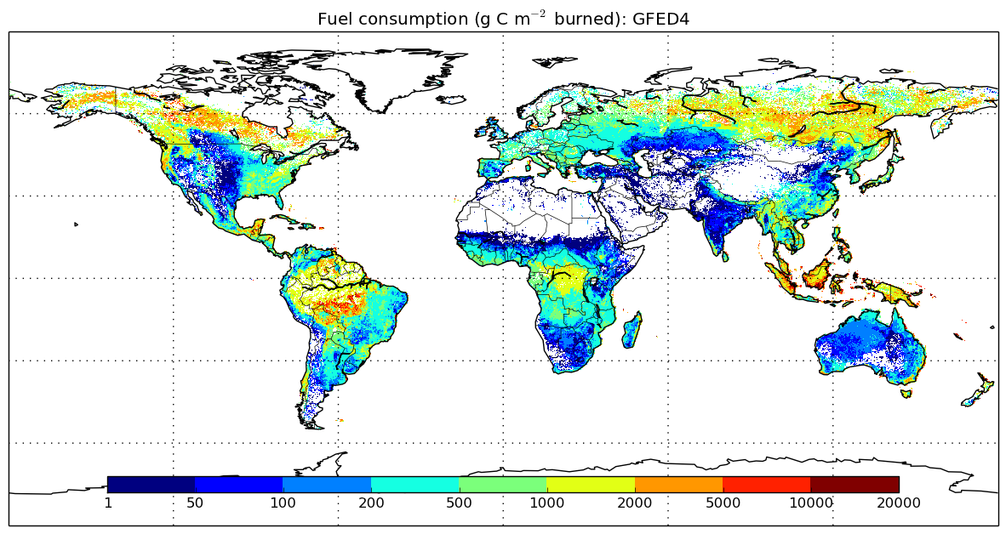
Global Fire Emissions Database (GFED)
Combines data from multiple datasets
MODIS burned area maps
VIIRS active fire data
ATSR world fire atlas
Final products have 0.25 degree resolution
Notes:
Combined 500 m MODIS burned area maps with active fire data from TRMM
Used VIIRS
Along-track scanning radiometer world fire atlas.
0.25 deg resolution

Slide 19
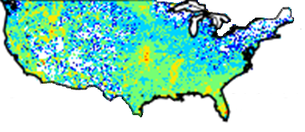
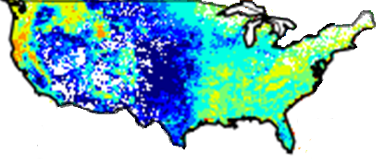
Global Fire Emissions Database (GFED)
Combines data from multiple datasets
MODIS burned area maps
VIIRS active fire data
ATSR world fire atlas
Final products have 0.25 degree resolution
Burned area (fraction of grid cell)
Fuel consumption (g C m⁻² burned)

Slide 20
Some other DEVELOP fire projects…

Slide 21
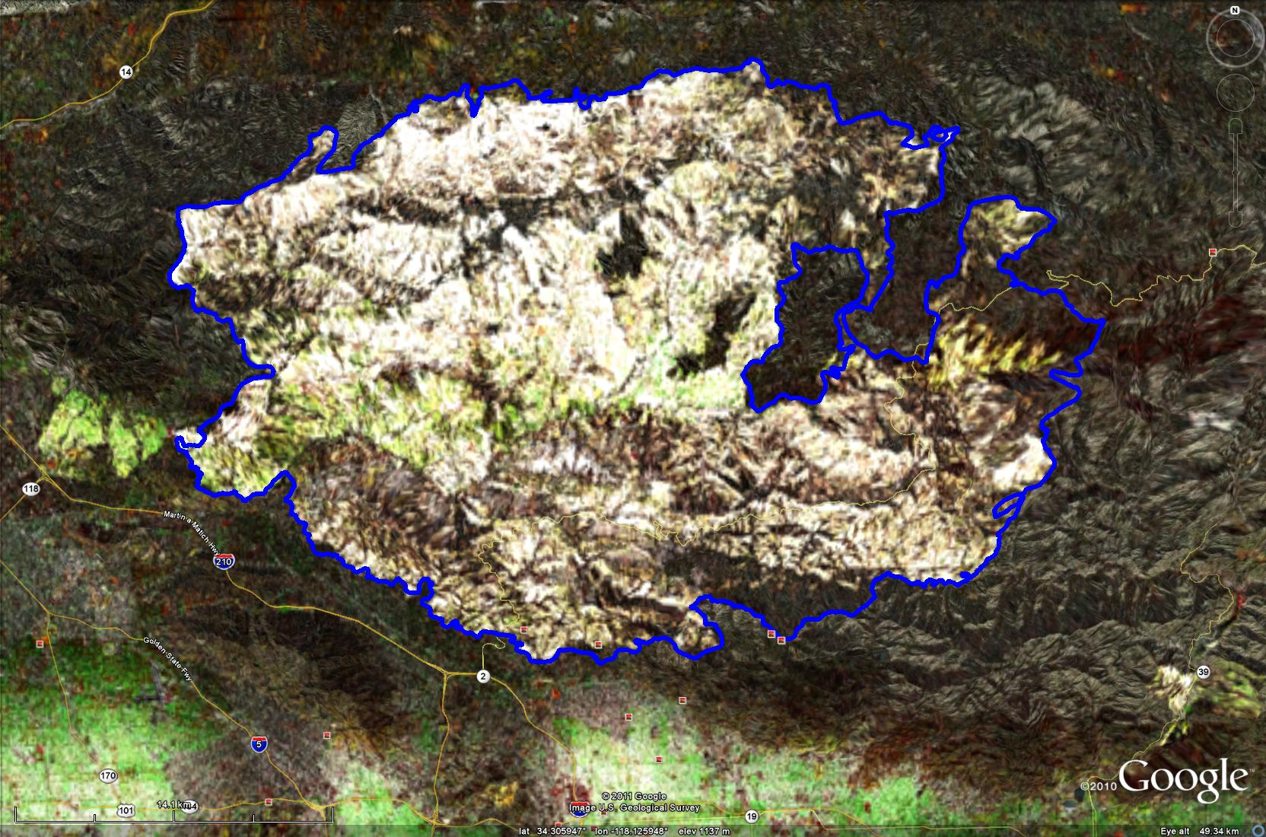
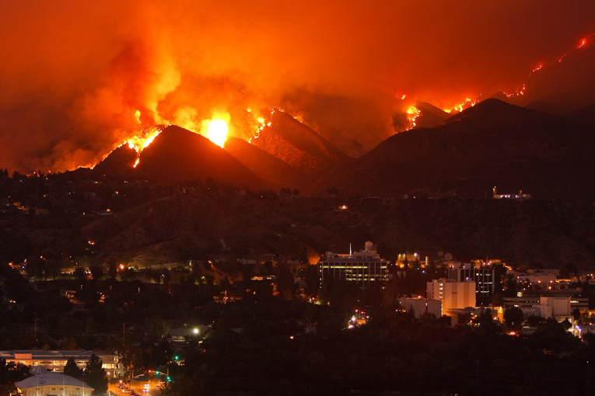
Exploring the potential for near-real-time monitoring of wildfires with airborne polarimetric SAR
Insensitive to smoke, clouds and time-of-day
Can provide critically needed near-real-time information about a fire’s location, spreading rate and as input into estimates of projected path
Photo by Dan Finnerty
JPL
View across JPL
Caltech
Map of 2009 Station Fire (Los Angeles County). White area is SAR-derived burn map and blue outline is the USFS post-burn map

Slide 22
Jet Propulsion Laboratory: Exploring the potential for near-real-time wildfire monitoring with airborne polarimetric SAR
Insensitive to smoke, clouds and time-of-day
Can provide critically needed near-real-time information about a fire’s location, spreading rate and as input into estimates of projected path
Photo by Dan Finnerty
JPL
View across JPL
Caltech
Map of 2009 Station Fire (Los Angeles County). White area is SAR-derived burn map and blue outline is the USFS post-burn map

Slide 23
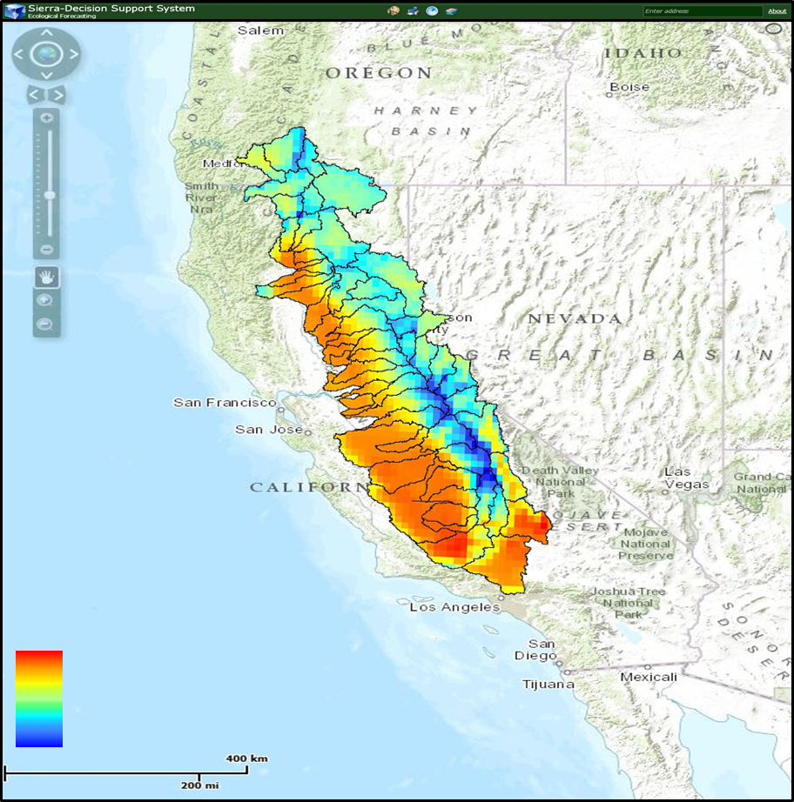
Ames Research Center: Sierra Nevada Decision Support System
Community Concerns
Increasing temperatures
Reduced spring snowpack
More severe wildfires
Partners
USDA Forest Service, RO5
Esri
Plotly
Features
Web Mapping Application
Climate, hydrology, and vegetation datasets in a Mapping Viewer
Statistically & graphically analyzed datasets
Download portal for data

Slide 24
For More Information
Contact the DEVELOP National Program Office
NASA-DL-DEVELOP@mail.nasa.gov
(757) 864-3761
Contact DEVELOP Center Representatives
Christine Rains – DEVELOP JPL Center Lead
Christine.Rains@jpl.nasa.gov
Andrew Nguyen – DEVELOP ARC Center Lead
Andrew.Nguyen@nasa.gov
Amber Brooks – DEVELOP ARC Geoinformatics Young Professional
Amber.N.Brooks@nasa.gov

Slide 25
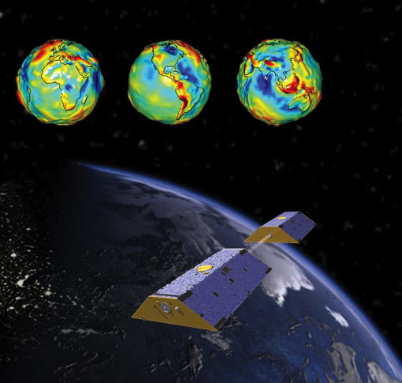
Contact for more information:
JT Reager
Jet Propulsion Laboratory
John.Reager@jpl.nasa.gov

