Slide 1

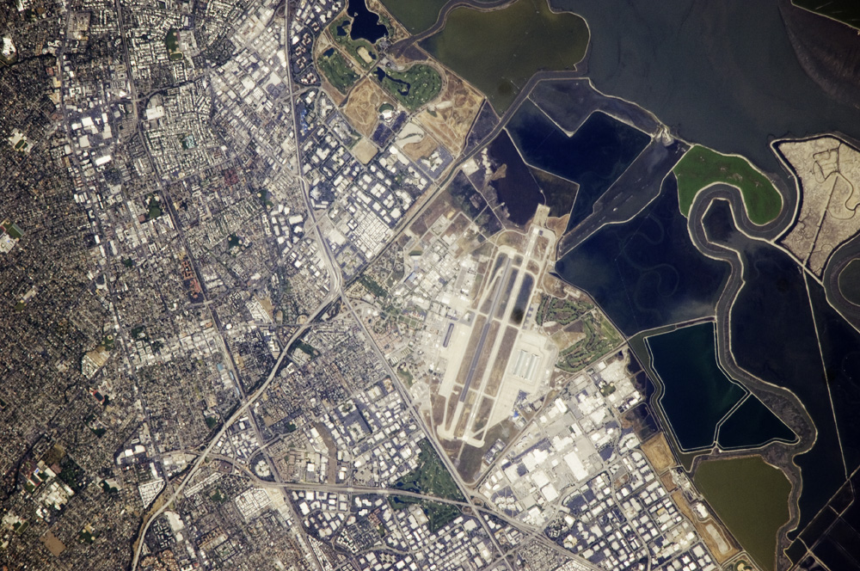
Airborne Science Program updates at
NASA Ames Research Center
TFRSAC Meeting, April 17th, 2013

Slide 2





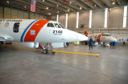




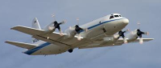






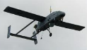

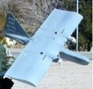
NASA Earth Science Research Capable Aircraft
DFRC
WFF
JSC
ARC
LaRC
GRC
80000
ER-2
70000
Global Hawk
WB-57
60000
Lear 25
C-20/G-III
50000
Falcon
DC-8
Altitude (feet)
40000
S-3B
Ikhana
B-200/UC12
P-3
30000
Twin Otter
C-130
20000
Sherpa
C206
UH-1 Huey
SIERRA
10000
Rigel
Dragon Eye
0
2
4
8
12
18
30
Endurance (hrs)

Slide 4
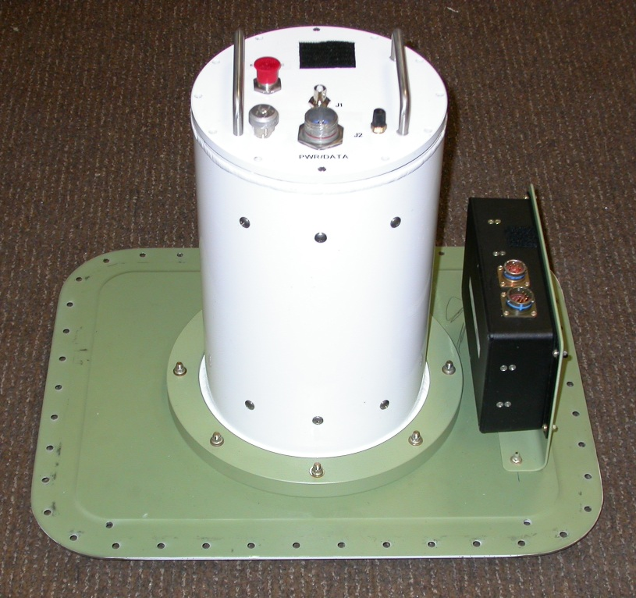
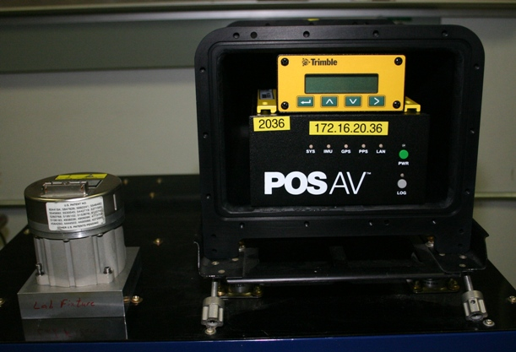
Facility Instrumentation at the ASF
MODIS and ASTER Airborne Simulators (MAS & MASTER)
UAS AMS (Autonomous Modular Sensor System)
Precision Geo-Positioning Hardware (Applanix POS-AV 510 & 610)
Electro-Optic and Film Cameras
UAS-AMS Sensor
POS-AV IMU / DGPS
DCS Cameras
MODIS & ASTER Airborne Simulators
and

Slide 5
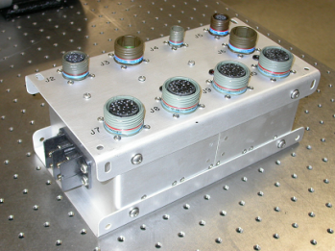
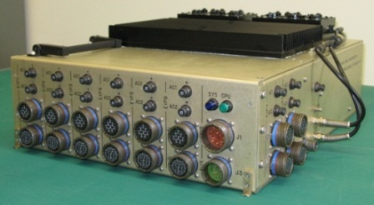
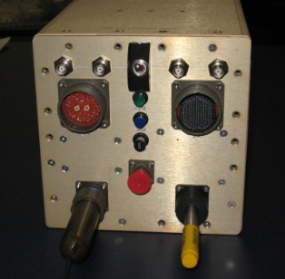
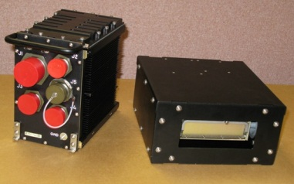
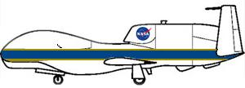
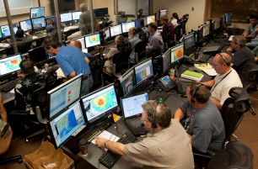
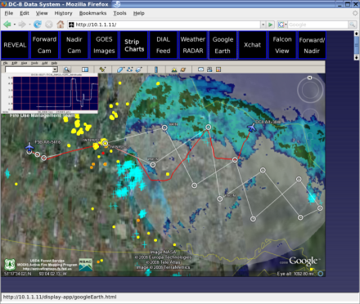
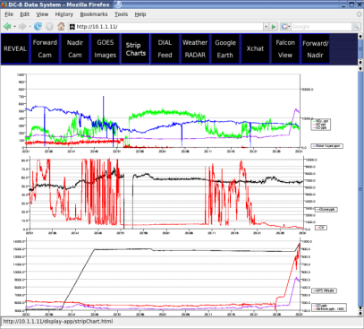
Airborne Science Sensor Network Architecture and Hardware
(Global Hawk Configuration)
Master Power Control & Interlocks
(Hard-Wired)
Master Payload Control System
& PDU
Interface Panels (8)
Payload Instruments
EIP
MPCS
Ethernet
NASDAT
Network Host (NASDAT)
Link Module Telemetry I/O Mass Storage
LM + Disk
Iridium (2 ch)
AIRCRAFT
GROUND
Iridium (4 ch)
Ku-Band or Inmarsat Sat-Com
Pilot’s MPCS GUI
Web-Based Users
COMPASS, GHOC, or Portable Ground Stations
Data visualization software tool kits
GHOC Network or remote Internet
Experimenter Workstations
Visualization Tools
GHOC

Slide 6

Cross-cutting System Overview / Mission Utilization

Slide 7
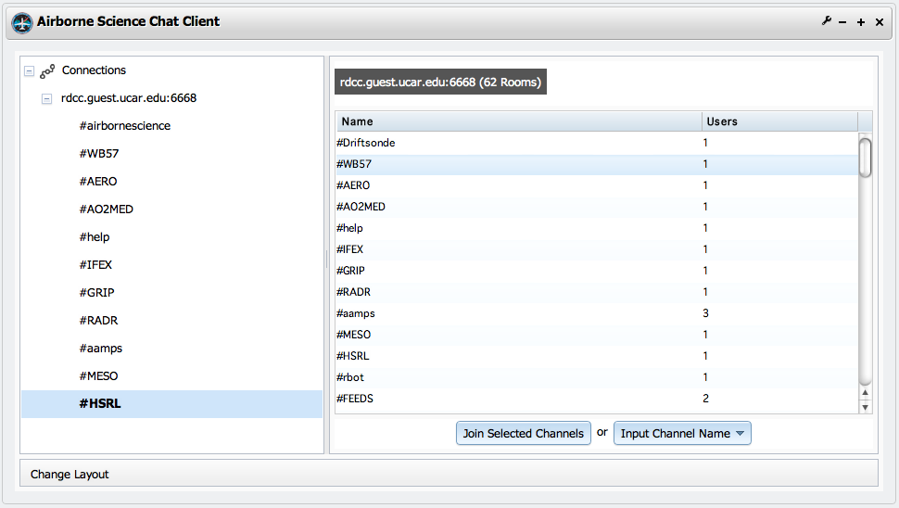
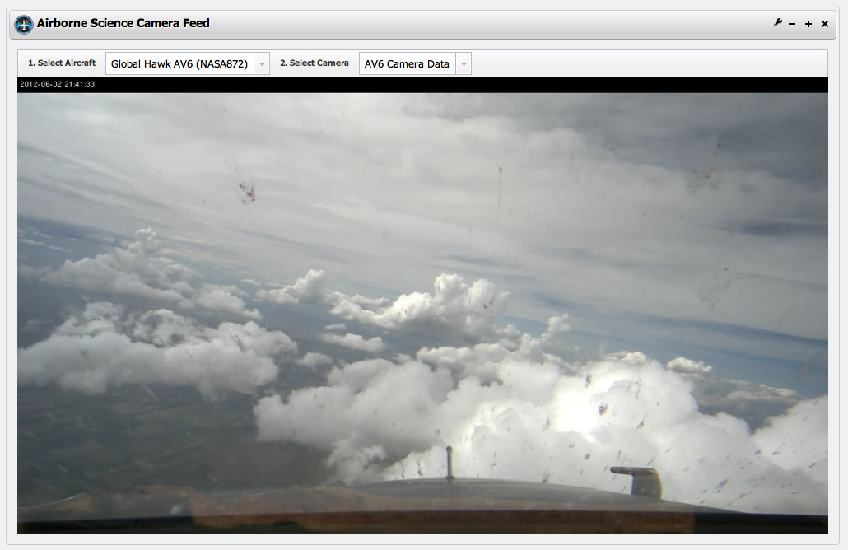
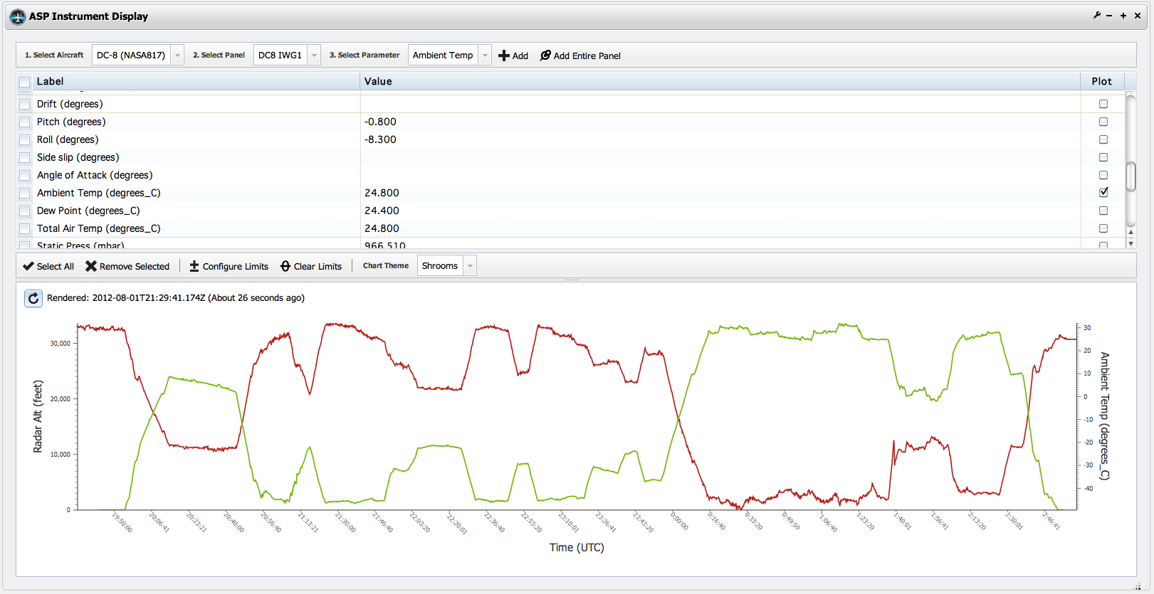
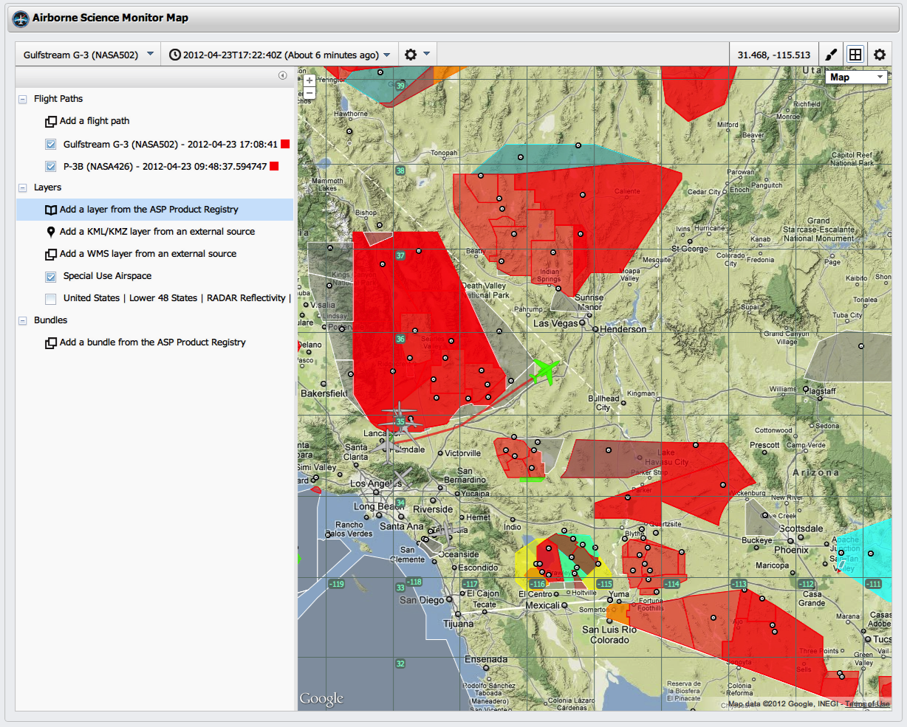

Slide 8

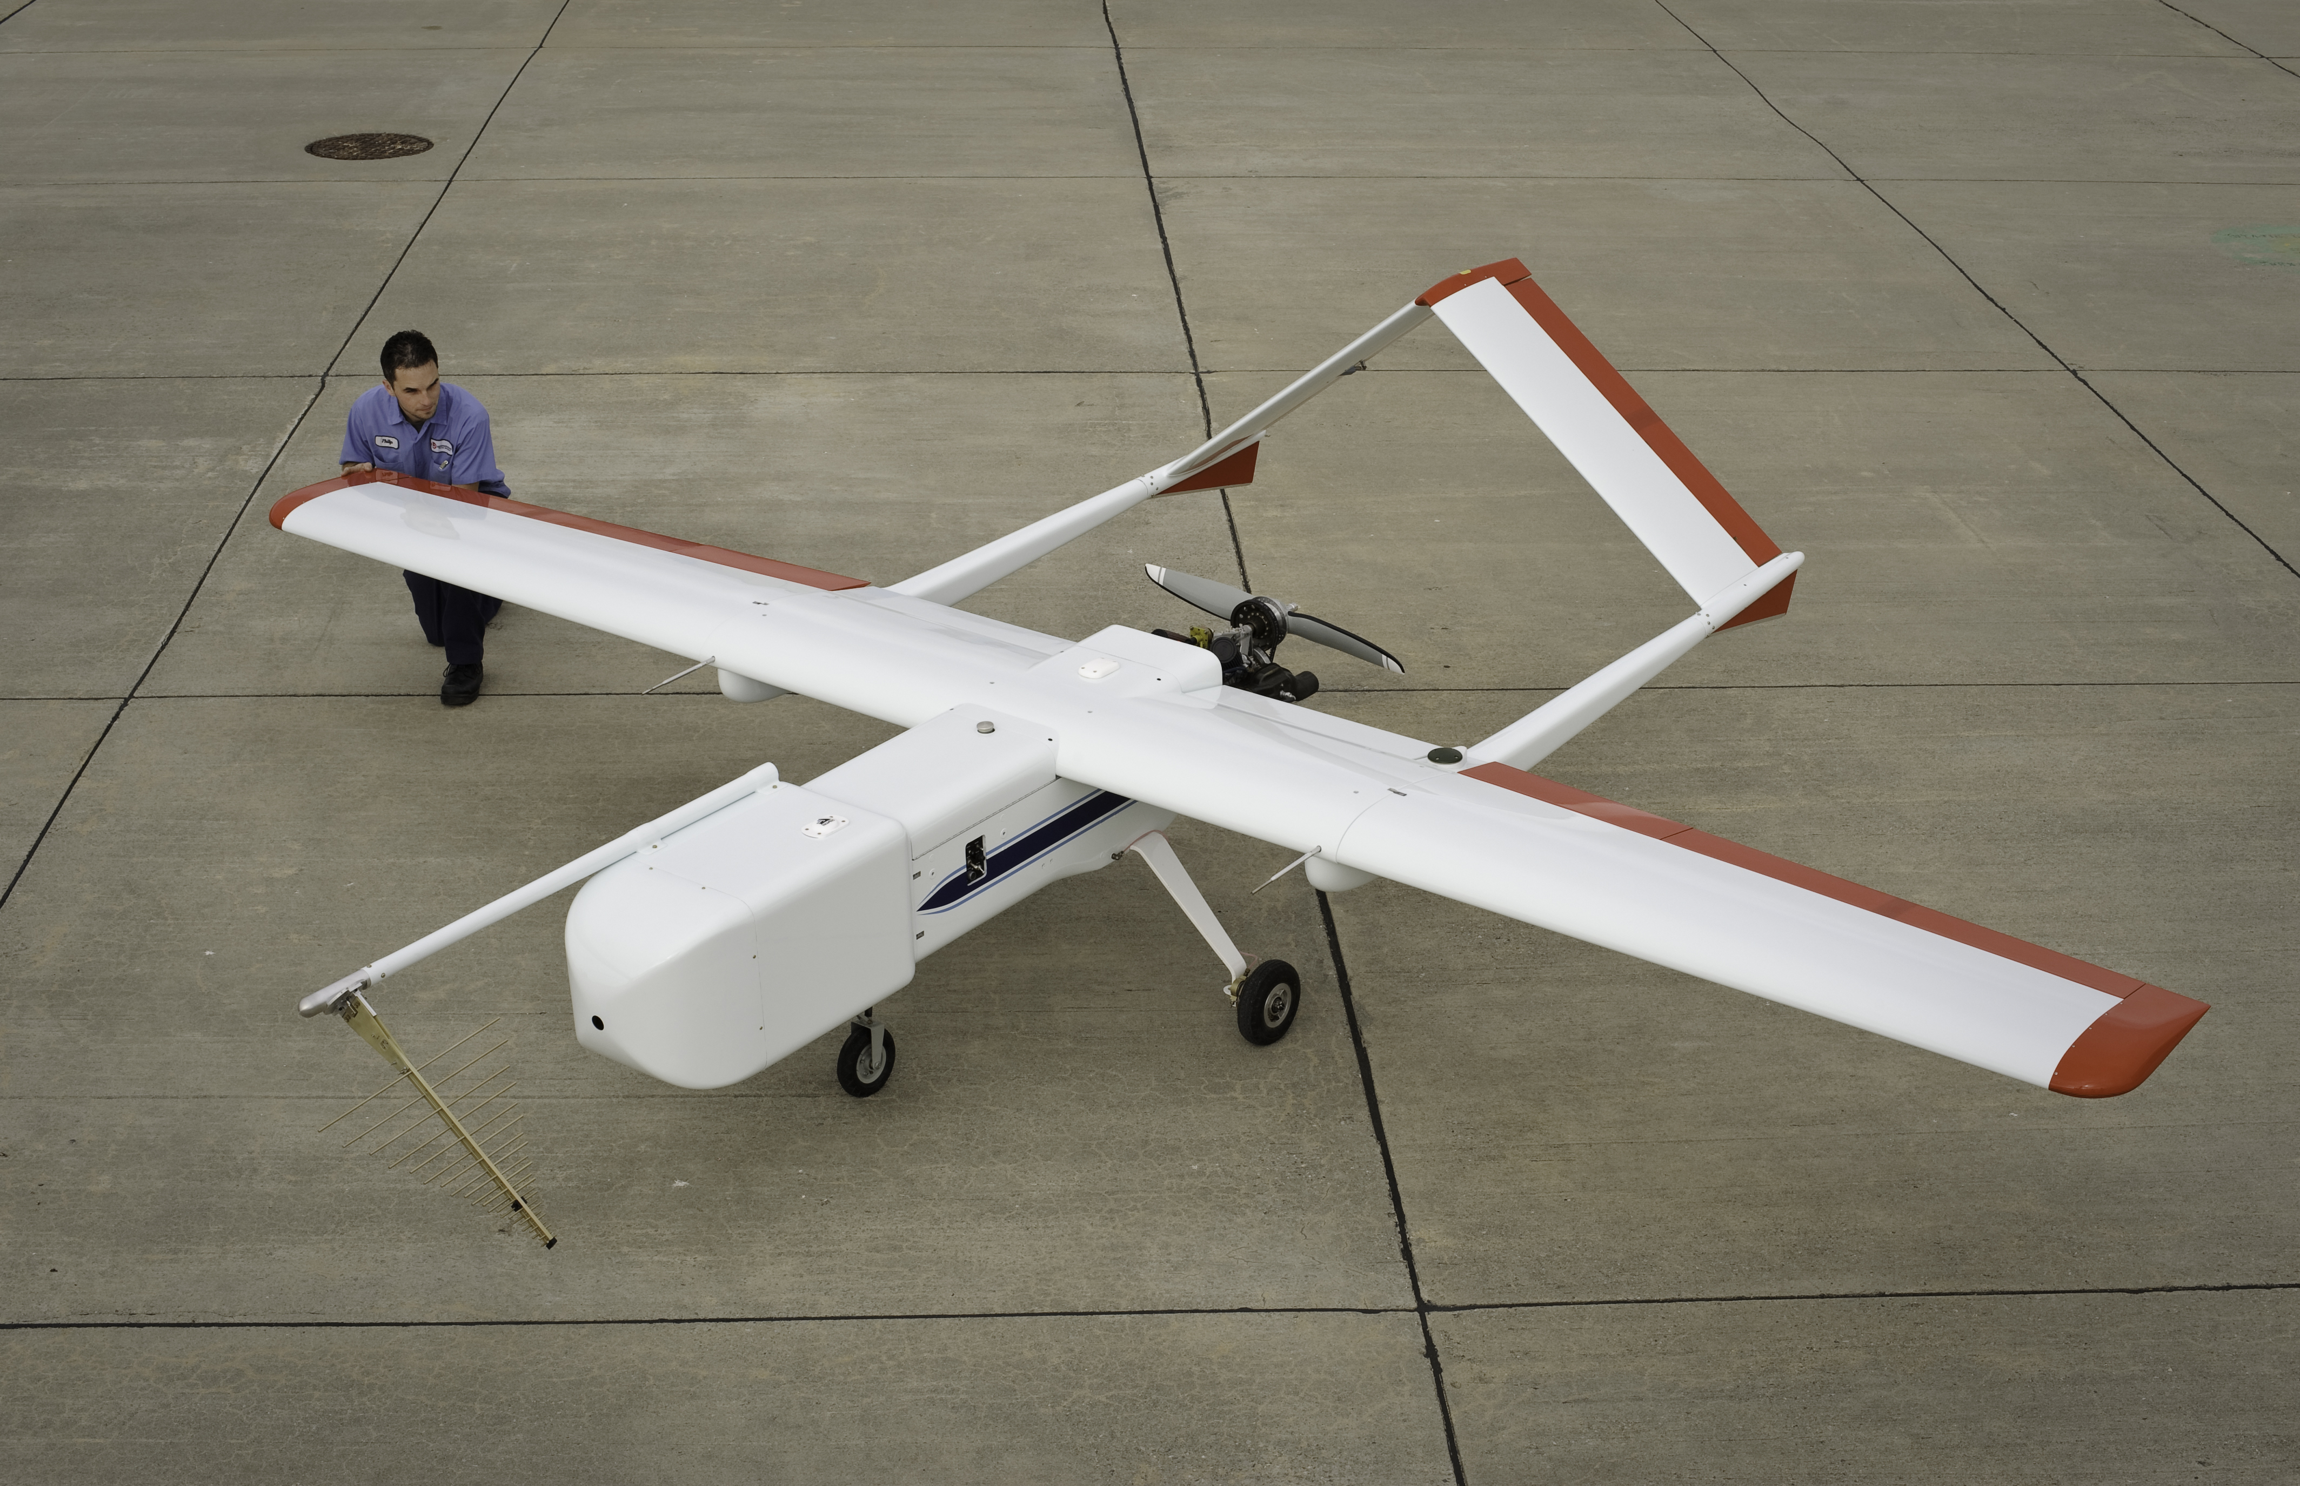

SIERRA complements other UAVs in the NASA science fleet specializing in dangerous, low altitude missions that require larger payload capacity than typical small UAVs
Airframe designed by NRL; systems development and integration at NASA Ames
First Flight October 2008
Payloads flown include:
  VIS/NIR Hyperspectral Imager (NASA Ames)
  LIDAR Profilometer (CU-Boulder)
  Ocean Color suite (NASA GSFC)
  MMS (NASA Ames)
  CO2/CH4/H20 (Los Gatos Research/Picarro)
  C-Band SAR (Artemis/BYU)
  UHF/L-band SAR (Mirage Systems)
  Flux-gate Magnetometer (Geometrics)
Phil Schulyer, SIERRA crew chief with the aircraft carrying a GP-SAR antennae and modified nose
Wing Span
Length
Height
Wing Area
Empty Weight
Gross Weight
Max Speed
Cruise Speed
Stall Speed (clean)
Aspect ratio
Rate of Climb
CG Position
Payload weight
Payload power
Duration
20 ft.
11.8 ft.
4.6 ft.
42.4 sq. ft.
215 lbs.
375 lbs.
79 kts.
55 kts.
30 kts.
9.43
545 ft./min.
29-32% Chord
~100lbs
28V DC
8-10 hrs

Slide 9
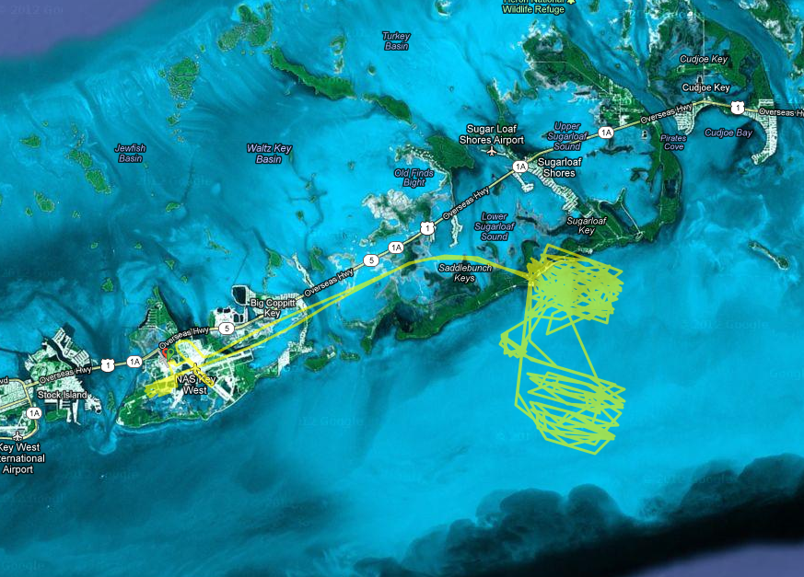
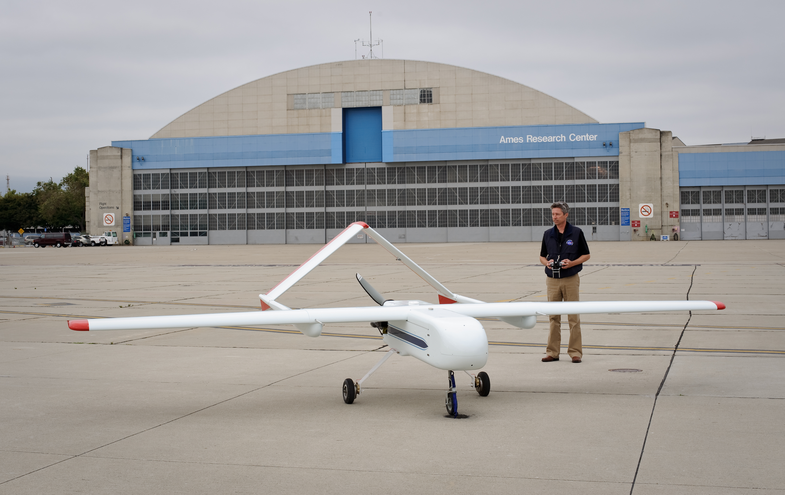
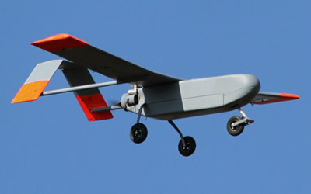

High Resolution Assessment of Carbon Dynamics in Seagrass & Coral Reef Biomes Project (Seagrass/Coral Reef)
PI: Stan Herwitz
Current Status:
Completed first deployment to Florida Keys with the BAT 4 carrying a multi-spectral camera
Imagery from manned A/C was also collected
In water teams provided calibration support
Currently deployed to Florida and operating SIERRA from the Key West Naval Air Station
Flight lines from Oct 17th off of Key West FL.
Project Schedule (2012-2013):
May 13-24 – Sugarloaf Shores
Oct 18-28 – Sugarloaf Shores
Jan 8-20 – Tobago, Buccoo Reef
May 15-26 – Sugarloaf Shores (contingency mission)
MLB BAT 4
NASA SIERRA
Acrylic chamber deployed in seagrass bed (left) and SHARQ benthic incubation chamber deployed in coral reef biome (right).

Slide 10
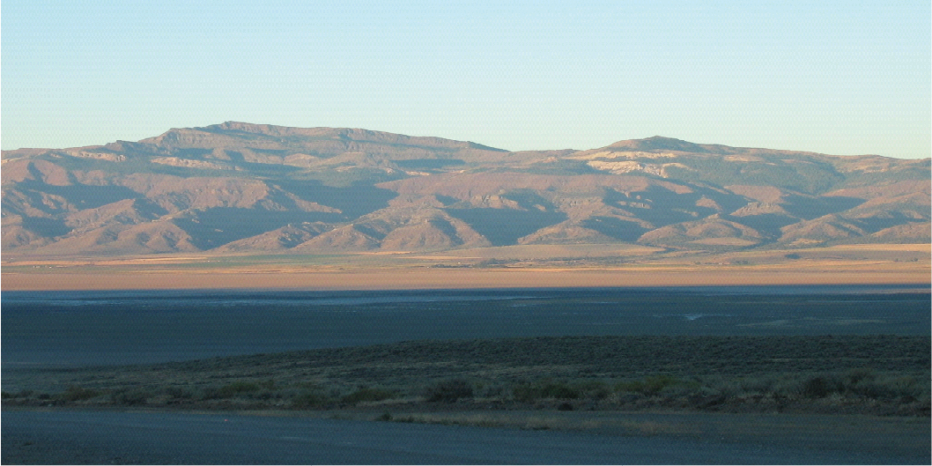
Resolving subsurface geology and structures with UAS-borne magnetics: Earthquake hazard and geothermal resource studies
U.S. Geological Survey
NASA Ames
Carnegie Mellon University
Central Washington University
September 2012

Slide 11
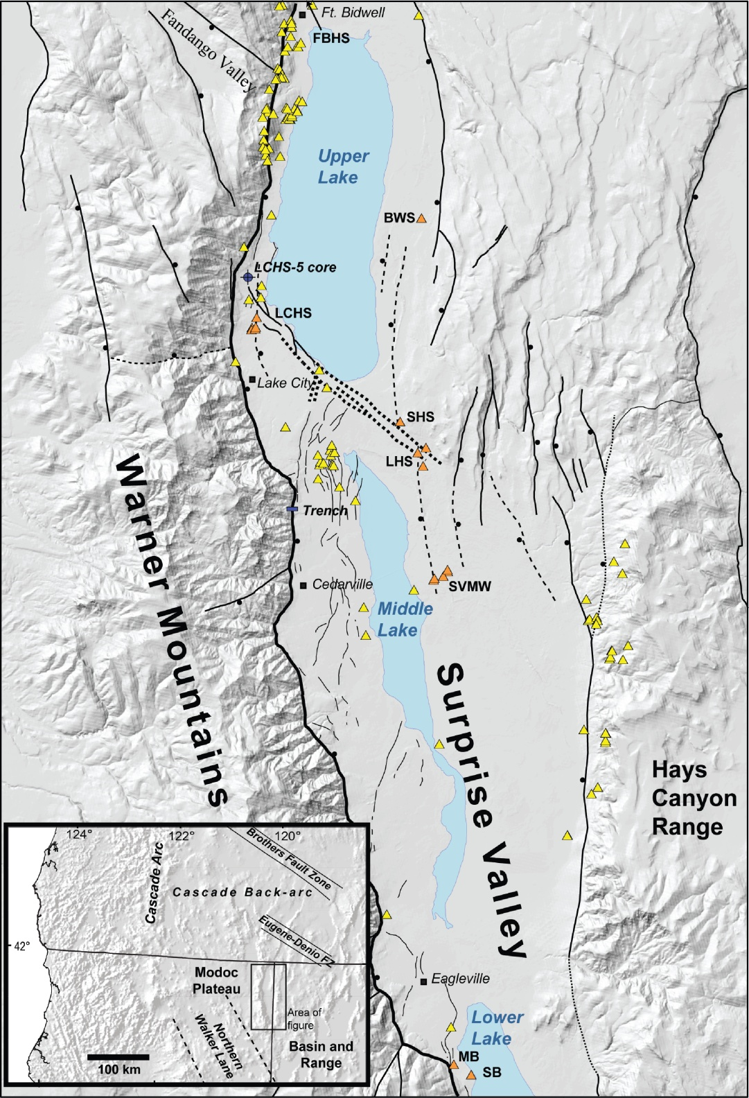
Study area: Surprise Valley
spring
hot spring

Slide 12
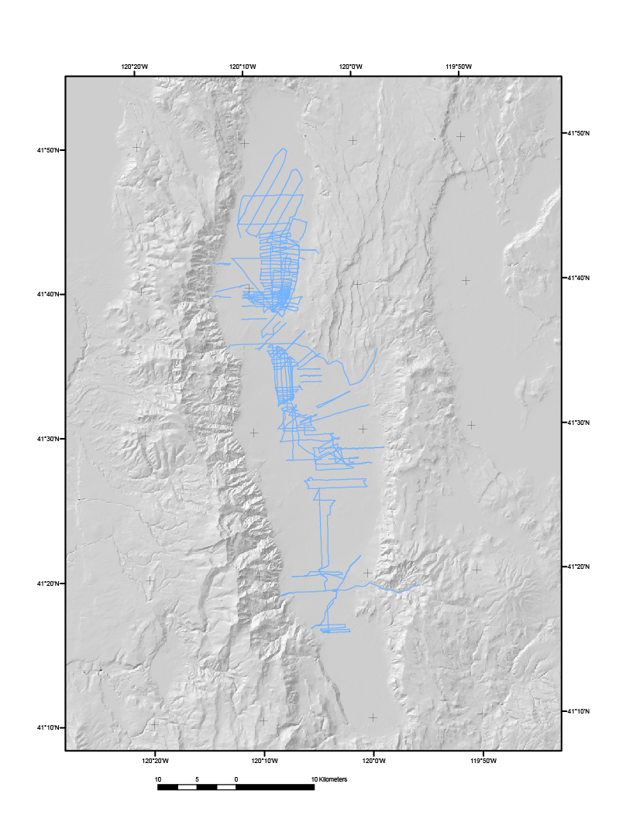
Existing ground magnetic paths
3 Seasons
Total line: 1043km
Walked 279km
Suburban 80km
ATVs 684km

Slide 13
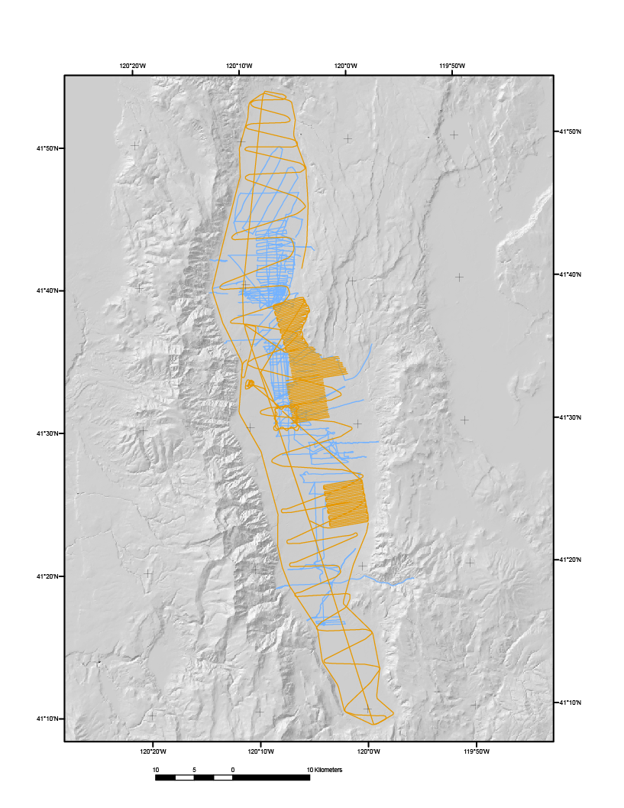
Ground and UAS magnetic paths
UAS
Ground
Total ground: 1043km
3 seasons (~8 weeks)
Total UAS: 1183km
3 days

Slide 14
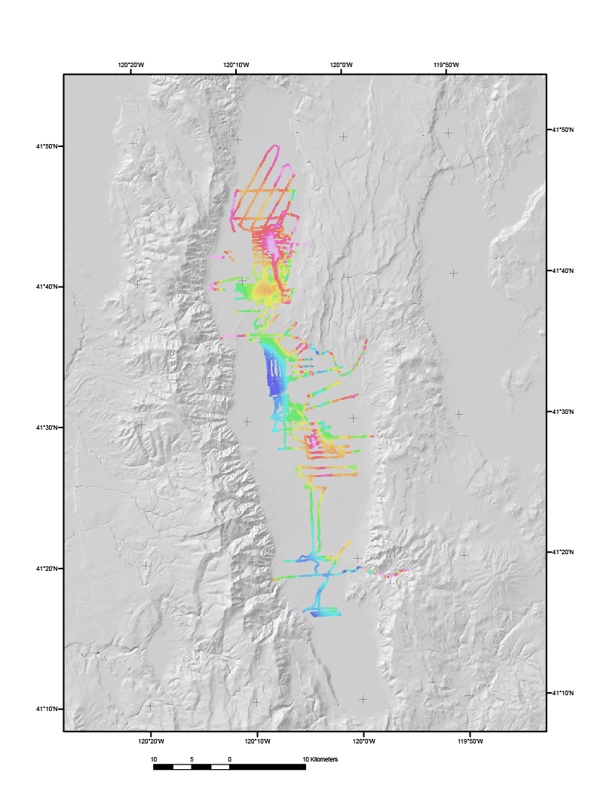
Ground magnetic map

Slide 15
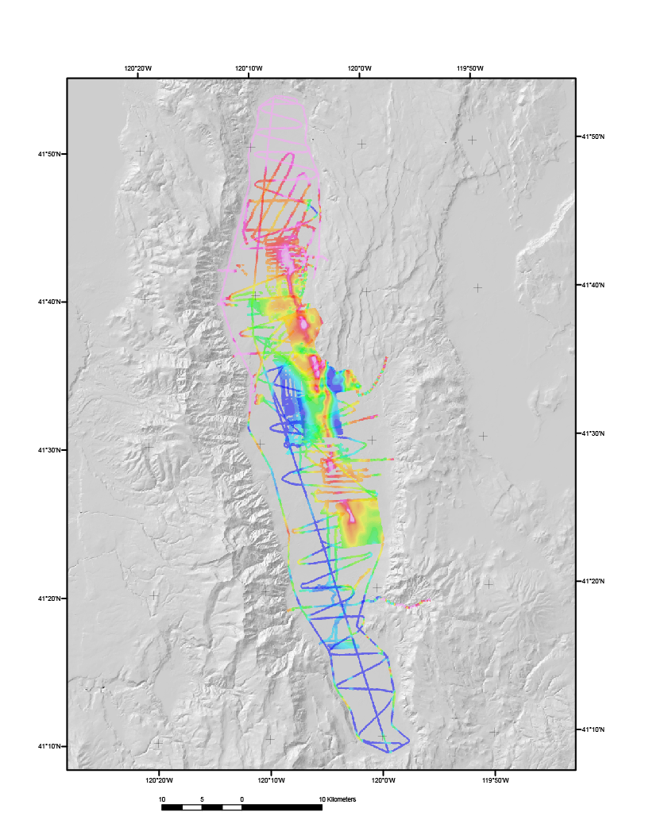
Ground and UAS magnetic maps

Slide 16
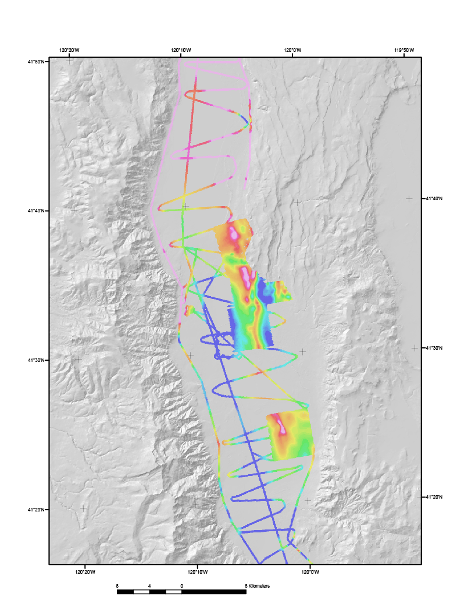
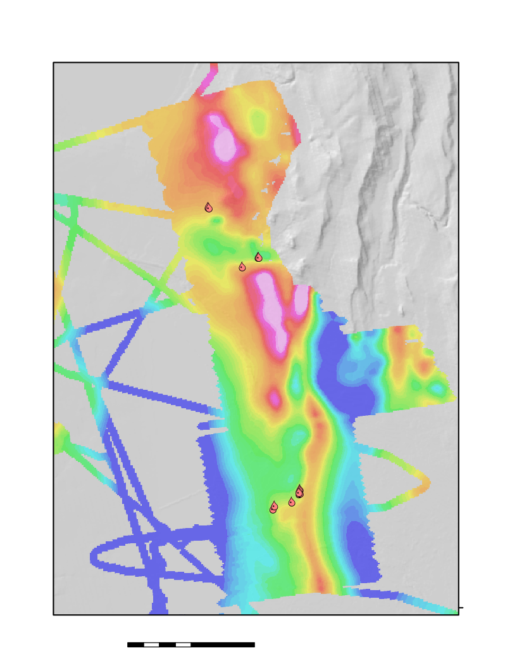
SIERRA UAS magnetic survey
Detailed UAS survey reveals that hotsprings are located at structural breaks along basin magnetic high
Seifert Hotsprings
Leonards Hotsprings
Surprise Valley Hotsprings
0
1
2 km

Slide 17
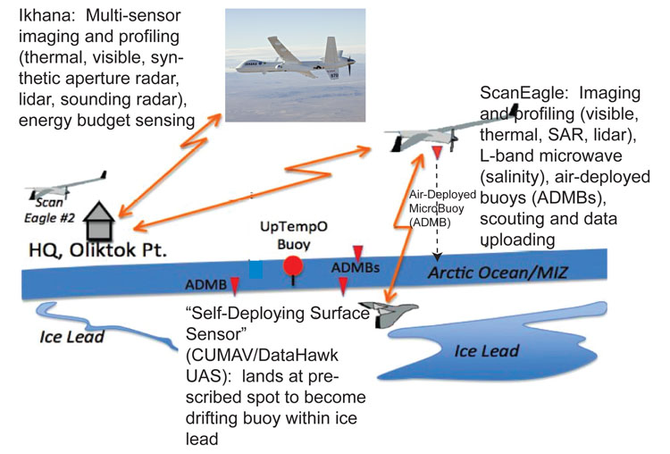
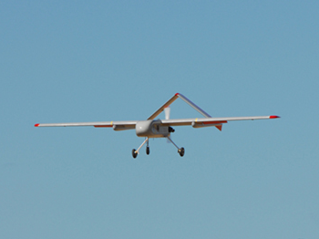
MIZOPEX Concept of Operations Over the Beaufort Sea:
SIERRA flies long-range transects along straight-and-level tracks co-located with satellite overpass tracks.
ScanEagles focus on detailed, sustained observations at low altitude over more localized locations, including dropping “air-deployed micro buoys”.
DataHawk “Self-Deploying Surface Sensor” (SDSS) mini-UAVs are launched on one-way flights to land on water and deploy sensor strings.
ScanEagle and DataHawk UAS include safety aspects such as lost-comm procedures and failure modes.
Both UAS have considerable history of safe use, with ScanEagles having accumulated 10’s of thousands of flight hours.

Slide 18
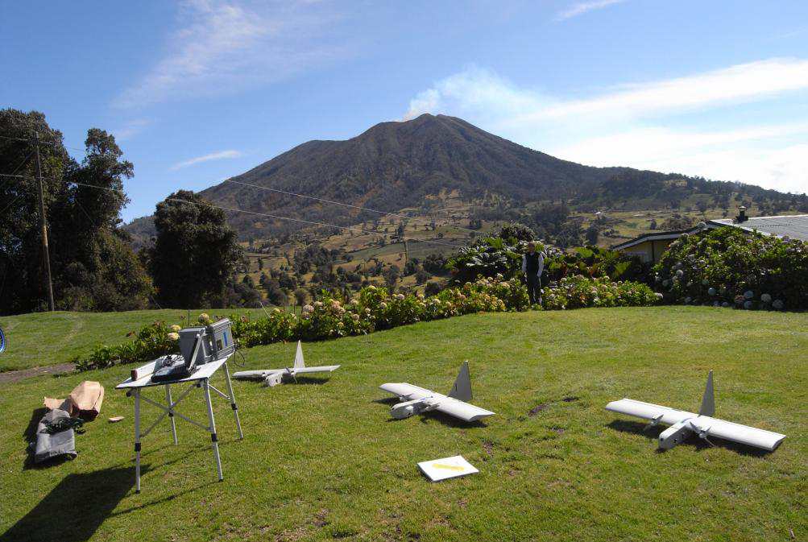
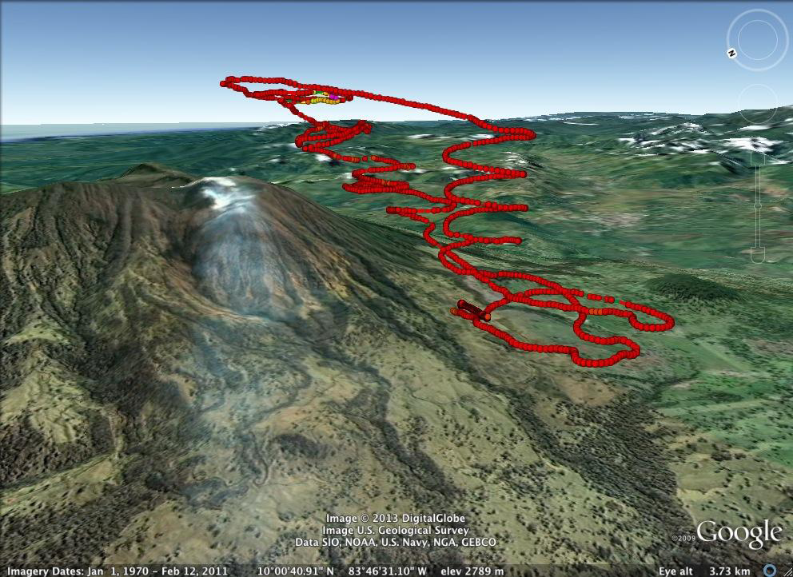
Dragon Eye Deployment to Turrialba Volcano in Costa Rica in Support of ASTER SO2 Data Product Validation
The RQ-14 Dragon Eye sUAVs were recently acquired by Ames from the U.S. Marine Corps via GSA to support this mission—good example of civilian repurposing of military hardware
Flights occurred from March 10-13, 2013
5 science flights with SO2 sensor and 1 science flight with thermal camera (7-12µm band)
SO2 concentrations of ~6-20 ppm were detected throughout the day
Collected measurements in the volcano plume coincident with an ASTER overpass
Expanded flight envelope up to 12,500 ft ASL from 8,000 ft ASL published operational ceiling
Next deployment in 2014 will include the ARC SIERRA UAV carrying a mass spectrometer and other instruments + Dragon Eye
Funded by NASA Earth Surface & Interior Focus Area (John Labrecque) and the University of Costa Rica (Prof. Jorge Andres Diaz, Co-I)
US Flight Team from JPL, ARC, WFF
Other participants/advisors
  Applied Sciences University Düsseldorf (Germany)
  RadMet LLC (Redwood City, CA)
  Teledaq LLC (Santa Clarita, CA)
  Aerovironment, Inc. (Monrovia, CA)
Principal Investigator: David C. Pieri (JPL)

Slide 19
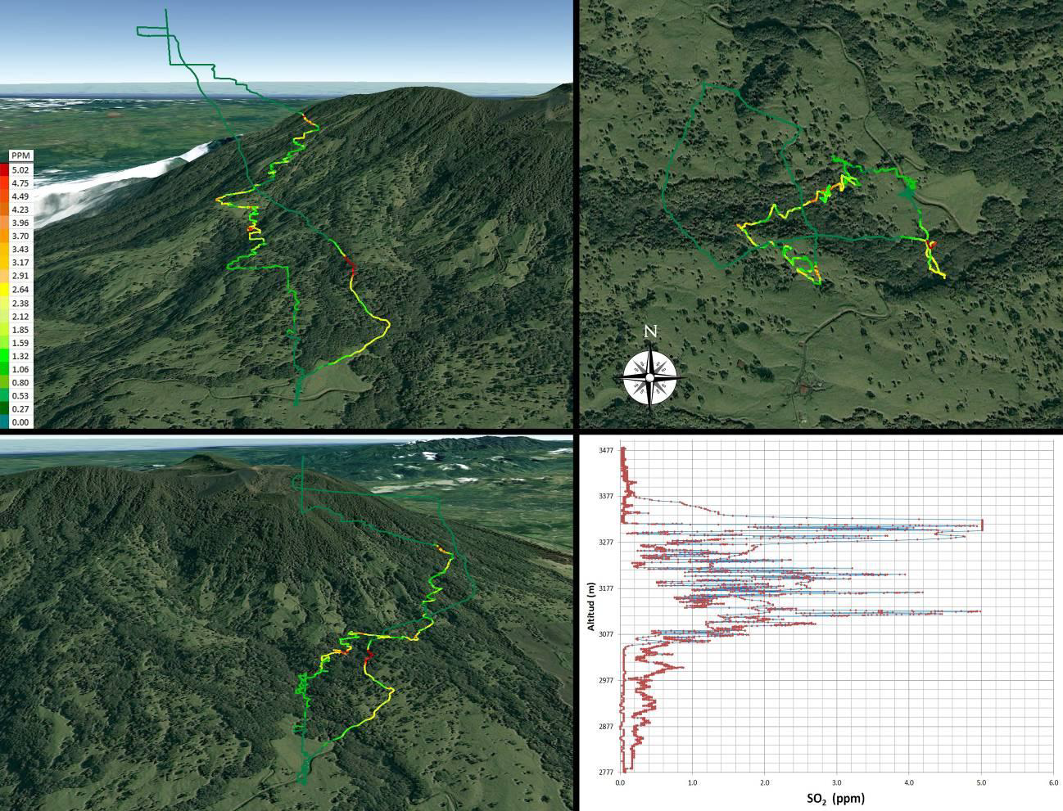
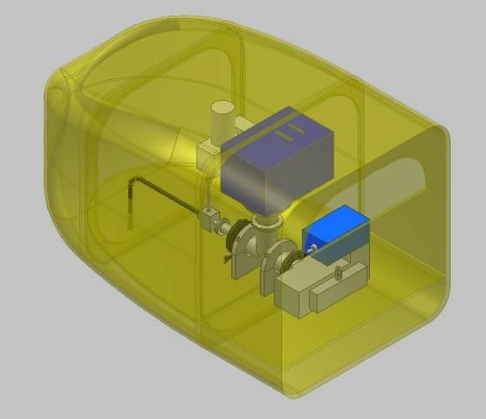
In-Situ Chemistry of Volcanic Plumes
Balloon-borne 3D in situ volcanic plume SO2 concentration data for Turrialba Volcano Feb. 1, 2012 (red in the GPS traces indicates the highest SO2 concentrations--around 5ppmv)

