Slide 1
2013 Seasonal Outlook
Chris Waters
Battalion Chief – Predictive Services
Sacramento HQ

Slide 2
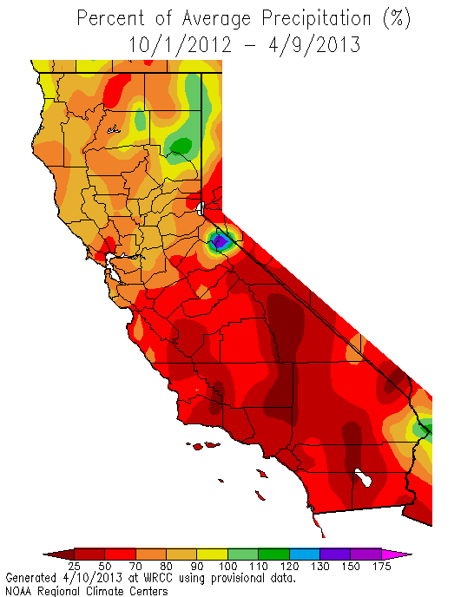
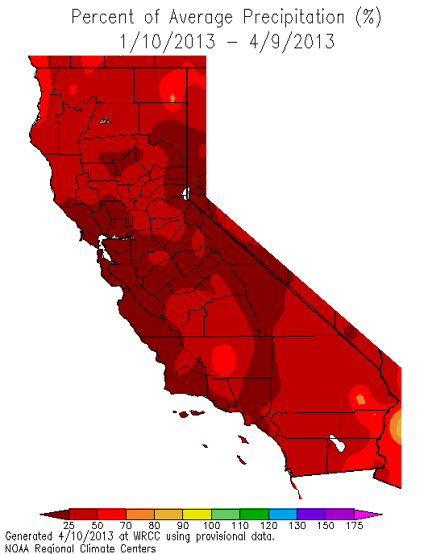
Percent of Average Precipitation
SINCE OCT 1
PAST 90 DAYS

Slide 3
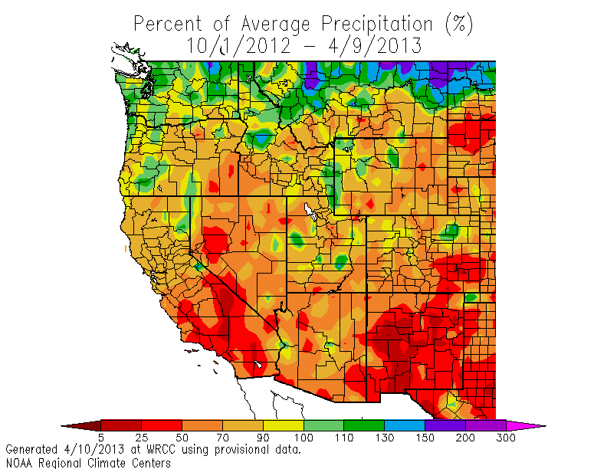
Western US % of Average Precipitation
SINCE OCT 1

Slide 4
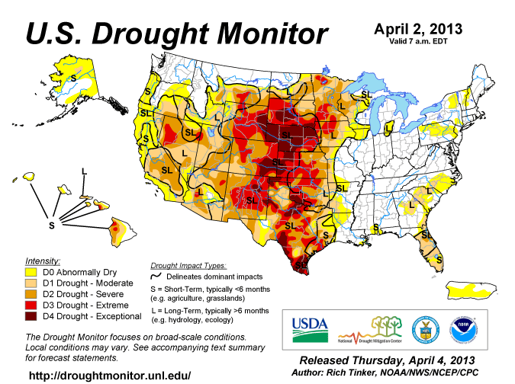
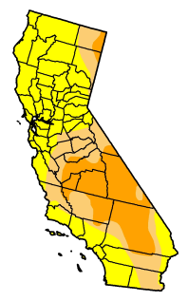

Slide 5
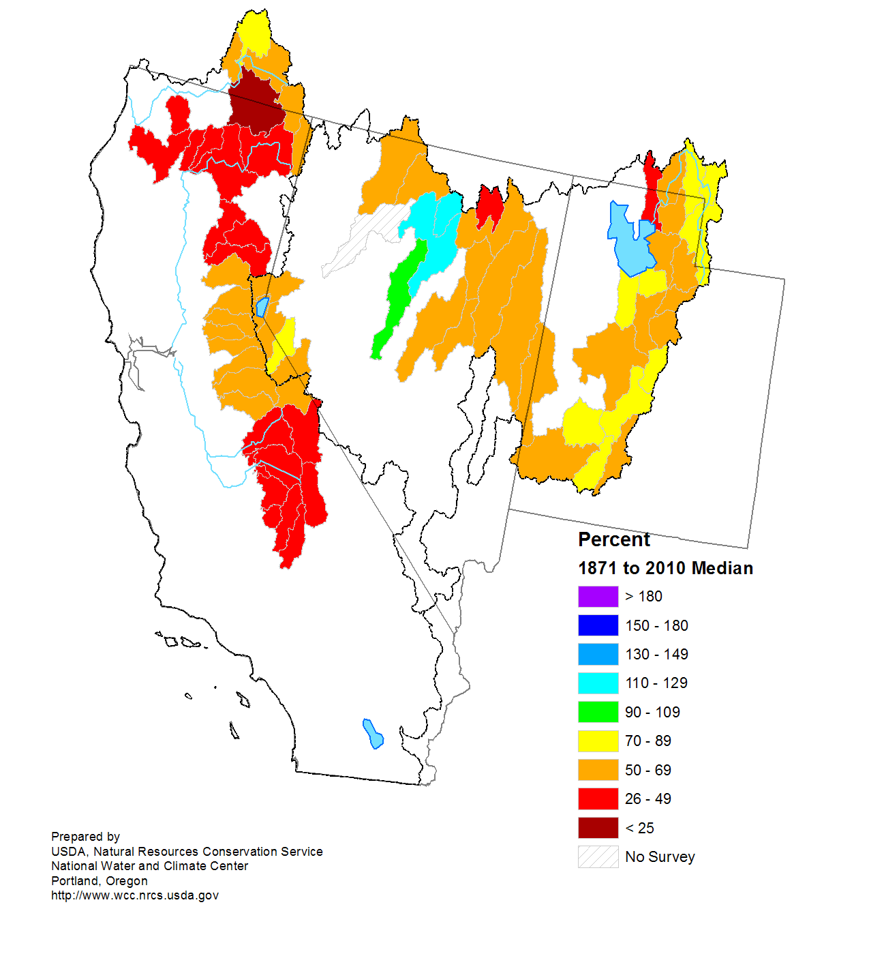
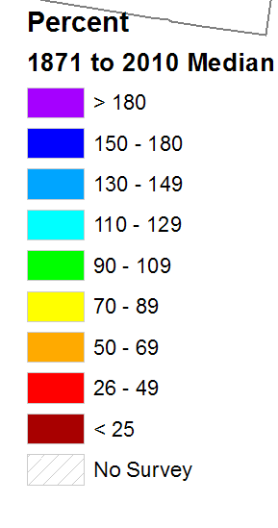
Mountain Snow Pack as of April 1

Slide 6
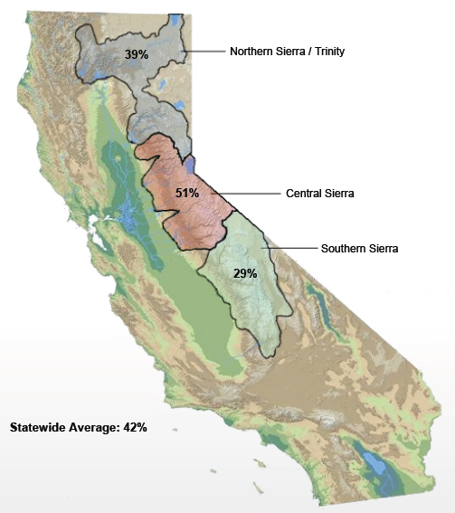
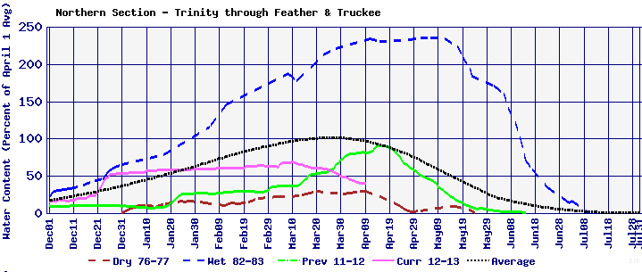
Automated Station Snowpack Through Early April 2013
’82-’83
AVE
2011-2012
2013
’76-’77

Slide 7
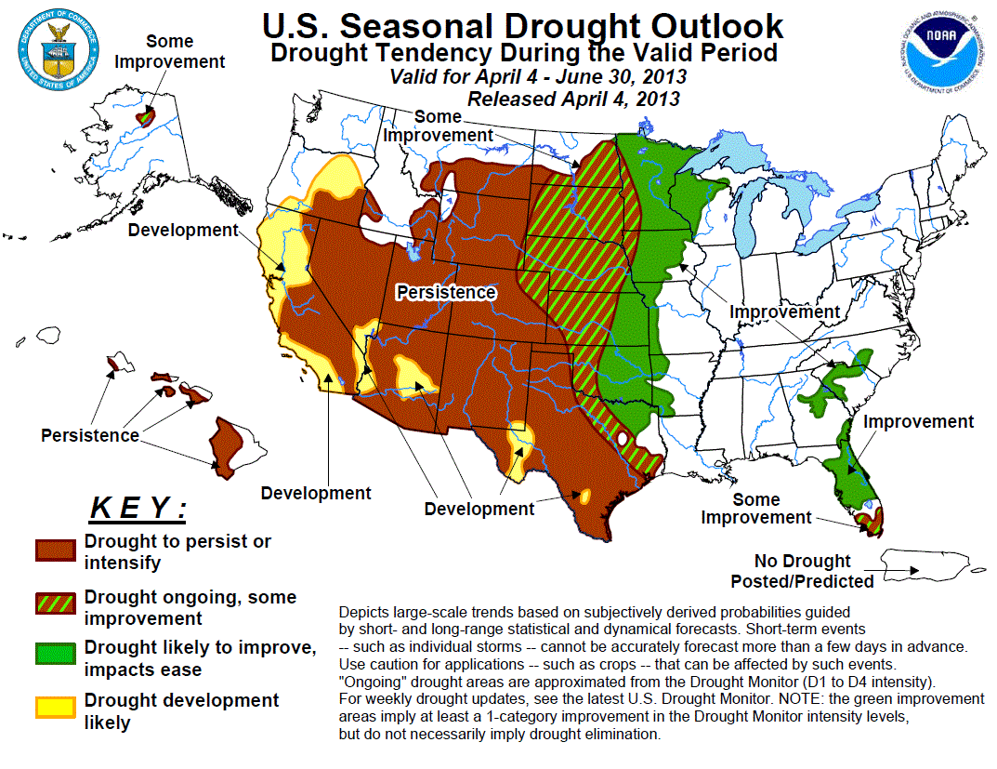

Slide 8
Where We Are, Where We’re Headed
Snowpack water low, varies from ~25-70% of average
Record dryness occurring in some areas early this year
Poor new grass crop in NE from precip lacking
Drought development seems likely
Preliminary signals indicate an above normal Fire Season in all NOR CAL mountain areas
Catch the OFFICIAL seasonal outlook end of April
http://gacc.nifc.gov/oncc/predictive/outlooks/index.htm

Slide 9
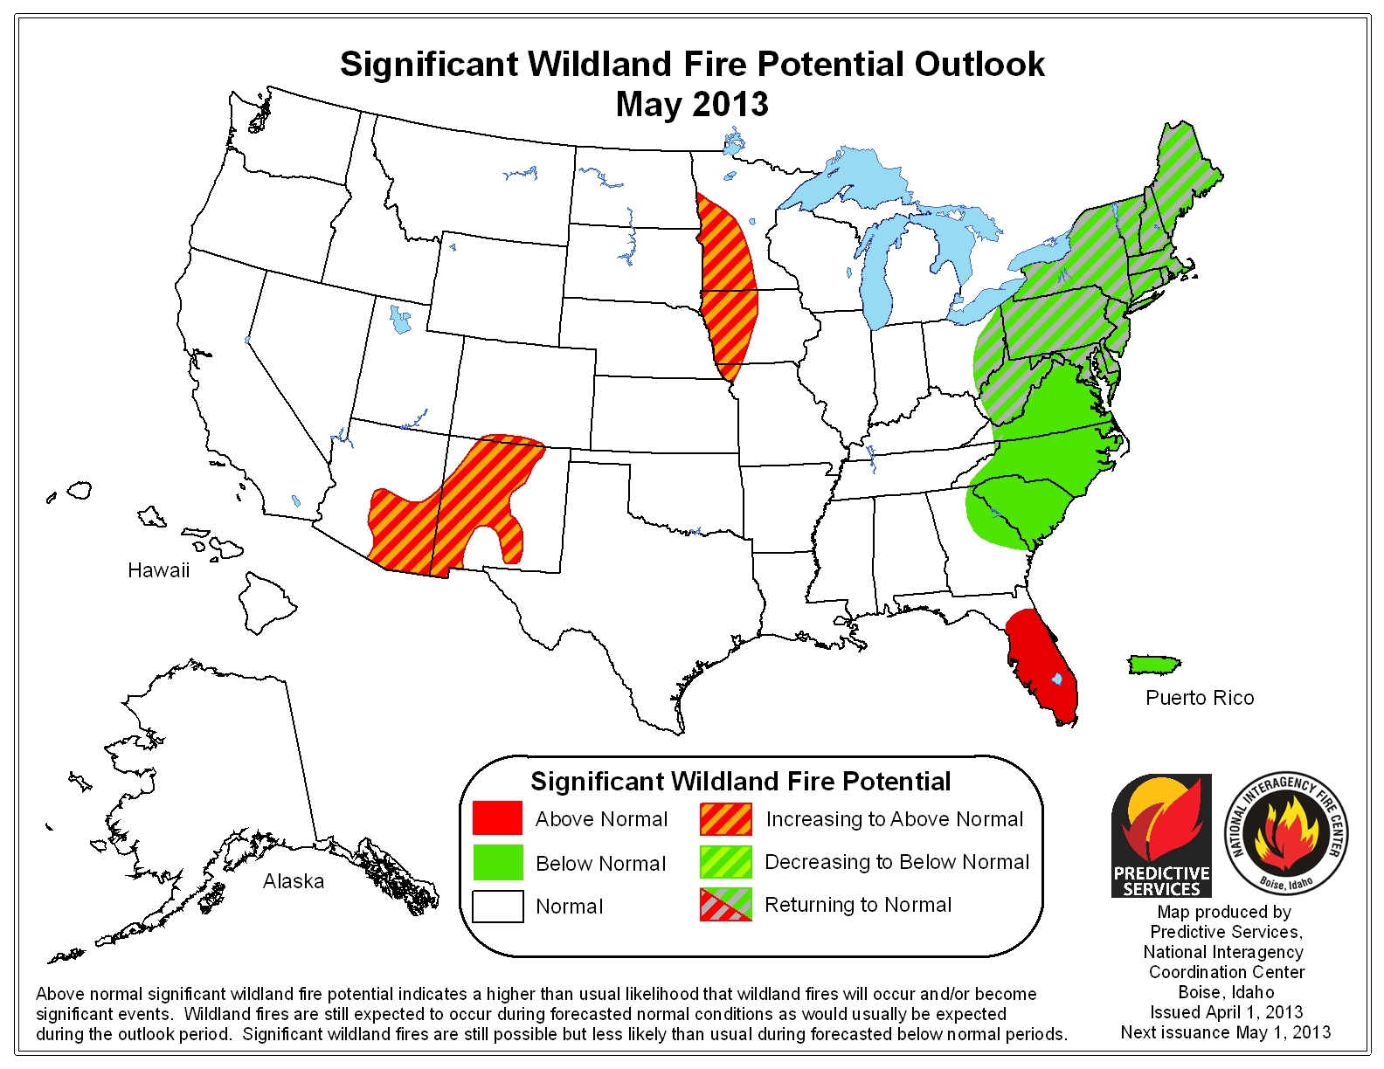
May 3013

Slide 10
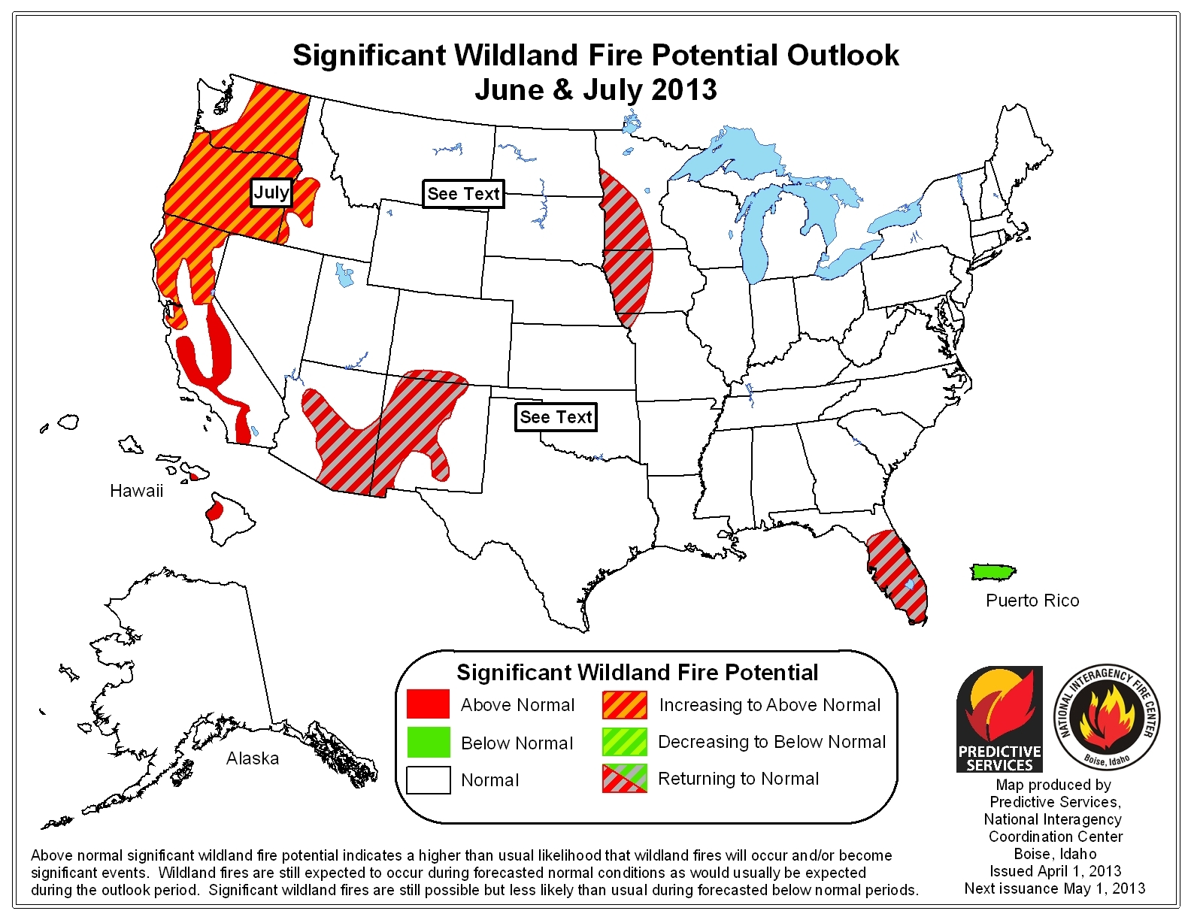
June – July 3013
QUESTIONS?

