Slide 1
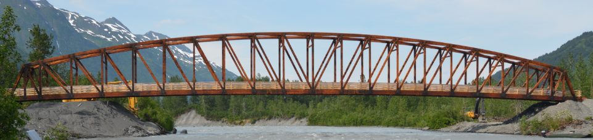



USFS Placer River Trail Bridge Inspection
Using Unmanned Aircraft Systems
Tactical Fire Remote Sensing Advisory Committee
Spring Meeting / May 27-28, 2015
Mark Riley, Forest Service, Juneau, AK
Rodney Dell’Andrea, Forest Service, Juneau, AK
Robert Goetz, Forest Service, Juneau, AK

Slide 2
Unmanned Aerial System
Unmanned Aerial Vehicle
Uninhabited Aerial Vehicle
Uncrewed Aerial Vehicle (Un-crude!)
Drone
Remotely Piloted Aircraft

Slide 3
Goals
Evaluate UAS capability to perform bridge infrastructure inspections and compare the results to USFS conventional techniques.
Minimize risk to inspection personnel associated with conventional techniques.
Contribute to the development of FAA and Forest Service UAS policy and guidelines.
Use dense Structure from Motion (SfM) image processing techniques to produce a measurable 3D wireframe and raster bridge model.
Notes:
Capabilities to evaluate:
flight characteristics in various environmental conditions;
ability to maneuver in tight spaces;
capture high definition photos in all 3 axes;
alternative to “arms reach” visual inspections (i.e. rope climbing, specialized equipment);
inspection costs;
suitability for wide range of infrastructure (bridges, dams, towers, tramways, etc,).
Typical risks: falls, impacts, debris, chemicals, confined spaces, insects, snakes, etc.
Working within the framework of the FAA approved “Alaska UAS Test Site”. This test site became operational on May 5, 2014. The University of Alaska proposal contained a diverse set of test site range locations in seven climatic zones as well as geographic diversity with test site range locations in Hawaii and Oregon. The research plan includes the development of a set of standards for unmanned aircraft categories, state monitoring and navigation. Alaska also plans to work on safety standards for UAS operations.

Slide 4
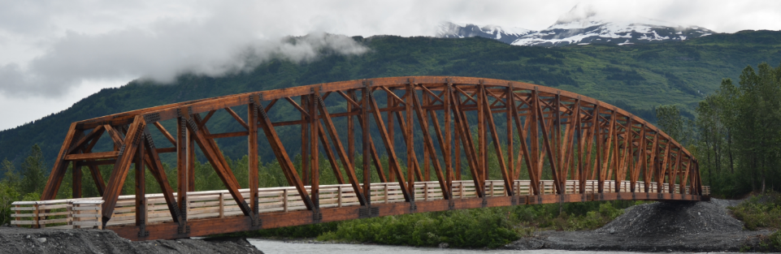
About the bridge
Longest clear-span glue-lam timber truss pedestrian bridge in North America at 280 feet
Design service life of 50-years
Anticipated operational service life of 75-years

Slide 5
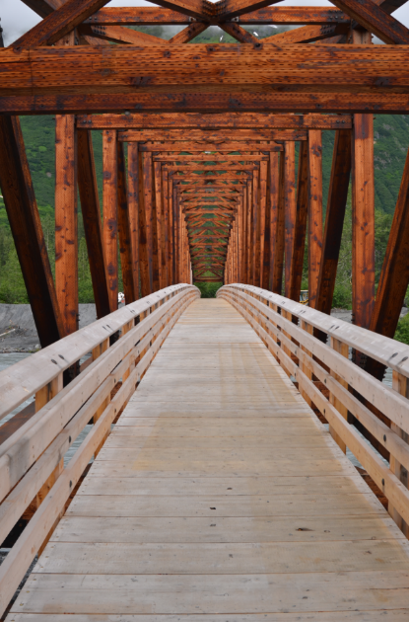
About the bridge
Completed in July 2013
Managed for pedestrian use
Remote site;
accessible via Alaska Railroad
Camelback truss design;
  280’ long, 15’ wide, 6’ walkway
Pedestrian load - 90 psf
Ground snow load - 250 psf
Dead Weight - 275,000 lbs
Weathering steel used for truss member connections
Alaska Yellow-Cedar decking and barrier rail system

Slide 6
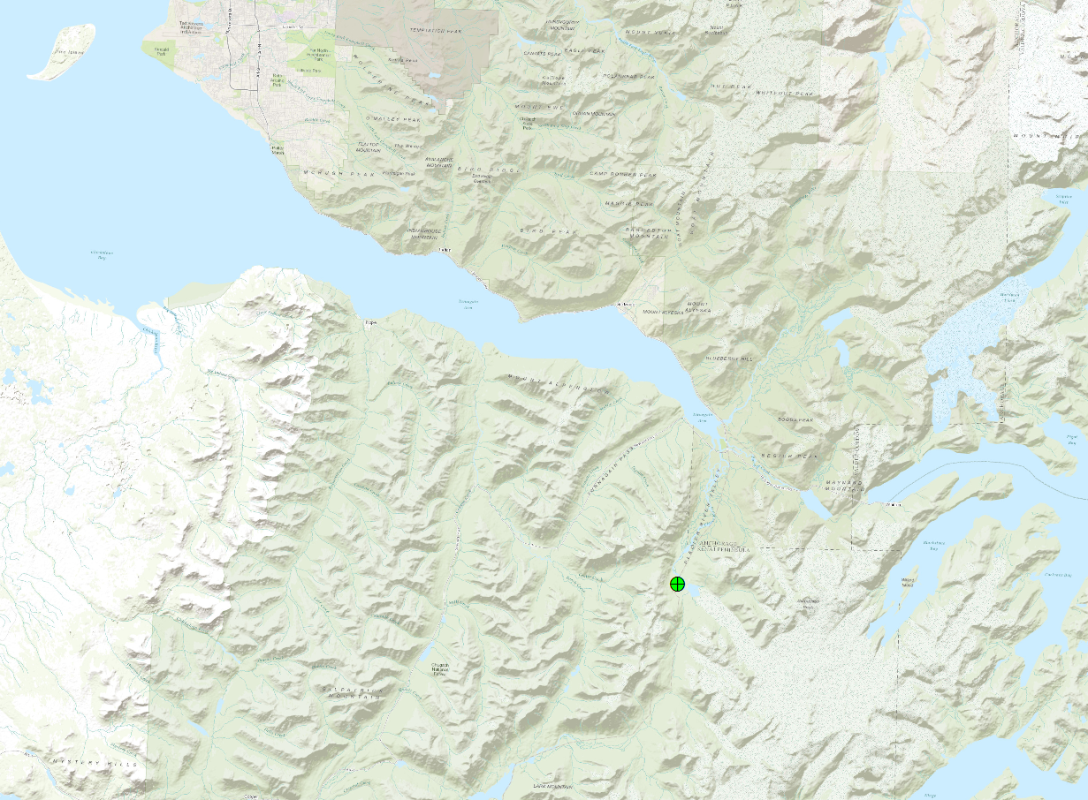
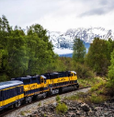
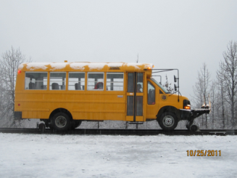
Location
Anchorage
89-km (55 miles) south of Anchorage
Access using Whistle Stop train or rail bus
Girdwood
Placer River Trail Bridge

Slide 7
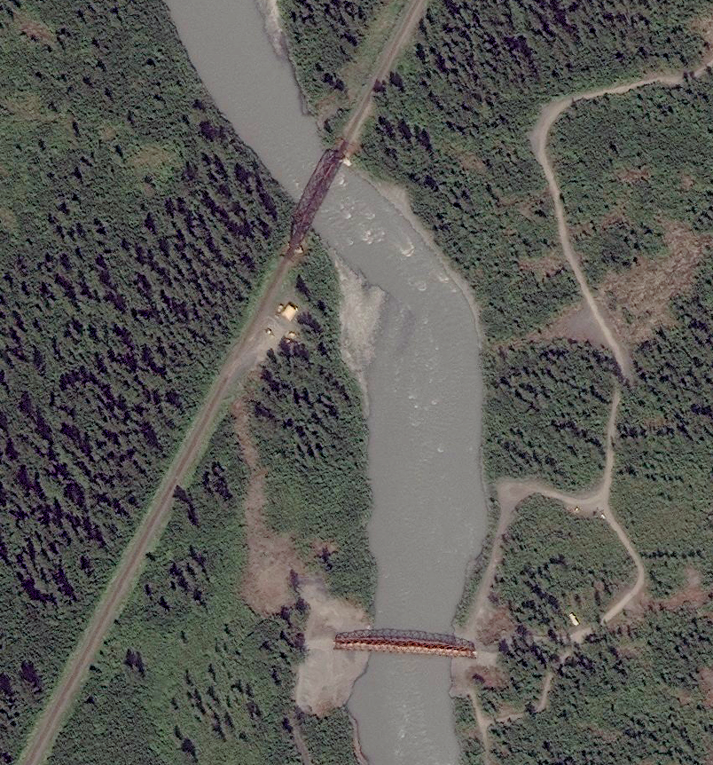
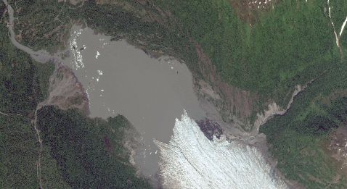
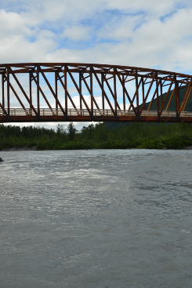
Location detail
Placer River Trail Bridge
Alaska Railroad Bridge
2 miles
Spencer Glacier
230-meters (750-ft)
Sufficient design height over Placer River to avoid collision with ice flowing from Spencer Glacier
Worldview-2 July 13, 2013
Notes:
Mirror and not compete with visual morphology of AK railroad bridge, which is just downstream.

Slide 8
Bridge inspections
Three inspection methods are used for bridges:
Visual – Primary Method
Physical – Implemented because of concerns identified during visual examination
Advanced – Specialized training and expertise may be required
A UAS is well-suited to complete a Visual Inspection.
Notes:
“Arm’s length” requirement for special scheduled inspections on steel structures with fracture critical members, i.e. “A steel member in tension or with a tension element whose failure would probably cause a portion of or the entire bridge to collapse.”
If member should fracture in direction of tensile stresses and propagate it will rupture: no load path redundancy.

Slide 9
Bridge inspections
Inspection types which can be performed with UAS:
Initial, Routine
Fracture Critical
In Depth, Damage, Special
Inspection Types which cannot be performed with UAS:
Under Water
Need to inspect and photo document whole structure, regardless of material; especially hard-to-reach top, sides, understructure, and enclosed spaces.
Notes:
Initial - Performed as the first inspection for new structures, or for structures that have been modified or have changed ownership.
Routine - Normally performed at regular intervals (Typically not to exceed 24 months for highway bridges).
Fracture Critical – Steel members in tension or with a tension element, whose failure would probably cause a portion of, or the entire bridge to collapse are considered fracture critical. These members are required to receive hands-on inspection every 24 months.
In-depth - Generally require special equipment or procedures to evaluate deficiencies not readily detectable during a routine inspection.
Damage - Performed to assess structural damage from a collision or environmental actions.
Special - Performed at the discretion of the bridge owner, usually to monitor a specific condition or deficiency.
Underwater - Performed regularly at intervals (Typically not to exceed 60 months for highway bridges)
“Arm’s length” requirement for special scheduled inspections on steel structures with fracture critical members, i.e. “A steel member in tension or with a tension element whose failure would probably cause a portion of or the entire bridge to collapse.” If member should fracture in direction of tensile stresses and propagate it will rupture: no load path redundancy.

Slide 10
Inspection DETAILs
Bridge components are inspected for:
Delamination & Cracking
Traffic wear & rutting
Hardware Corrosion – bolts, nuts, washers, brackets, flanges, fasteners, etc.
Loose Connections
Surface stain & oil
Insect damage
Rot, decay, spongy areas, and fruiting bodies
Scour at foundations and piers
Notes:
Components:
Primary – Truss chords, web members, floor beams, purlins, deck;
Secondary – Sway frames, top and bottom chord bracing;
Other – Bearing seats, hangers, plates, fasteners.

Slide 11
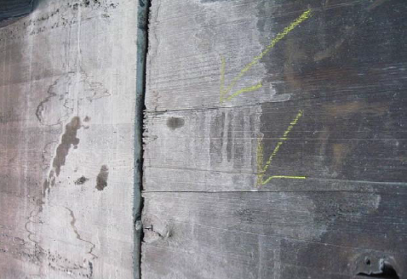
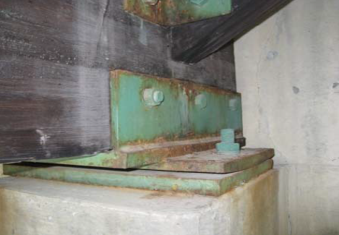
COMMON FINDINGS
Girder - splitting and water staining
Rocker Bearing - paint failing, surface rust

Slide 12
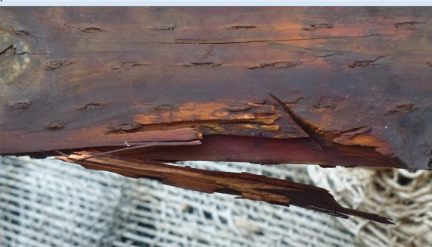
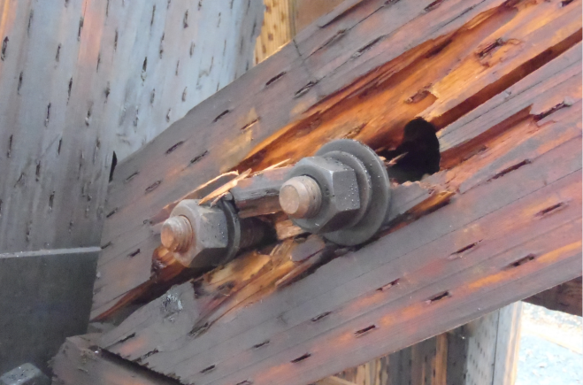
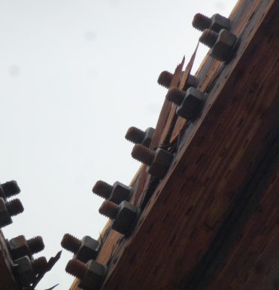
COMMON FINDINGS
Construction Damage

Slide 13
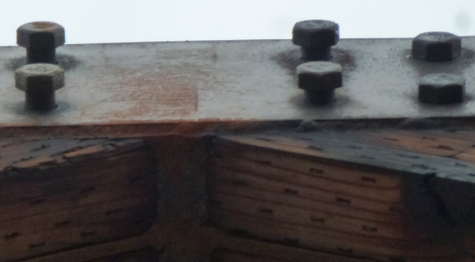
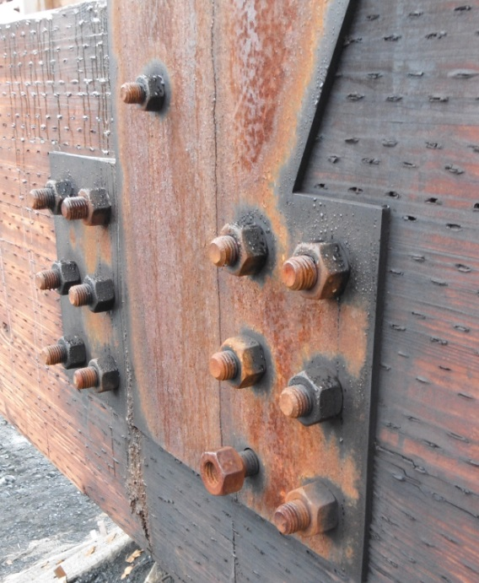
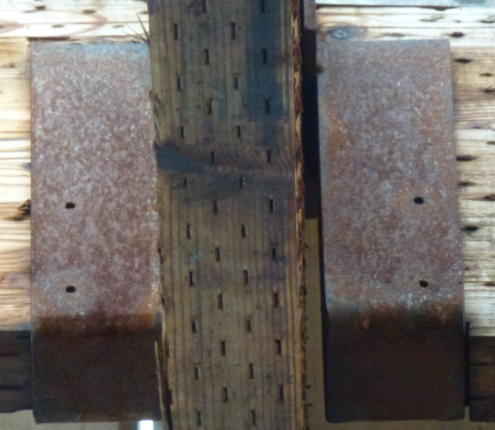
COMMON FINDINGS
Missing or Loose Fasteners

Slide 14
Conventional methods
Methods and Tools
Direct observation (line-of-sight)
Binoculars, spotting scope, camera with zoom lens
Climbing (may require specialized rope training)
Fiber Optic inspection camera, e.g. Dewalt DCT410S1
Wireless camera control, e.g. CamRanger
Disadvantages
Time consuming: can take several days
Additional specialized training may be needed
Specialized and bulky equipment
Can put inspector in life-threatening situations
Costly
Variable effectiveness
Notes:
Variable effectiveness depending on inspector, potential time, weather, budget and cost constraints
Binoculars, spotting scope, camera with zoom lens – optics to aid human eye

Slide 15
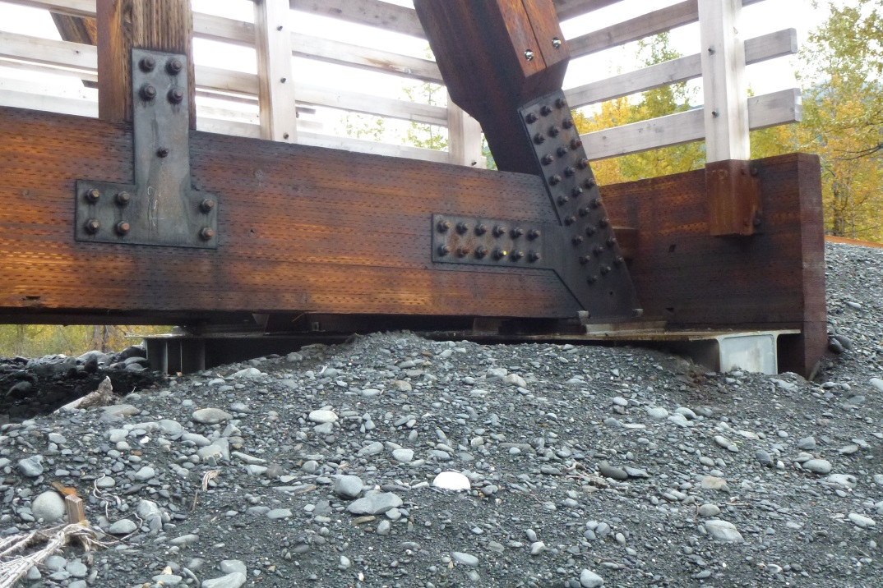
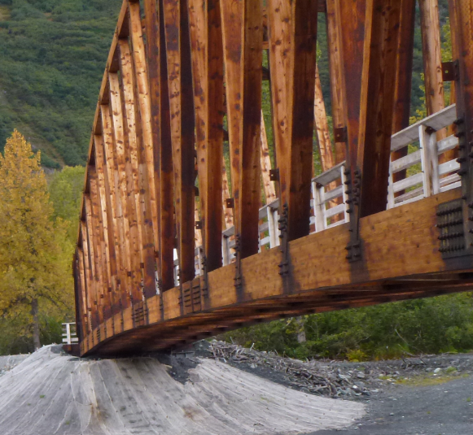
Conventional methods
Direct Observation
Inspection limited to what can be observed from the bank or on the deck.
Hard to reach areas constitute most of the structure.

Slide 16
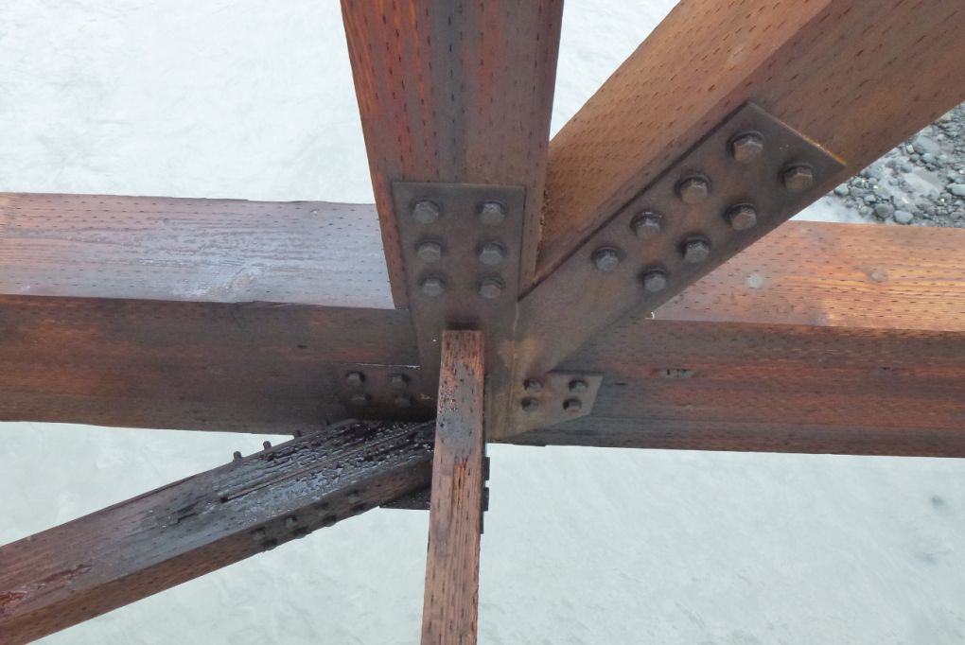
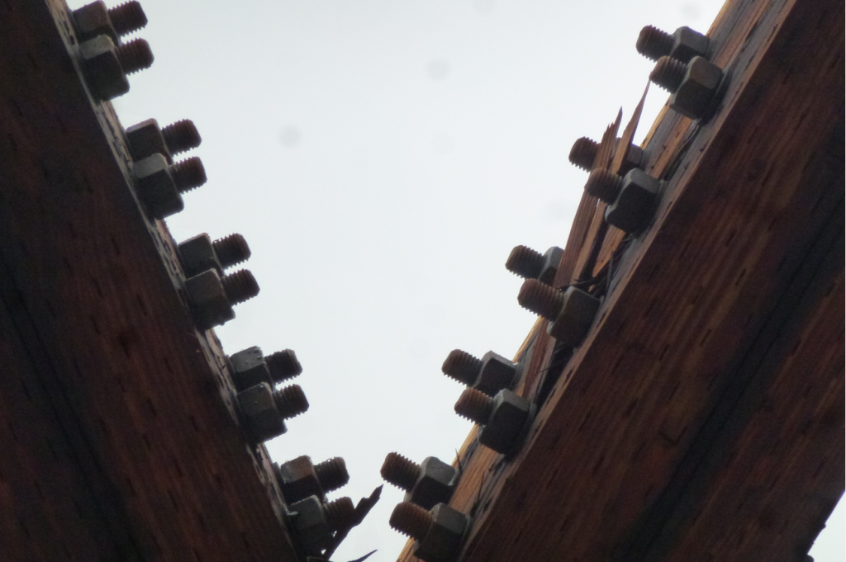
Conventional methods
Camera with Zoom Lens
Inspection limited to what can be observed from the deck or the river bank.
Affected by ambient lighting.
Notes:
Illumination under deck is an issue.

Slide 17
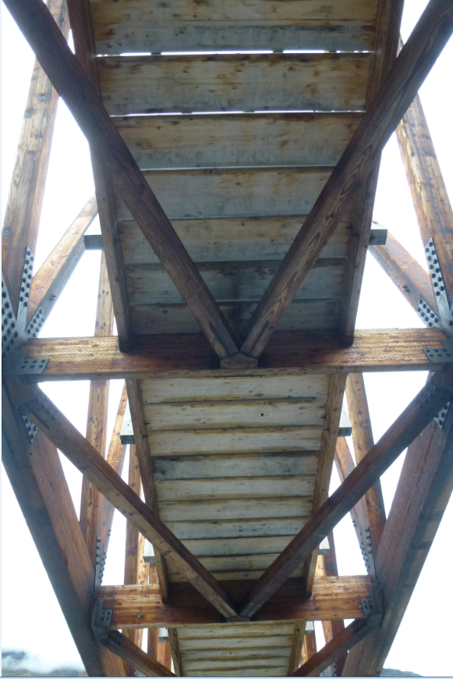
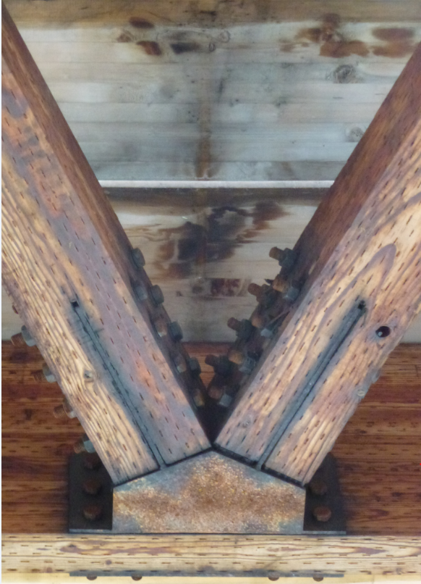
Conventional methods
Details only visible at “arms length”
Notes:
UAS will need to simulate spatial resolution achieved at arms length
This was close enough to zoom from shore. Only viable for 4/20 panels since most are over river.

Slide 18
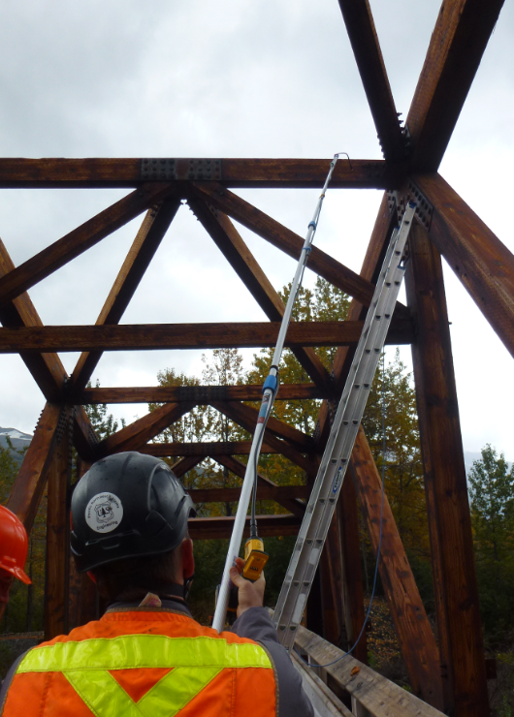
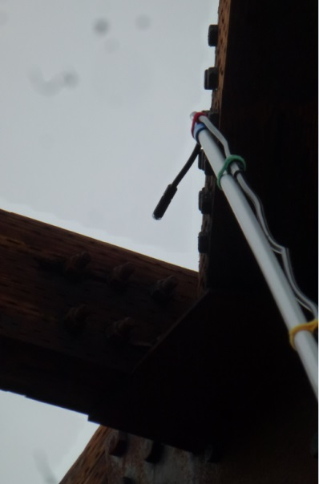
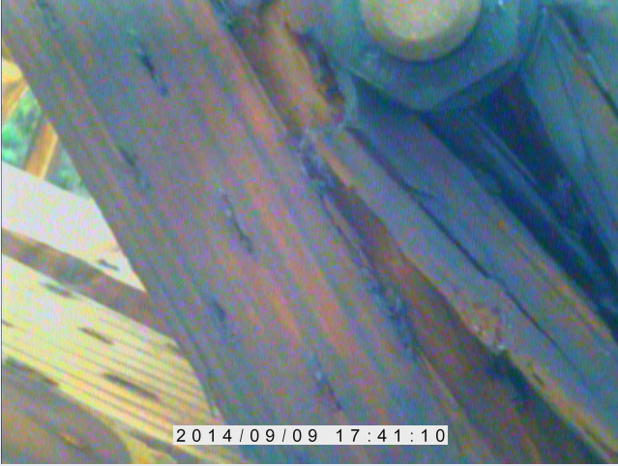
Conventional methods
Inspecting with the aid of Fiber Optic Inspection Camera
Notes:
Not enough time to capture each upper chord joint, UAS could capture each one
Could not articulate fiber optic for under bridge images

Slide 19
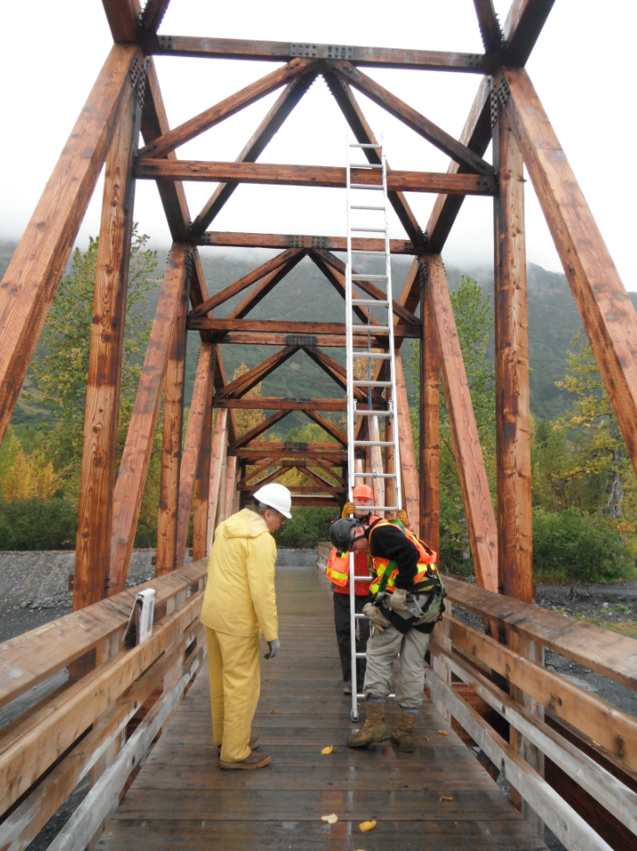
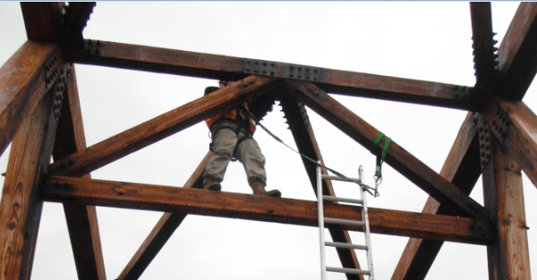
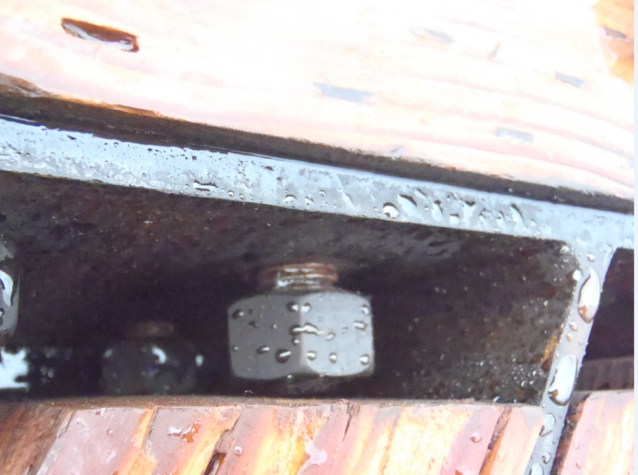
Conventional methods
Details only visible at “arms length” utilizing Climbing Techniques
Notes:
30 minutes or so to capture image and inspect small area.

Slide 20
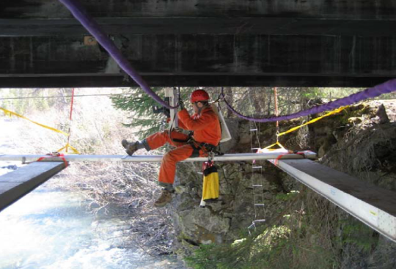
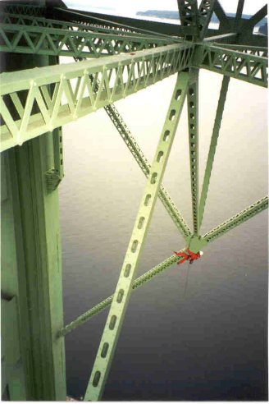
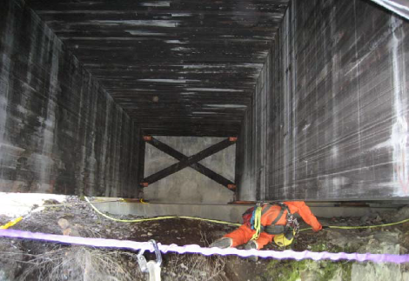
Conventional methods
Extreme Access
Extreme Access
Rope climbing and rigging techniques may be needed to access under bridge components. This method is awkward, time consuming, costly, and risky.
Notes:
Traditional “arms-length” requirements for bridge inspection are time-consuming, not always comprehensive, can require specialized training and equipment, and can put the inspector into a potentially life-threatening situation.

Slide 21
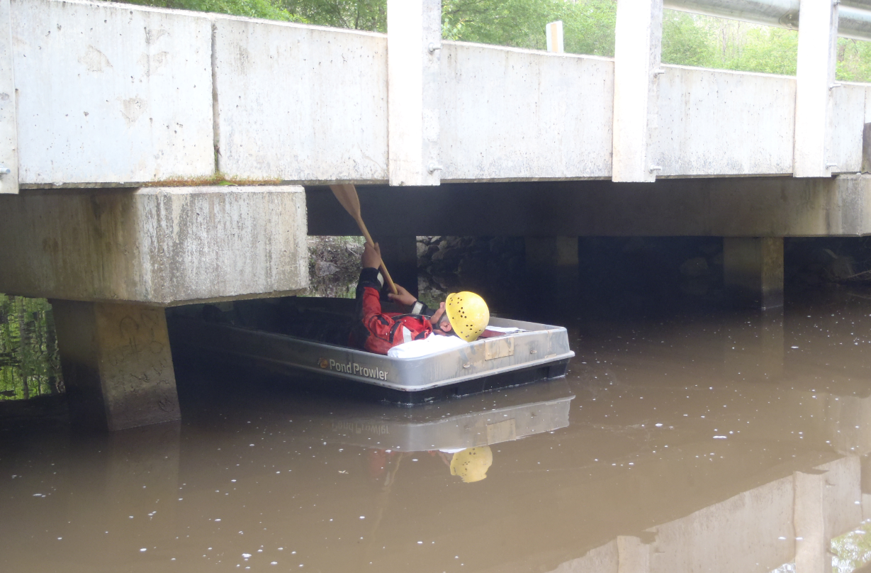
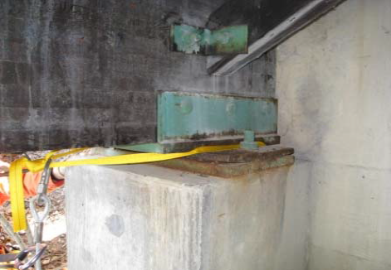
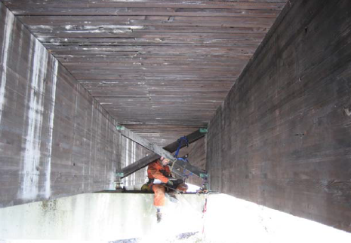
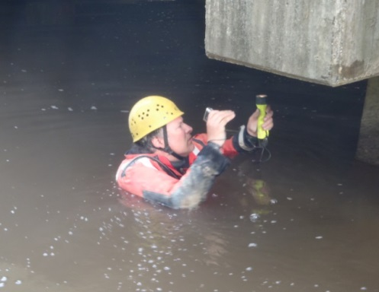
Conventional methods
UAS can potentially access hidden and difficult to reach areas of bridge and collect imagery with precision navigation.
Notes:
Images from Tom Laurent, Petersburg. The drysuit is a Coastguard boat suit. $1800 through GSA. Forest Service bridge in SE US (Mississippi). Hazards may include cotton mouth snakes and alligators.

Slide 22
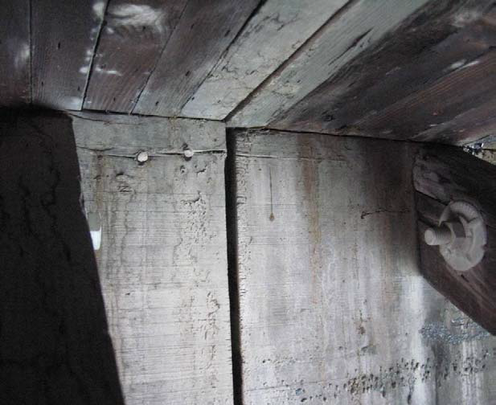
COMMON FINDINGS
Relative displacement between girder ends
UAS configured with upward-capable sensor can image hard to reach areas and achieve spatial resolutions and FOV exceeding human capability.

Slide 23
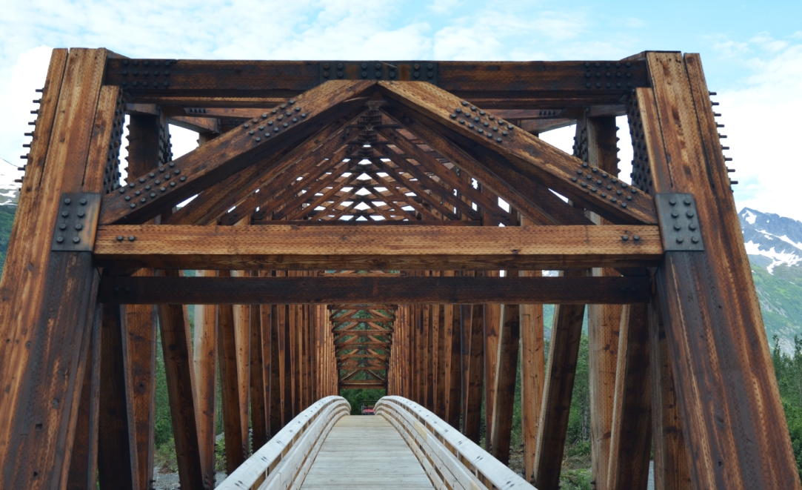
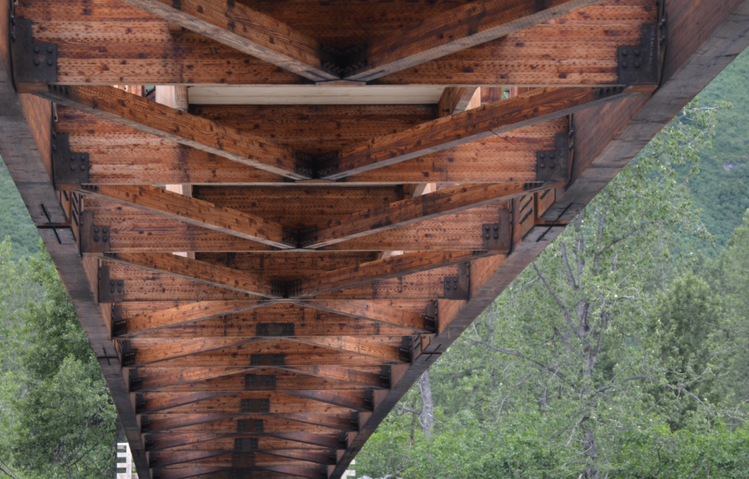
Inspection members
Due to the construction and volume of fasteners, connectors, and joints a UAS-enhanced inspection of the Placer River Trail Bridge will be very systematic.
Notes:
Bridge is a series of repetitive framing patterns

Slide 24
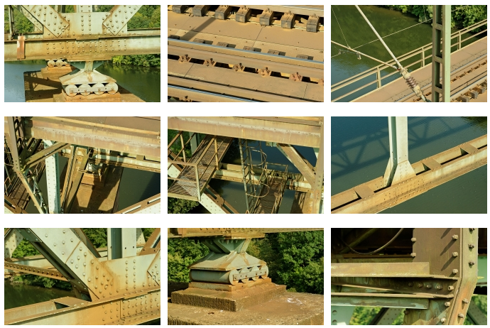
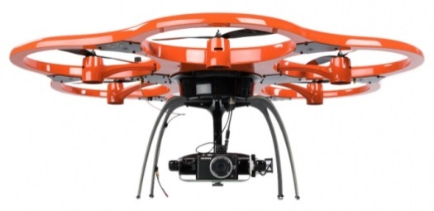
Inspection in Germany
sUAS collected detail images for Hamburg Köhlbrand bridge
www.aibotix.com/bridge-inspection.html

Slide 25
Structure from motion
Measureable wire frame
3D model and point clouds similar to lidar
Ortho-corrected using earth or local coordinate system
Baseline for deflection over time, monitoring
Requires powerful computer
SfM is the next evolution in digital softcopy photogrammetry and UAS-specific workflows and software have been developed.

Slide 26
UAS methods
Advantages of sUAS Methods
UAS may provide more comprehensive imaging for inspection, potentially extending lifespan of bridge more effectively than conventional methods
Supplement conventional methods
May be used in a wider range of weather and environmental conditions
Post inspection image analysis and measurement potential with SfM
Notes:
If costs are favorable (savings) bridge could be put on inspection cycle with decreased frequency. If you can catch a defect, the faster it can be repaired. More information more frequently at less cost and bridge owner can react more quickly. Sometimes defects are found so late that repair is less effective.

Slide 27
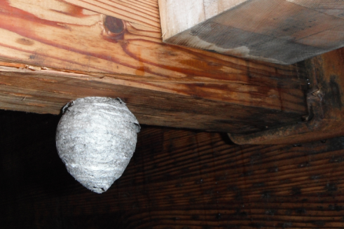
UAS methods
Advantages of sUAS Methods
Cost reduction due to fewer personnel, operating costs, and time on site
Improved time-on-site efficiencies
Reduced transportation and logistics costs
Access hard to reach areas with less effort: increased maneuverability
Increased safety and risk reduction

Slide 28
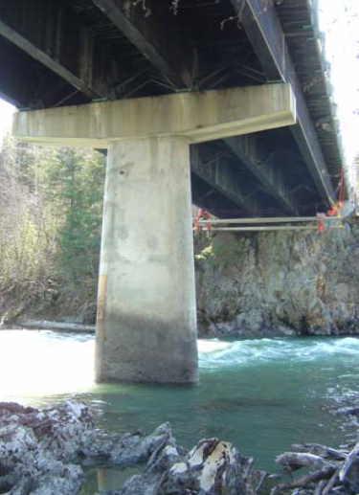
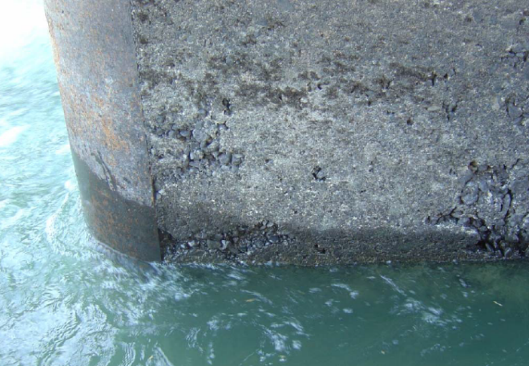
UAS considerations
Visual inspection from suspended rope access, binoculars, or telephoto camera lens.
UAS can capture images more safely and quickly.
Honeycombing at waterline
Depth of damage measurement using SfM methods.

Slide 29
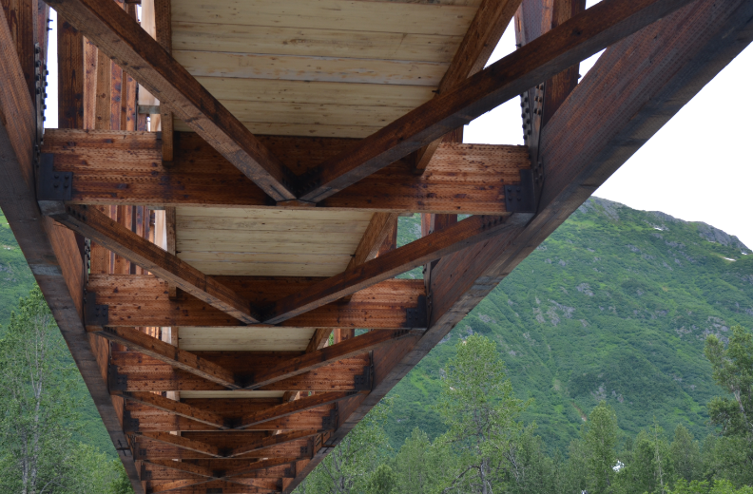
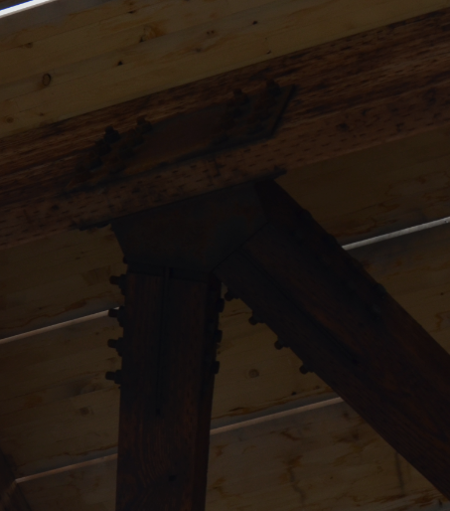
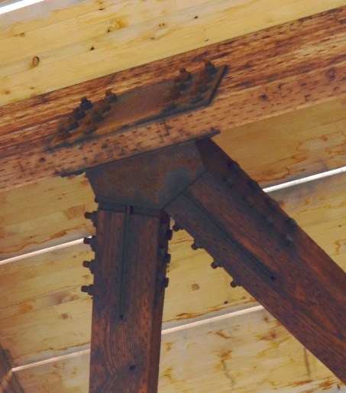
UAS considerations
Insufficient natural lighting for quality imaging (e.g. beneath the bridge) is a common problem which may necessitate some form of illumination for the UAS.
Notes:
Can be post-processed for enhancement. Images are part of a legal document and any adjustments need to be thoroughly documented.

Slide 30
UAS considerations
Camera & other Sensors
Up-looking gimbaled cameras
Streaming video
Optical – RGB image, larger than 10 megapixel
Shutter types – frame versus scan
Focus distance – fix focus
Infrared – Research on IR for bridge inspections
Hyperspectral – Research on HS for bridge inspections
Sensor illumination – Flash, strobe, IR LED: aligned with sensor or area illumination
Sensor options and costs
Aircraft
Hover is a requirement
Stability requirement – may have an updraft issue if aircraft is too close to road deck
4-6-8 or more rotors, with 8 rotors providing optimal stability
GPS may not work well under bridge
Sensor weight
Battery life requirements and weight (20-minutes?)
Sensor on sUAS top, to look up at structure from underneath
LED natural light illuminator on sUAS top
Aircraft Options and Costs
Passive collision prevention
Auto return home
Handle light wind and rain
Prop guards
Sensor & Aircraft Modifications
Is counterweighting necessary if sensor is on top?
Do the rotor blades need to be shrouded?
Modification costs

Slide 31
UAS platform
UAF Ptarmigan hexacopter
Mass in flight configuration: 11 kg (24 lbs)
Dimensions: 1m x 1m x 0.5m
Max. forward speed: 10 m/s
Max. flight time: 18 min
Capable of various payloads up to 2.2 lbs
2.4 GHz radio control
Affordable option
Electric
Nikon D800 and GoPro
ACUASI
Purpose built, higher order data collection tool.

Slide 32
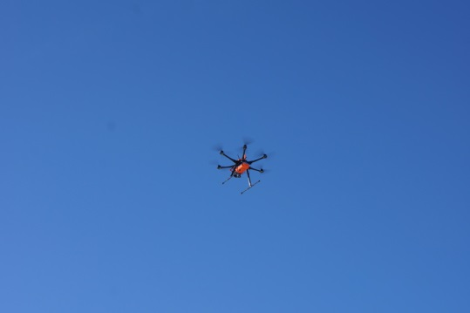
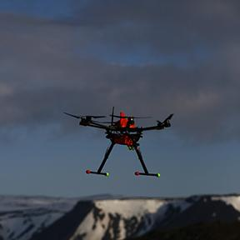
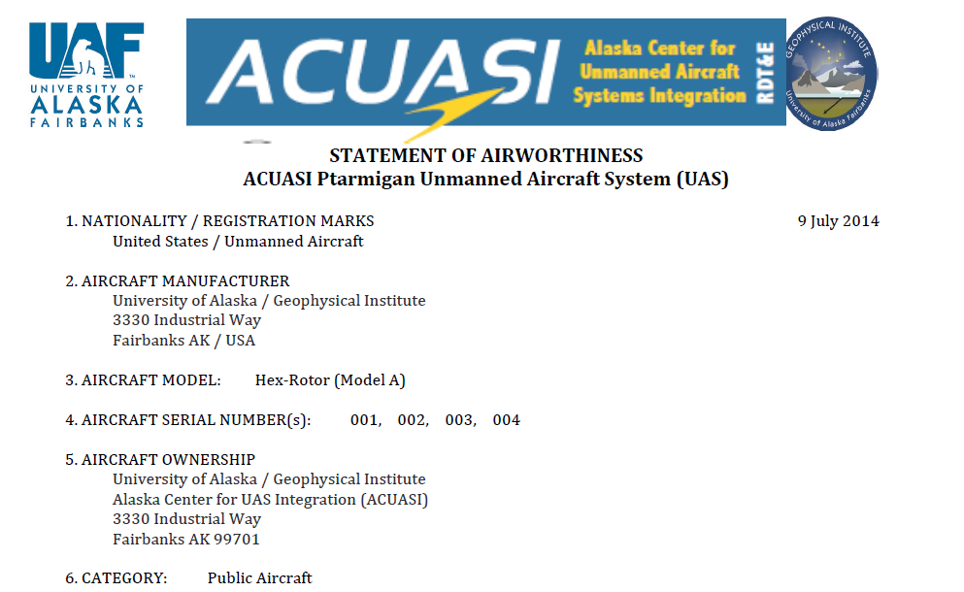
UAS platform
UAF Ptarmigan hexacopter
This aircraft is equipped with a GPS navigation system. Should the link between the aircraft and the ground controller be lost, the aircraft will immediately return and land at the takeoff point.
ACUASI
Has met FAA requirements and has a formal
Statement of Airworthiness based on rigorous testing.

Slide 33



UAS platform
UAF Ptarmigan hexacopter
Equipment is bulking and transport to site poses some challenges.
http://www.northernembeddedsolutions.com

Slide 34
Current status
2014 Research History
April 22 | Introduction & description of problem
April 25 | Preliminary user needs document
May 2 | Bridge Inspection methods
June 6 | Questions of COA & tethered operation
July 15 | User needs summary & next steps
July 29 | FAA clarification on tethered operations & COA
August 11 | Discussion of Alaska UAS Interest Group Conference
September 4 | Latest updates to the User Needs Analysis
Contributors
Keith Cunningham | UAF, ACUASI | kwcunningham@alaska.edu
Dave Lattanzi | George Mason University | dlattanz@gmu.edu
Rodney Dell’Andrea | USFS, Structural Engineer | rdellandrea@fs.fed.edu
Mark Riley | USFS, Remote Sensing | markriley@fs.fed.us
Robert Goetz | USFS, Geospatial | rgoetz@fs.fed.us
Tom Heutte | USFS, Regional Aviation | theutte@fs.fed.us
Everett Hinkley | USFS, WO Remote Sensing | ehinkley@fs.fed.us
Michael Wilcox | USFS, Environmental | mrwilcox@fs.fed.us
Rayjan Wilson | UAF, ACUASI | rayjan.wilson@alaska.edu

Slide 35

Next Steps
Forest Service national endorsement (Complete)
FAA Certificate of Authorization (COA) (Complete)
Project plan and safety plan (Complete)
Collect data, complete pilot study (June 2015)

Slide 36


Mark Riley
Remote Sensing Coordinator
markriley@fs.fed.us, 907-586-8759
USDA Forest Service
Juneau, AK

