Slide 1
Supporting RxCADRE Fire Measurements Unmanned Aerial Systems
TFRSAC, Moffett Field, CA
April 17, 2013
Thomas Zajkowski; RedCastle Resources, USFS Remote Sensing Applications Center, Salt Lake City UT
Otto Martinez, William Holley, Alexander Paxton; USAF AFMC 96th TSSQ/RNXT, Niceville FL
John Hiers; Air Force Wildland Fire Center, Jackson Guard, USAF AFMC 96th CEG/CEVSNP, Niceville FL
Matt Dickinson; USFS Northern Research Station, Newtown Square PA

Slide 2
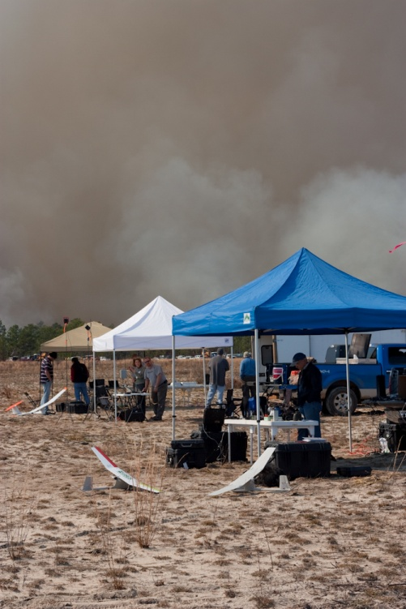
RxCadre 2011
RxCADRE – Prescribed Fire Combustion Atmospheric Dynamics Research Experiments
Eglin AFB February 3-6, 2011.
3 UAS – USGS Raven, Prioria Maveric, G2R
Flights were successful, demonstrated that sUAS is capable of collecting scientific measurements over controlled burns

Slide 3
Rx-CADRE Airborne Measurements - overview
Fuel Characteristics
1
Airborne: UAS and/or manned platform
Mass
Cover
Depth
Moisture
Local Event-Scale Meteorology
2
Satellite: MODIS, VIIRS, MISR
Plume properties
Fine-scale wind & thermodynamic fields
Fire Behavior
3
Fire intensity
Rate of spread
Convective/radiative power & energy
Soil heating
Wind/flame velocity
IR imagery
Fuel Consumption
1
Mass consumed by fuel component
Event-Scale Fire Mapping
3
4
Pre- and post-fire LiDAR collection (manned)
6
Fire Effects
Fire radiative power & energy
Flame front development
Satellite imagery of fire behavior and effects
Emissions & Event-Scale Plume Behavior
5
Thermal radiometry
HD visual imagery
Stem temperatures
CO, CO₂, H₂O, PM_{2.5}
Black carbon
Plume height
Active-fire smoke sampling (UAS and manned)
Active-fire IR/visible mapping (UAS and manned)
Satellite (MISR)
Satellite (MODIS, VIIRS)

Slide 4
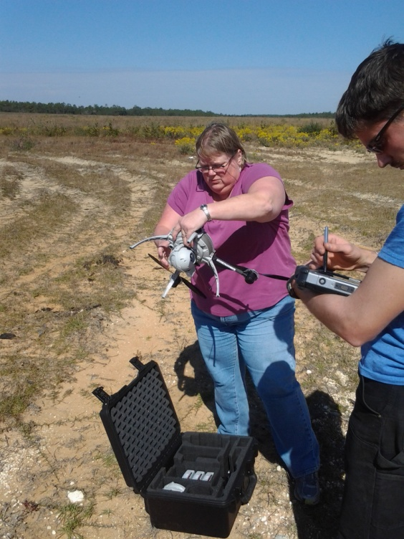
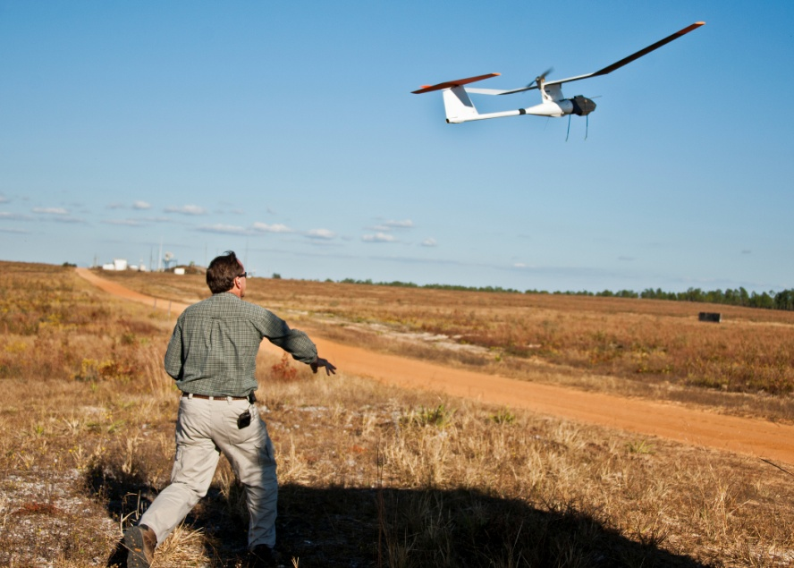
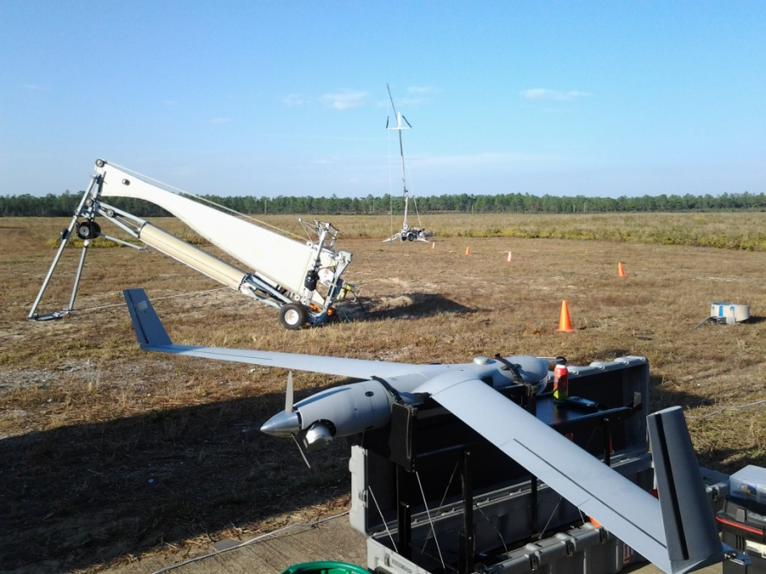
3 Types of UAS
Scout
G2R
Scan Eagle
Additional aviation assets
Cessna 337 – Smoke Sampling
Piper Navajo – Fire Imaging
EPA Tethersonde – Smoke Sampling

Slide 5
Rx-CADRE Active Fire Measurements – Large Units (500-1000 acres)
Active fire measurements
~4,100 – 10,000 ft AGL
>2000 ft separation
~1100 - 3000 ft AGL
10 m met tower
~650 ft AGL
500 ft. lat separation
30 m met tower
~600 ft AGL
Ground-instrument cluster
~ 50 – 100 ft AGL
Manned
Piper Navajo – WASP sensor (LWIR/MWIR/SWIR and visible fire mapping at zenith)
UAF Scout – LWIR, Flight 1 HIP-3, Flight 2 as directed
UAS
EAFB Test Wing G2R1, G2R2 – LWIR smoke sensor, wind, T, and RH sampler, F1 HIP-1, HIP-2; F2 MAPPS
U. Alaska ScanEagle – LWIR synoptic view
NOTE: Cessna 337 smoke sampling aircraft is downwind following plume ~1000 - 8000 ft AGL

Slide 6
B70L2G Manned/Unmanned Schedule November 10, 2012 V2
All times approximate, based upon ignition time
1000 Launch Weather Balloon 1
1000 Get MAPPs and Thethersonde coordinates.
1100 Launch Scan Eagle (SE)—1500 AGL
1115 Launch Low Manned (LM) (Urbanski, Smoke Sampling)
1130 Launch High Manned (HM) (Kremens, WASP)
1150 Low Manned begins sampling over B70L2G once SE Upwind LG1
1220 IGINITION
Launch Scout
Raise Tethersonde to 300 ft. AGL
Launch G2R1
Launch G2R2
LM Cleared to Orbit as desired North of Range Downwind
HM Orbit 6000 – 10000 ft. AGL over L2G
SE Orbit 1100 – 3000 ft. AGL over L2G
G2R1 – G2R2 Orbit 600/650 ft. AGL , 500 ft. lateral separation over HIP 2 – 3
Scout Orbit 50 – 100 ft. AGL HIP – 1
1235 Retrieve Scout once HIP – 1 is burned over
1235 Focus SE imagery over MAPPS
1240 Re-launch Scout (As needed / Directed)
1242 Satellite Overpass VIIRS
1243 Satellite Overpass MODIS
1245 Retrieve G2R1
1300 Retrieve G2R2
1305 Burnout Complete
Retrieve SE once LM confirms it is clear of B70 (Tree Line) or above 5000 ft. AGL
Retrieve G2R1
Release HM
1330 Lower Tethersonde
Confirm LM has departed
Confirm HM has departed B70
Confirm SE has landed
Confirm no RxCadre Aircraft Manned/Unmanned are airborne
1400 Launch Weather Balloon
1430 Release Airspace

Slide 7
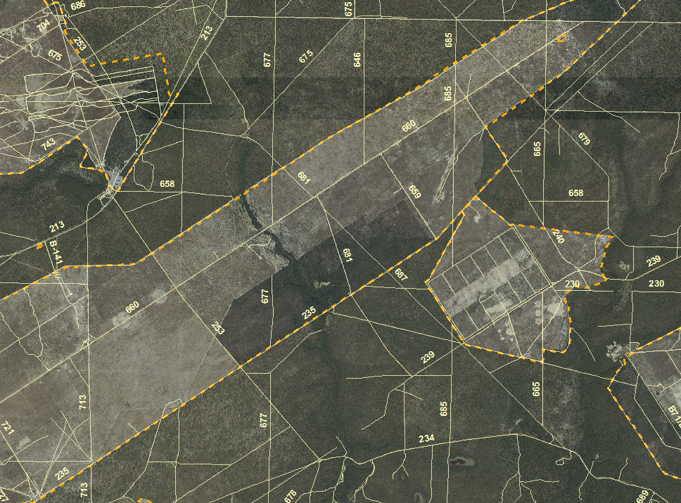
B-75
LM Profile (Approximate)
UAS Launch \ Recovery
Test Area B-70
Tethersonde Balloon
L2G
3
B-82
1
2
Scout Launch \ Recovery
30 meter tower(MAPPS)
L1G
N
HIP
B70L2G Air Plan 10Nov12

Slide 8
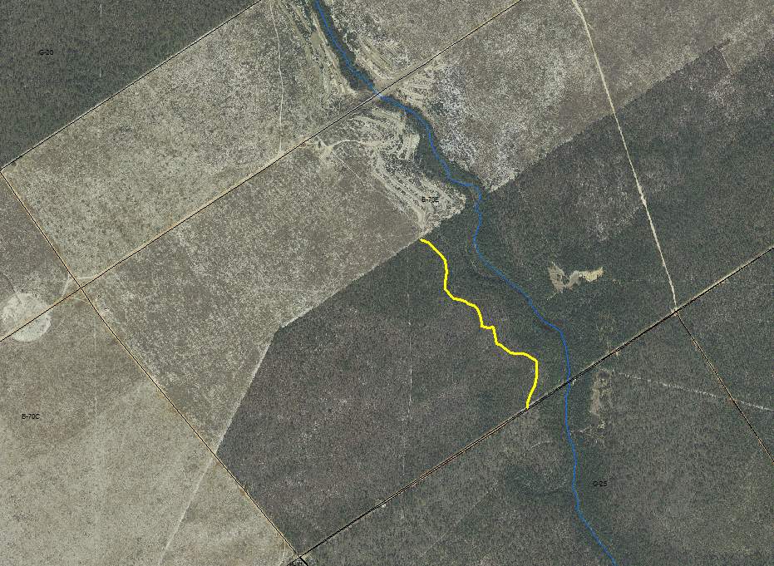
D
S
Aerostat Balloon
B-70
A
30 plot grid lines
3
Managed Pine HIP
Burn Block L2G
3
B-82
1
30 meter tower Burn 1
Burn Block L2F
30 meter tower Burn 2
N
2
B
C
0.6 miles
2
1
Natural Pine HIP
Oak HIP

Slide 9
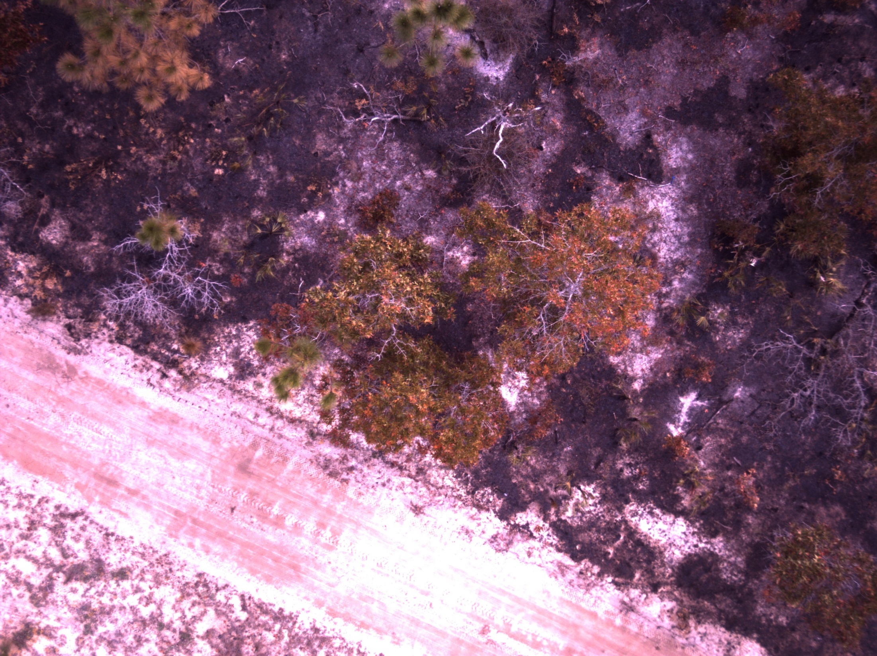
Scout Imagery

Slide 10
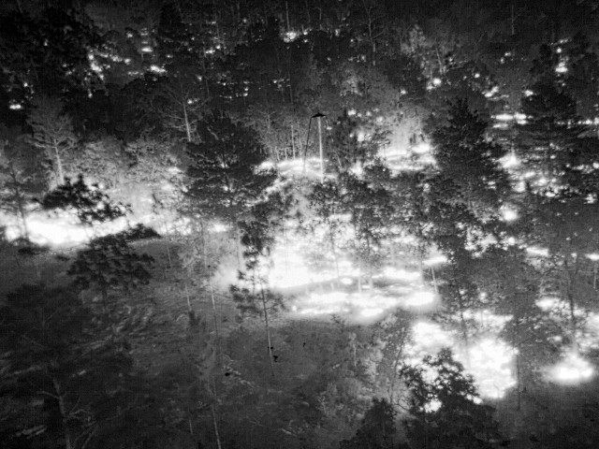
Scout TIR Imagery

Slide 11
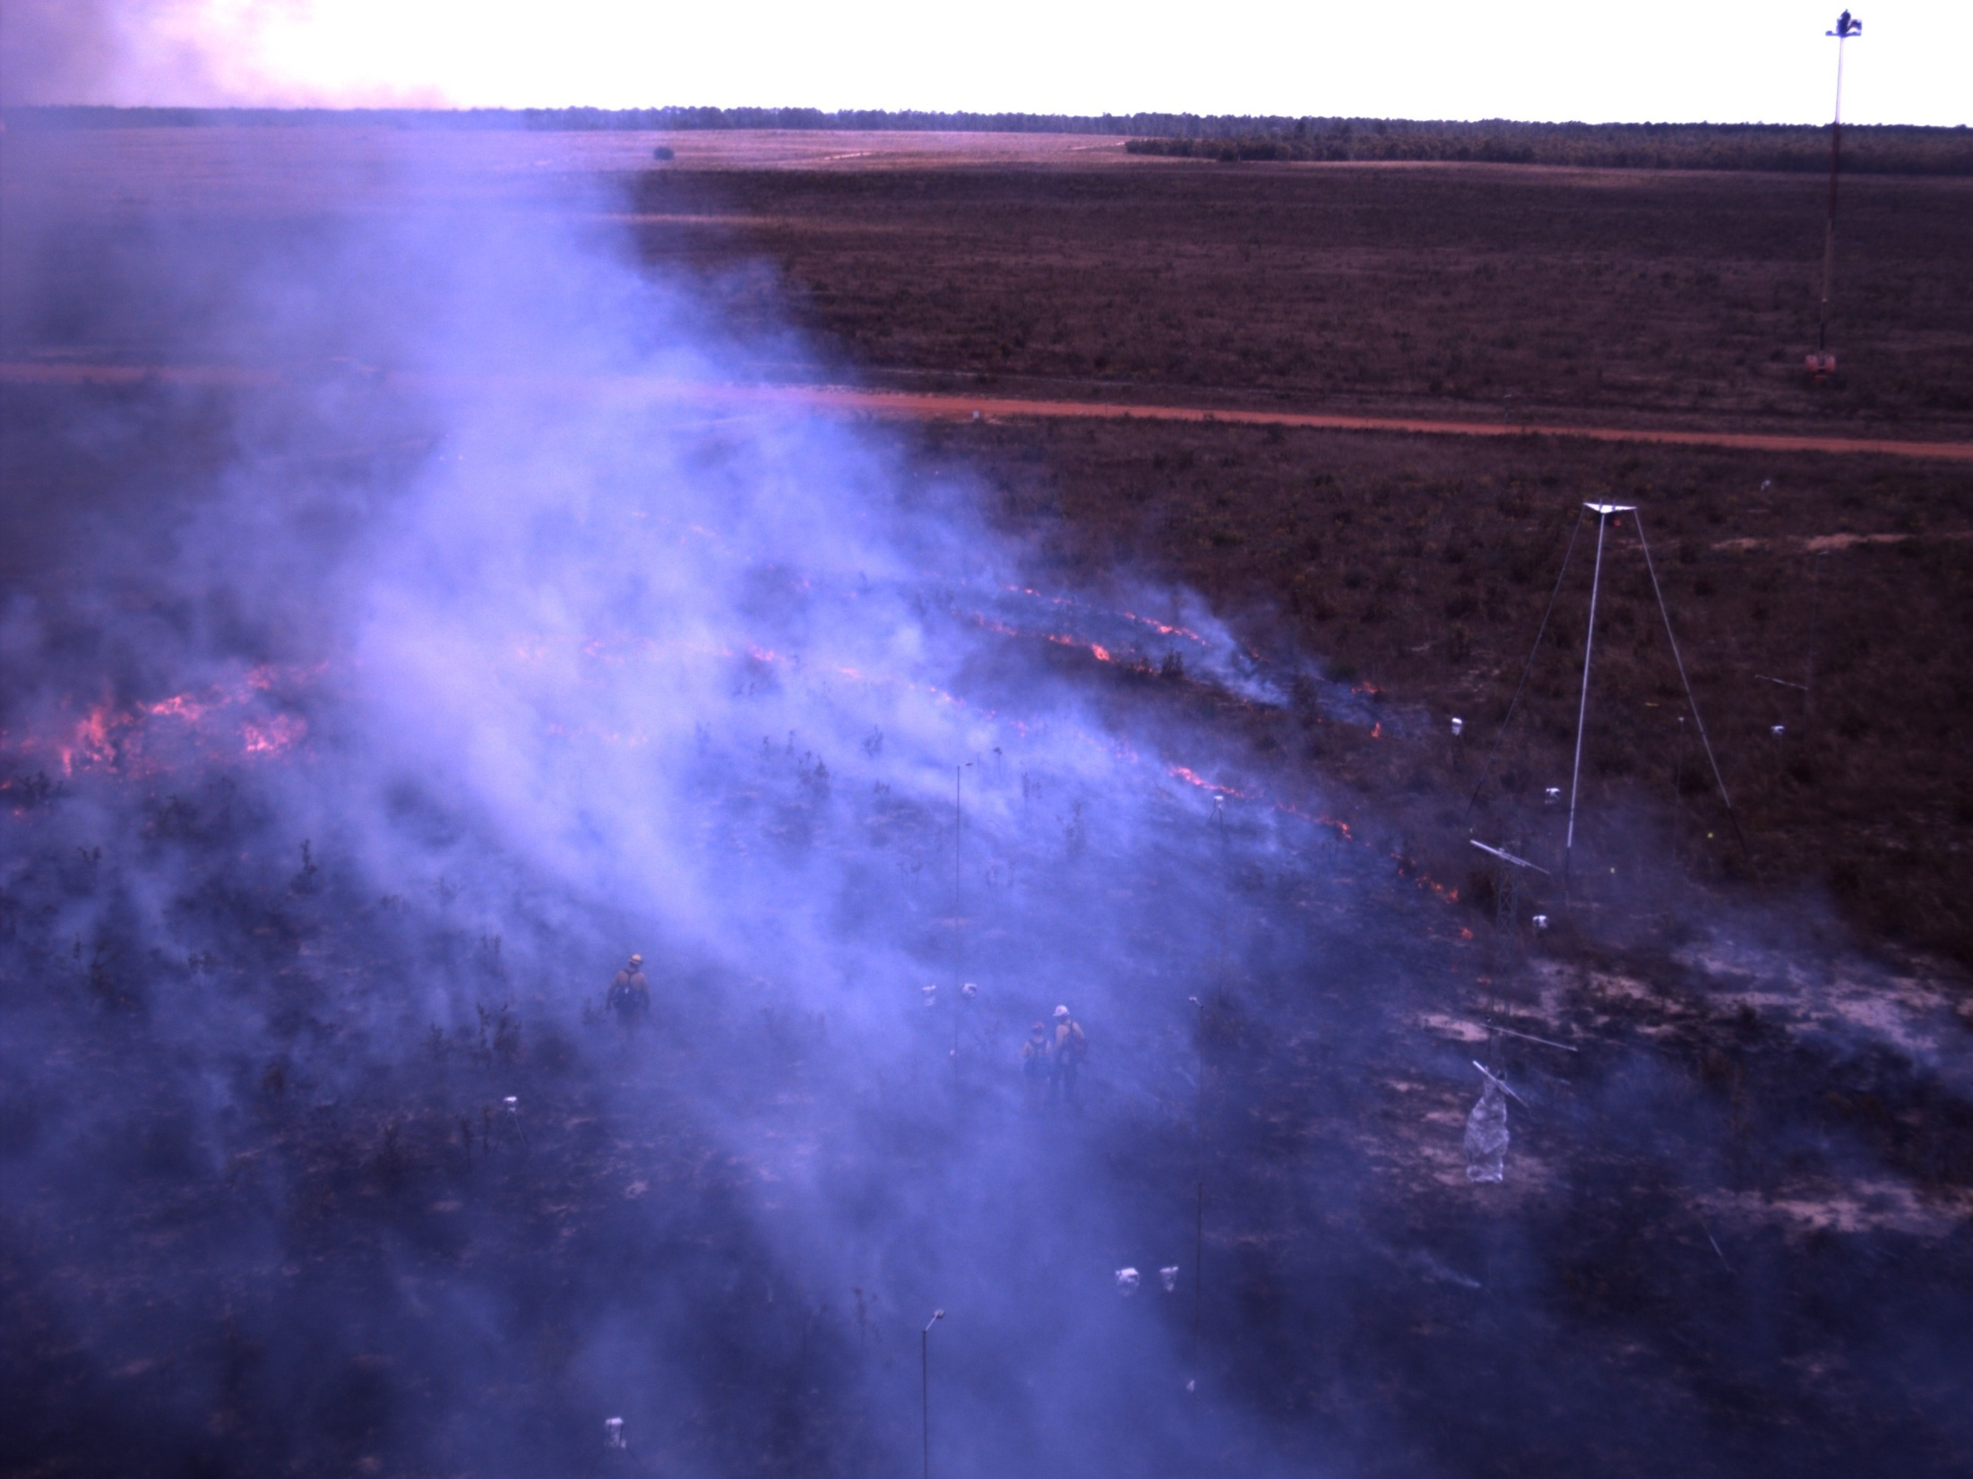

Slide 12
Scan Eagle Video

Slide 13
Scan Eagle TIR

Slide 15
G2R Video

Slide 16
Sarnoff TerraSite Output S-5
Hot Targets

Slide 17
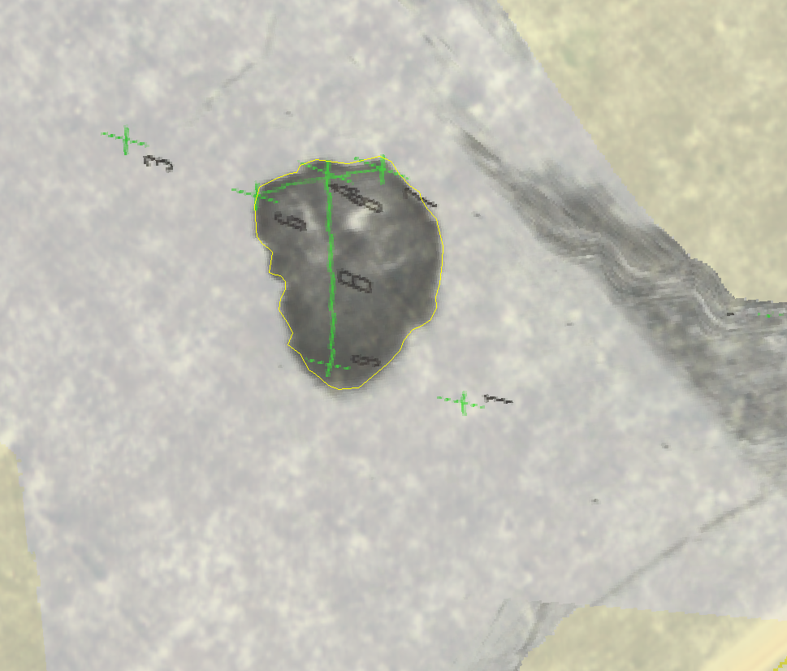
S5_18:15:58 – 5210 M², 1.28737 Acres

Slide 18
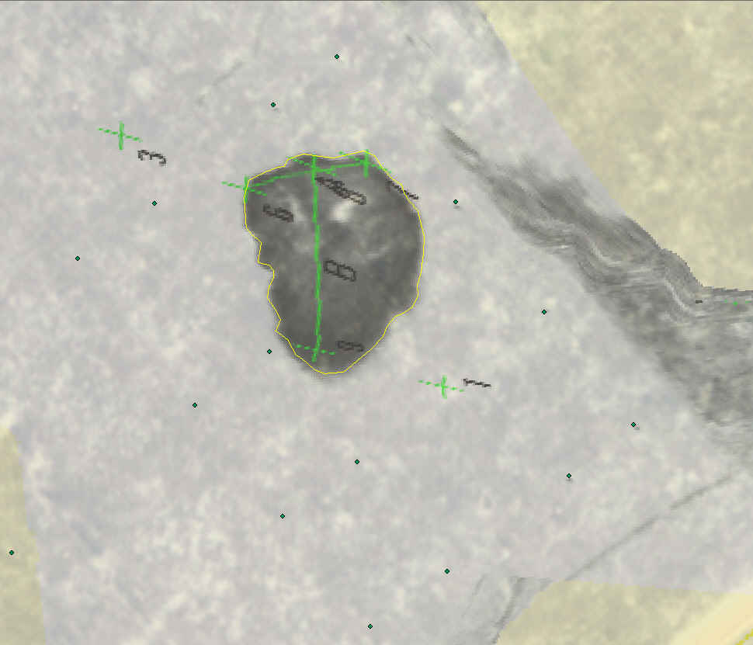
S5_18:15:58 – 5210 M², 1.28737 Acres

Slide 21
G2R Meteorological /Black Carbon
Delivered as kmz, shapefiles, txt???

Slide 24
RxCADRE 2012
UAS DATA PLAN V2
Air Plan
G2R
Specs
Scan Eagle
Specs
Scout
Specs
3D Mosaic Processing
B70CL1G
TerraSite Processing
Smoke Sampling
EO Video (RAW)
IR Video (RAW)
Mosaics
Stills
G2R
G2R
G2R
G2R
Scan Eagle
Scan Eagle
Scan Eagle
Scan Eagle
Scout
Scout
Scout

Slide 25
Comments/Questions
Thank you to JFSP for funding this project.

